Slide 1
Department of Electrical Engineering
University of Arkansas
ELEG 5693 Wireless Communications
Math Review
Dr. Jingxian Wu
Jingxian.wu@sonoma.edu

Slide 2
OUTLINE
2
Signals and System (Fourier analysis)
Random variables and random process

Slide 3
CONCEPT OF FREQUENCY
3
Frequency is the measurement of the number of times that a repeated event occurred in a unit time (1 second).
Frequency measures how fast a signal can change within a unit period of
time (or the measurement of the rate of change).
High frequency ➔ the signal changes fast
In signal processing, frequency is defined based on sinusoid signal → number of cycles per second.
Each sinusoid signal is uniquely associated with a single frequency based on its rate of change.
f = 0 Hz
f = 1 Hz
f = 3 Hz
1 second

Slide 4
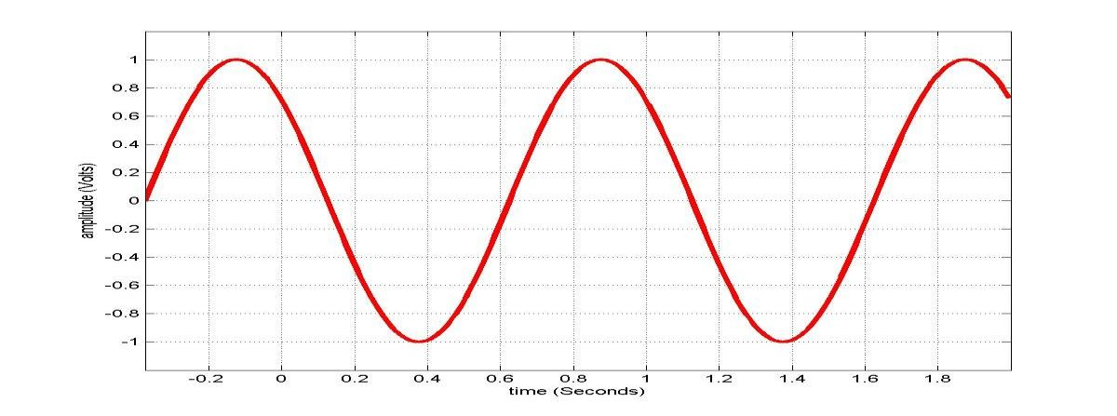
TIME DOMAIN SIGNAL
4
Sinusoid Signal
s(t) = Asin( 2πft +θ )
f : frequency. in the unit of Hz (1/second)
A : amplitude. maximum strength in signal, usually in unit of volts
θ : phase. relative position in time
t : time. in the unit of second
T : period. Time for one cycle or one repetition, T=1/f.
λ : Wavelength. Distance of the signal waveform propagated in one period T.
λ = vT , where v is the speed of the signal. In vacuum, it is the speed of light.
0 second
A
θ
2πf
T

Slide 5
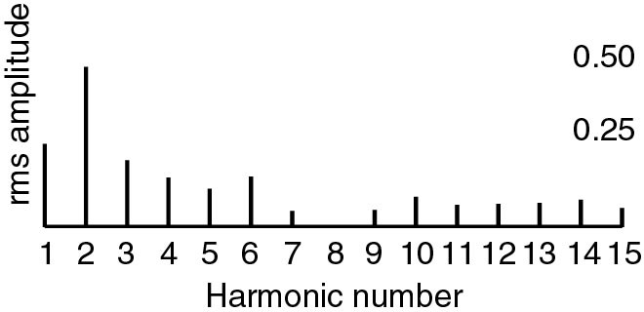
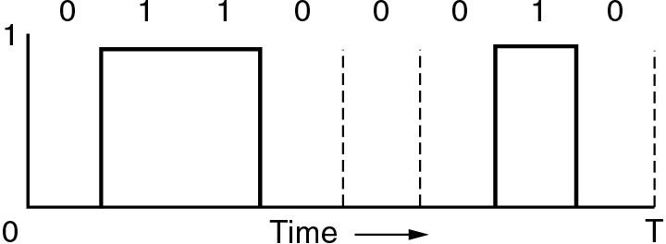


THEORY: FREQUENCY DOMAIN SIGNAL
5
Periodic signal can be written as the summation of a series of sinusoids (Fourier Series)
∞ ∞
s(t) = ¹ c + ∑
a sin( 2
πnf t) +
∑
b_{n} cos(2πnf_{n}t)
2
n n
n=1 n=1
Each sinusoid component has a unique frequency
Each sinusoid component is called a “harmonic” of the original signal.
There is a one to one relationship between a signal and its Fourier series.
With Fourier series, we can represent the signal in the “Frequency Domain”
_{a}2
+ b²
2
2
n
s(t)
Time Domain
_{a}2
+ b²
n n
Frequency Domain

Slide 6
6
FOURIER TRANSFORM
Let g(t) be a non-periodic deterministic signal, expressed as function of t. Its frequency domain representation, G(f) , can be obtained from Fourier transform.
Fourier transform
G( f ) = _{∫−∞} g(t) exp(− j2πft)dt
+∞
Inverse Fourier transform
g(t) = _{∫−∞} G( f ) exp( j2πft)dt
+∞
j² = −1
exp( jx) = cos(x) + j ⋅sin( x)

Slide 7
FOURIER TRANSFORM
7
Example 1:
Find the Fourier transform of g(t) = exp(−t) , t > 0
Sol.

Slide 8
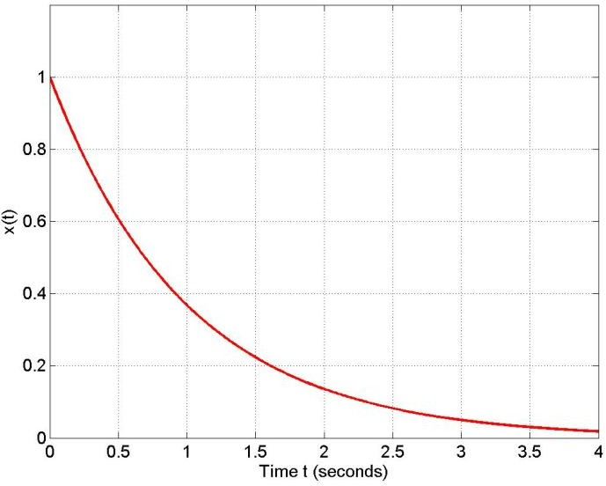
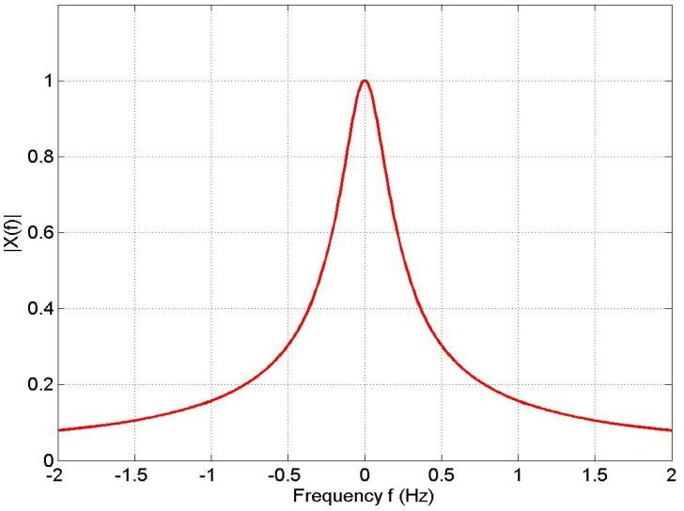
8
FOURIER TRANSFORM
Fourier Transform
1
1+ j2πf
s(t) = e^{−t} ,
t ≥ 0
S( f ) =
Time Domain
Frequency Domain

Slide 9
9
UNIT IMPULSE FUNCTION
Unit impulse function (delta function)
_{∫−∞} δ (t)dt = 1,
+∞
δ (0) = ∞,
δ (t) = 0,∀t ≠ 0
δ (t)x(t) = δ (t)x(0)
+∞
∫
δ (t) exp(− j2 ft)dt =
−∞
F [δ (t)]
δ (t)
1
1
t
f

Slide 10
10
LINEAR TIME INVARIANT (LTI) SYSTEM
x(t)
h(t)
y(t)
The output of the LTI system is the convolution of input x(t)
with the channel impulse response h(t)
+∞ +∞
y(t) = x(t) ⊗ h(t) = _{∫−∞} x(t −τ )h(τ )dτ = _{∫−∞} x(τ )h(t −τ )dτ
Time domain convolution ➔ frequency domain multiplication
X ( f ) = F[x(t)] H ( f ) = F [h(t)] Y ( f ) = F [y(t)]
Y ( f ) = X ( f ) × H ( f )

Slide 11
11
LTI
Example:
x(t)
x(t) = δ (t)
h(t)
y(t)
y(t) = ?
h(t) = exp(−t), t ≥ 0
Method 1:
Method 2:

Slide 12
CORRELATION
12
The cross correlation of two deterministic, complex-valued function a(t) and b(t) is defined as
R (τ ) =
+∞
a(t)b (t −τ )dt
∫−∞
*
ab
The auto-correlation of one deterministic, complex-valued function a(t) is defined as
R (τ ) =
+∞
a(t)a (t −τ )dt
∫−∞
*
a

Slide 13
13
ENERGY
The energy of a signal s(t) is defined as
E =
+∞
s(t) ² dt
∫−∞
s
If a signal has finite energy, the signal is called energy signal.
E.g. s(t) = exp(−t), t ≥ 0
E_{s} =
Relationship between energy and auto-correlation function
E =
+∞
s(t) ² dt =
+∞
s(t)s* (t − 0)dt = R (0)
∫−∞
∫−∞
s
s

Slide 14
POWER
14
The power of a signal s(t) is defined as
1
∫
+T / 2
−T / 2
2
P = lim
s(t) dt
s
T −>∞ _{T}
If a signal has finite power, the signal is called power signal
For periodic signal with period T
P = ¹
∫
T
s(t) ² dt
s
T
0
s(t) = Asin( 2πft +θ )
P_{s} =
– E.g.

Slide 15
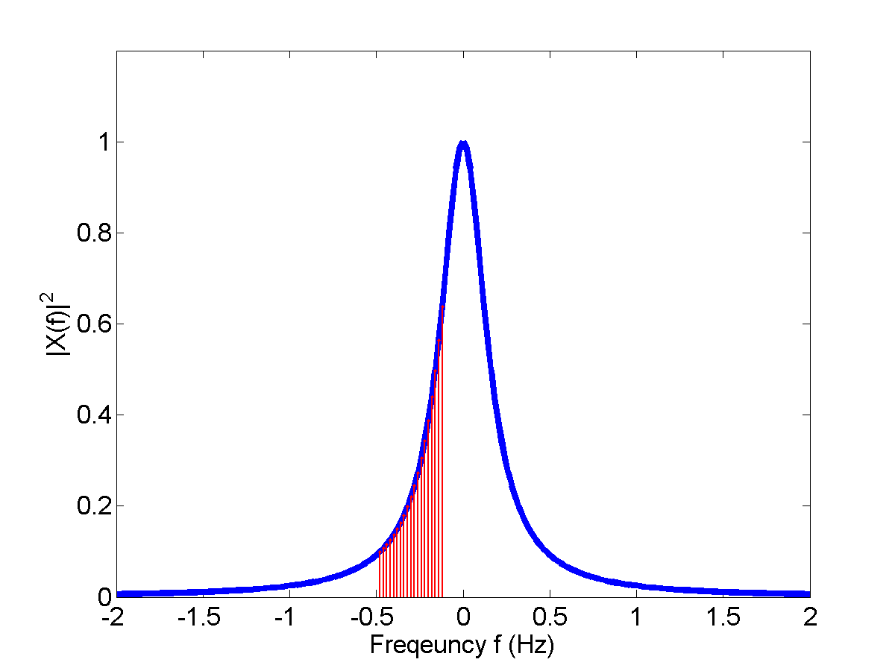
15
PARSEVAL’S THEOREM & ESD
E =
+∞
+∞
s(t) ²dt = S ( f ) ² df
∫−∞ ∫−∞
s
S( f ) ² is called the energy spectrum density (ESD) of the signal
– ESD represents the energy distribution in the frequency domain.
1
|1+ j2πf |²
e.g. ESD of
s(t) = exp(−t), t ≥ 0
∫
f
2
2
:The signal energy in the
S( f ) df
f₁
frequency range of
[ f , f ]
1 2

Slide 16
OUTLINE
16
Linear system theory (Fourier analysis) (Appendix A)
Random variables and random process (Appendix C)

Slide 17
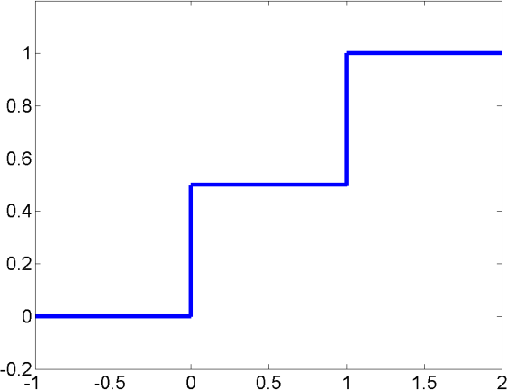
CUMLATIVE DISTRIBUTION FUNCTION (CDF)
18
F_{X} (x) = P( X ≤ x)
Example 1: toss coin
⎧
0,
x < 0
F (x) = ⎪ P( X = 0) = 0.5,
0 ≤ x < 1
X
⎨
⎪P( X = 0) + P( X = 1) = 1, x ≥ 1
⎩
Example 2: pick 1 balls from 10 balls
⎧
⎪
x < 0
0 ≤ x < 1
1 ≤ x < 2
x ≥ 2
F (x) = ⎪
X
⎨
⎪
⎪⎩

Slide 18
CONTINUOUS RV
19
RV X can take continuous values
– E.g.: X represents the average temperature
CDF
F_{X} (x) = P( X ≤ x)
F_{X} (−∞) = 0
F_{X} (∞) =1
Probability density function (pdf)
_{(x) =} dF_{X} (x)
dx
f
X
Interpretation: for small Δx ,
_{(x) =} F_{X} (x + Δx) − F_{X} (x) ₌ P(x < X < x + Δx)
f
X
Δx Δx
f _{X} (x)Δx = P(x < X < x + Δx)
or, the probability that the RV X is in the range of
(x, x + Δx)

Slide 19
PDF AND CDF
Relationship between pdf and CDF
20
dF (x)
F (x) =
∫
x
f ( y)dy
f (x) = ^{X}
X
X
X
dx
−∞
P(x₂ < X < x₁ ) = F_{X} (x₂ ) − F_{X} (x₁ ) =
∫
x
2
f ( y)dy
x
X
1
P( X < ∞) = F_{X} (∞) = _{∫−∞} f _{X} ( y)dy = 1
+∞

Slide 20
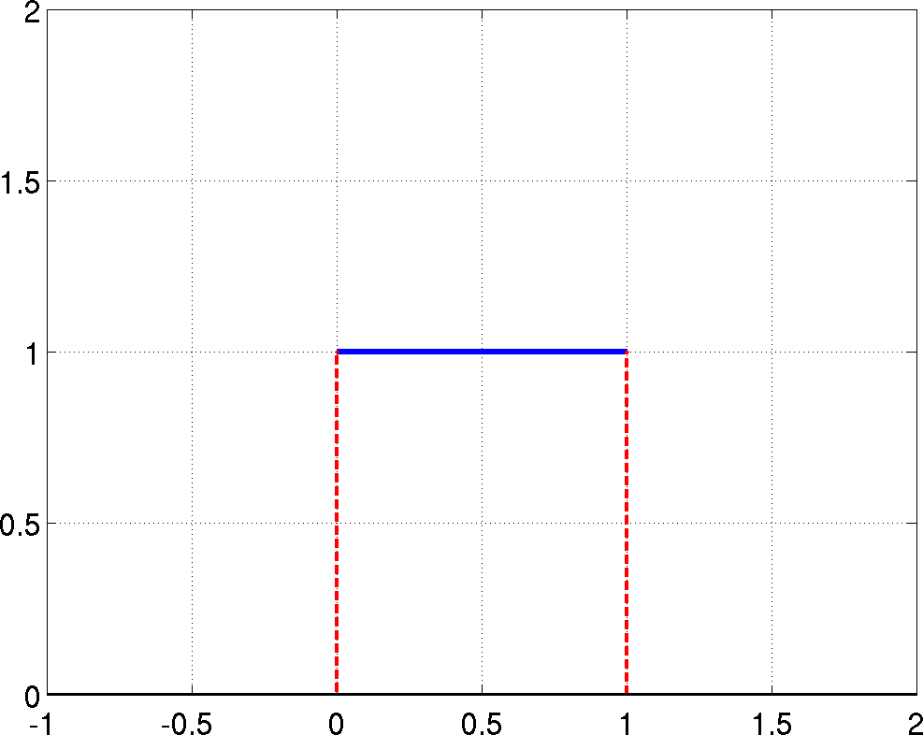
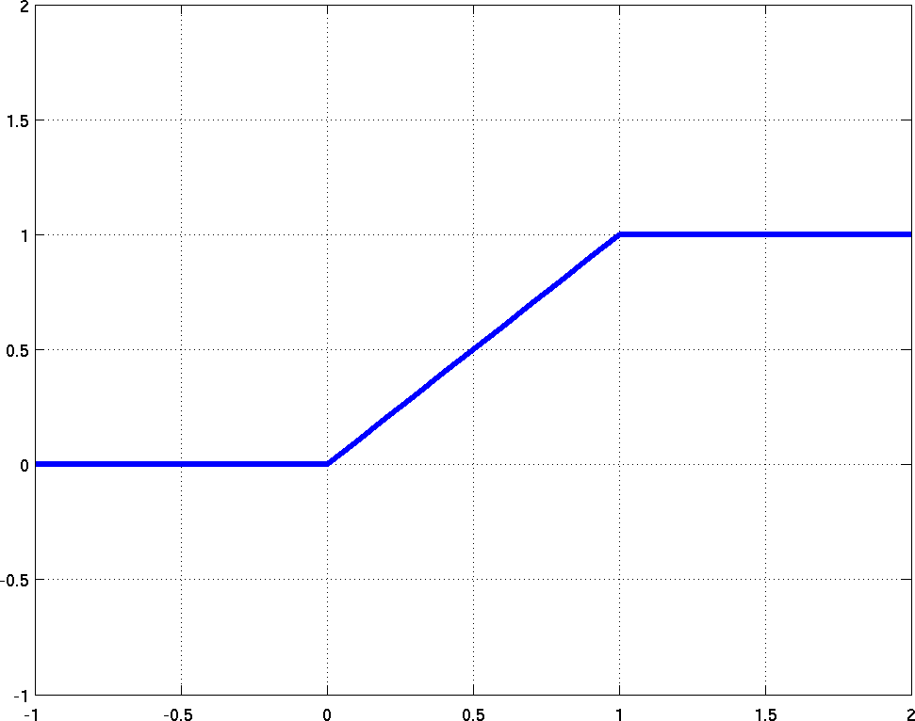
CDF AND PDF
22
1
1/(b-a)
0
a b
pdf of uniform distribution
a b
cdf of uniform distribution

Slide 21
23
EXPECTATION (MEAN)
Discrete-time RV
m_{X} = E( X ) = ∑ x_{i} P( X = x_{i} )
i
– Weighted sum
Continuous-time RV
m_{X} = E( X ) = _{∫−∞} yf _{X} ( y)dy
Example: find the expectation (mean) of the uniform distribution
+∞
1
f (x) =
, a < x < b
X
b − a

Slide 22
24
VARIANCE
Discrete RV
(
)
σ =E ( X − m ) =
∑ i X i
2
2
⎡
2
⎤
x − m
P( X = x )
⎣
X
⎦
i
Continuous RV
₎2
σ ² =E ⎡( X − m )² ⎤ =
+∞
(
y − m
f ( y)dy
⎣ ⎦
∫−∞
X
X
X
( )
•
σ =E X − m
2
2
2
X
– Proof:

Slide 23
26
GAUSSIAN DISTRIBUTION
The pdf of Gaussian distribution is
1
2π σ
⎡
(x − m)² ⎤
f _{X} (x) =
exp ⎢−
⎥
⎣
2σ
2
⎦
– The pdf is determined by two parameters:
m = E(X )
σ = E(X − m_{X} )
2
mean
standard deviation
The sum of Gaussian RVs is still Gaussian distributed

Slide 24
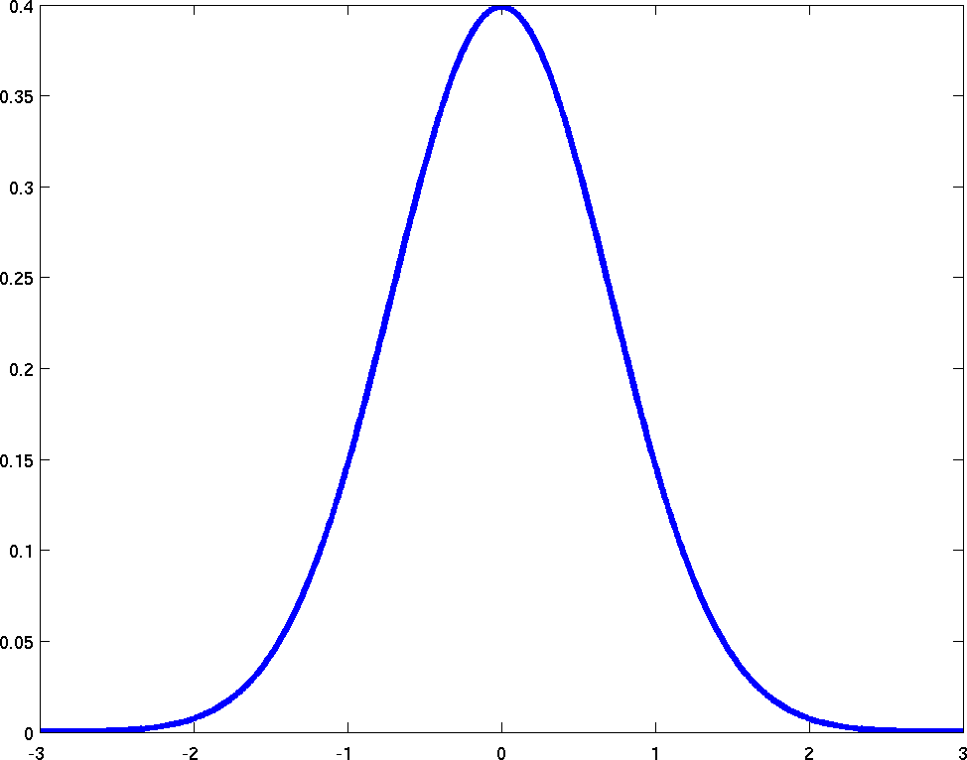
27
GAUSSIAN DISTRIBUTION
mean

Slide 25
28
JOINT DISTRIBUTION
Consider two RVs, X, and, Y. The joint CDF of X and Y is
F_{X ,Y} (x, y) = P( X ≤ x,Y ≤ y)
Joint pdf
_{(x, y) =} ∂F_{X ,Y} (x, y)
f
X ,Y
∂x∂y
Given the joint pdf, we can find the marginal pdf of each RV
f (x) =
∫
+∞
f (x, y)dy
f ( y) =
∫
+∞
f (x, y)dx
X
X ,Y
Y
X ,Y
−∞
−∞
Independent
– If f _{X ,Y} (x, y) = f _{X} (x) f_{Y} ( y) , then X and Y are independent.

Slide 26
30
CORRELATION
The correlation of two RVs X and Y is calculated as
E[XY ] =
+∞ +∞
xyf (x, y)dxdy
∫ ∫
−∞ −∞
XY
The covariance of two RVs X and Y is
E[(X − m_{X} )(Y − m_{Y} )] = E[x]E[Y ] − m_{X} m_{Y}
If E[XY ] = E( X )E(Y ) , then X and Y are uncorrelated.
If X and Y are independent ➔ they must be uncorrelated.

Slide 27
CORRELATION
31
Example:
⎧x + y,
0 ≤ x ≤ 1,0 ≤ y ≤ 1 otherwise
f _{X ,Y} (x, y) = ⎨
⎩
0,
Are X, Y uncorrelated?
– Sol:

Slide 28
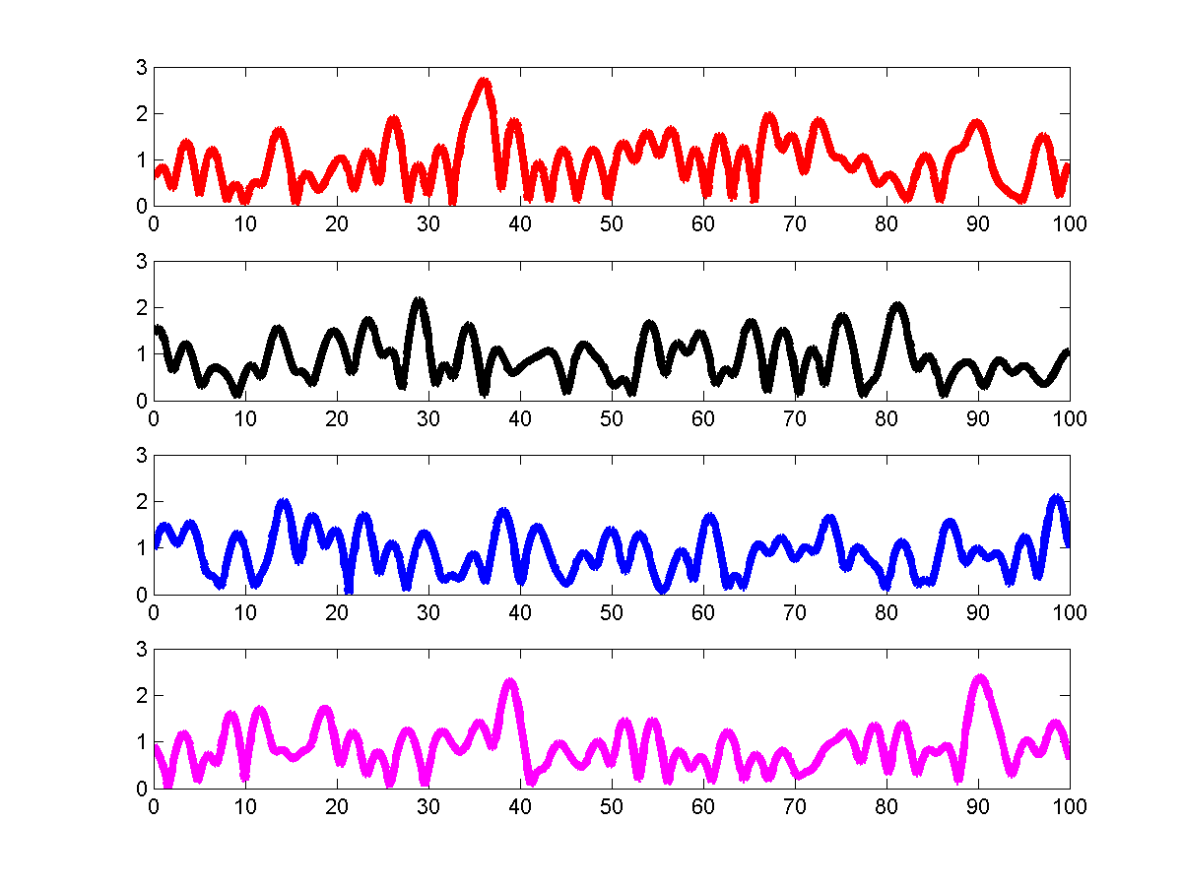
RANDOM PROCESS
32
Random process X(t): an RV changes w.r.t. time
X(t) is a function of time t
At any time instant t₀ , X (t₀ ) is a random variable.
Each realization is called a sample function of the random process
mean: (ensemble average)
m_{X} (t₀ ) = E[X (t₀ )]
Time (ms)
At each time instant, we have a RV

Slide 29
33
RANDOM PROCESS
Let X (t) be a random process,
at time
t₁
, we have a RV
X (t₁ ) ;
X (t₂ ) .
at time t₂ , we have another RV
Then we have the joint distribution functions
F (x , x ) = P
[X (t ) < x , X (t ) < x ]
X (t ) X (t ) 1 2
1 1
2
2
1
2
∂F
(x , x )
f
(x , x ) =
X (t ) X (t ) 1 2
X (t₁ ) X (t₂ ) 1 2
1 2
∂x ∂x
1 2

Slide 30
34
AUTO-CORRECTION FUNCTION (ACF)
Let X (t) be a random process,
at time
t₁
, we have a RV X (t₁ ) ;
X (t₂ ) .
at time t₂ , we have another RV
Then we can calculate the correlation of X (t₁ )
and X (t₂ ) :
R (t ,t ) = E[ ]
X (t )X (t )
*
X 1 2 1
2
R_{X} (t₁ , t₂ )
is defined as the autocorrelation function of X(t)

Slide 31
35
WIDE-SENSE STATIONARY (WSS)
A random process is wide-sense stationary (WSS) if the following two conditions are satisfied
m_{X} (t) = E[X (t)]= m_{x}
R_{X} (t₁, t₂ ) = R_{X} (t₁ + h, t₂ + h) = R_{X} (t₁ − t₂ )
1.
2.
m_{X} (t) = E[ X (t)] = m_{X}
The first condition states that the mean of the random process is independent of time.
The second condition states that the auto-correlation function is only
dependent on the time difference between the two RVs, and it’s independent
of the starting time.
E[ X (t₁ ) X (t₂ )] = E[X (t₁ + h) X (t₂ + h)]
The autocorrelation function of WSS process is usually represented as
R_{X} (τ )

Slide 32
36
POWER SPECTRUM DENSITY
The power spectrum density (PSD) of WSS random process is defined as the Fourier transform of the auto-correlation function of the process
S_{X} ( f ) = _{∫−∞} R_{X} (τ ) exp(− j2πfτ )dτ
+∞
Power spectrum density represents the power distribution in the frequency domain.
N
E.g.
R (τ ) =
0
δ (τ )
x
2
+∞
N N
S ( f ) =
∫−∞
0
δ (τ )dτ =
0
x
2
2
R_{X} (τ )
S_{X} [ f ]
N0/2
N0/2
τ
f

Slide 33
37
RANDOM PROCESS PASS THROUGH LTI
x(t)
h(t)
y(t)
If x(t) is a WSS random process, then y(t) is a WSS random process as well.
The relationship between mean of y(t) and mean of x(t)
E[y(t)]= E
⎡
∫
+∞
h(t −τ )x(τ )dτ
⎤
⎥⎦
=
∫
+∞
h(t −τ )E[x(τ )]dτ
⎢⎣ −∞
−∞
The relationship between PSD of y(t) and PSD of x(t)
2
S ( f ) = H ( f ) S ( f )
Y
X

Slide 34

Department of Electrical Engineering
University of Arkansas
ELEG 5693 Wireless Communications
Introduction
Dr. Jingxian Wu
wuj@uark.edu

Slide 35
OUTLINE
2
Background
Major modern wireless communication standards
Basic Concepts
Block diagrams of a wireless communication system

Slide 36
BACKGROUND
3
Wireless Communications:
– Transmit information from transmitter to receiver through the
propagation of unguided electromagnetic waves (channel).
Transmitter
Channel
Receiver
Wireless communication: channel is wireless!
Wireless channel imposes numerous challenges.
This course:
How to characterize the wireless channel?
How to efficiently and accurately transmit signal over the wireless channel? (How to format signals based on the properties of wireless channel?)

Slide 37
BACKGROUND: MILESTONES
4
1864. Maxwell predicted the existence of electromagnetic wave (radio wave).
1887 Hertz demonstrated the existence of radio wave.
1901 Marconi realized first across Atlantic wireless transmission (England to Canada)
1906 First radio broadcast (AM radio)
1946 First public mobile telephone systems
1981 First analog cellular system in Scandinavia.
Prototype of current cellular systems.
1983, Advanced Mobile Phone Service (AMPS) in North America.
2019 First 5th generation (5G) services launched in US and
China

Slide 38
BACKGROUND: SPECTRUM
5
Radio Frequency (RF)
1MHz to 1GHz (general classification, not absolute)
100 MHz to 1GHz (more widely used definition)
Applications: AM radio, FM radio, TV, some cellular telephone systems, etc.
Microwave
1 GHz to 300 GHz (general)
1 GHz to 100 GHz (more widely used)
Most cellular telephone systems, wireless LAN, Satellite, etc.
Trends towards use of higher frequencies
Maximum bandwidth ≈ 10% of carrier frequency
More users and higher data rate
More difficult to design ➔ more $$

Slide 39
BACKGROUND: EXAMPLES
6
Garage door opener
Remote control
Paging system
Cordless telephone system
Fixed microwave
Point-to-point link for long distance telephone
Most have been replaced by fiber optics.
Cellular telephone system
Wireless local area network (LAN)
Wireless sensor networks (WSN)
Vehicular Ad-hoc network (VANET)
Internet-of-Things (IoT)

Slide 40
OUTLINE
7
Background
Major modern wireless communication standards
Basic Concepts
Block diagrams of a wireless communication system

Slide 41
STANDARDS: MOBILE TELEPHONE SYSTEMS
8
1st generation: analog voice
Example: Advanced Mobile Phone Service (AMPS)
2nd generation: digital voice and narrowband data
Examples: GSM (T-Mobile, Cingular, AT&T, Verizon), D-AMPS (AT&T), IS-95 (Interim Standard-95) (Sprint)
2.5 generation: EDGE, GPRS
3rd generation: digital voice and broadband data
Examples: WCDMA (HSDPA), cdma2000 (EV-DO)
4th generation: broadband multimedia communication
LTE (long term evolution)
LTE advanced (true 4G)

Slide 42
STANDARDS: MOBILE TELEPHONE SYSTEMS
9
5th generation: seamless wireless coverage everywhere
Standard: IMT-2020 (International Mobile Telecommunication
2020)
It specifies all the requirements for 5G
3GPP develops the actual standards that meet all IMT-2020
requirements
NR (new radio),
NB-IoT (narrowband Internet-of-Things),
LTE-M (Long term evolution – Machine type communications)
Usage scenarios:
Enhanced Mobile Broadband (eMBB)
Ultra-Reliable Low-Latency Communications (URLLC)
Massive Machine-Type Communications (mMTC)

Slide 43
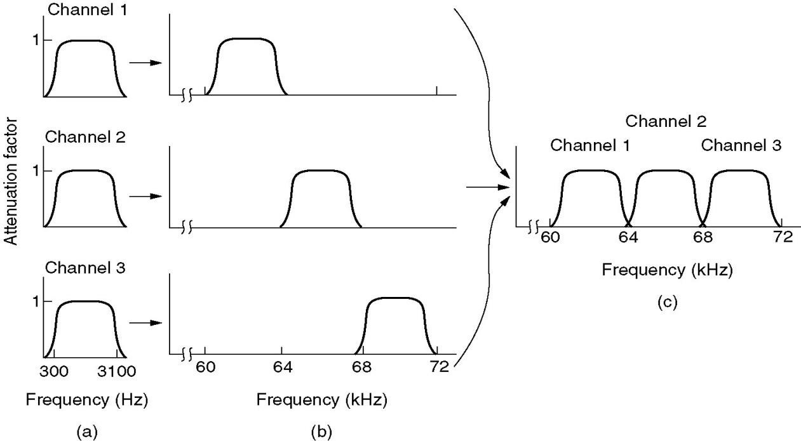
STANDARDS: MOBILE TELEPHONE SYSTEMS
10
AMPS
Advanced Mobile Phone System
1983, AT&T
Analog voice (control information is digital)
Frequency Division Multiple Access (FDMA)
Available spectrum divided into channels
each user is assigned a channel
(c) The multiplexed channel
(a) The original
bandwidths
(b) Bandwidths raised in frequency

Slide 44
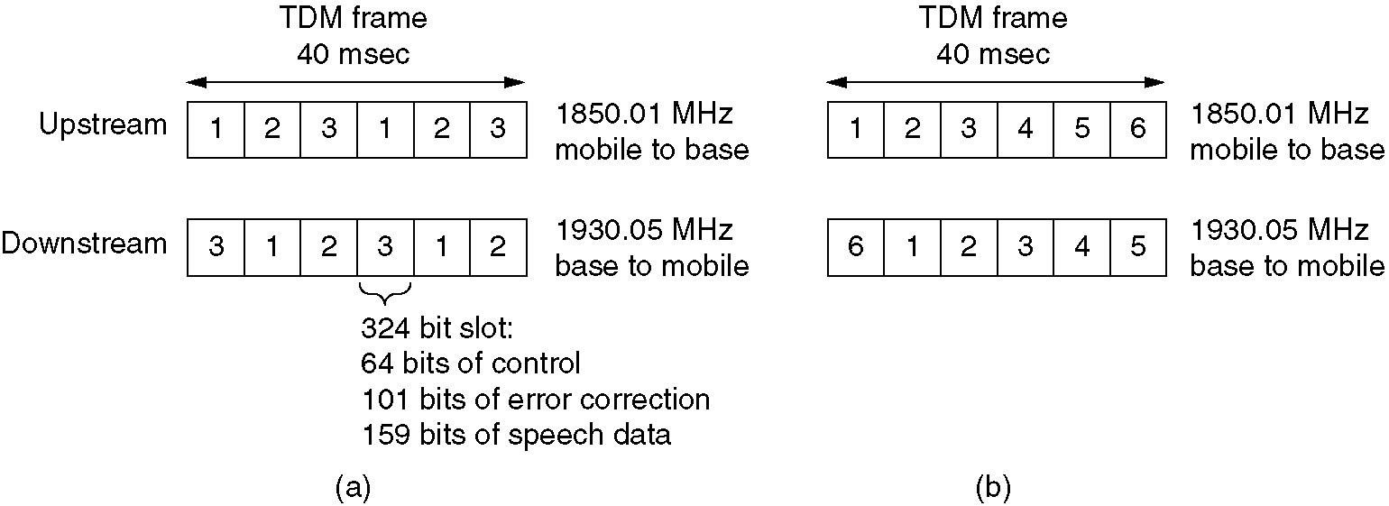
STANDARDS: MOBILE TELEPHONE SYSTEMS
11
D-AMPS (IS-54/136)
Digital AMPS
Digital voice: analog voice is digitalized and compressed by vocoder before Tx
Time Division Multiple Access (TDMA)
Time is divided into frame, frame divided into slots
Each user is assigned one or more slots
TDMA is usually on top of FDMA (30 KHz channel, 6 users per channel)

Slide 45
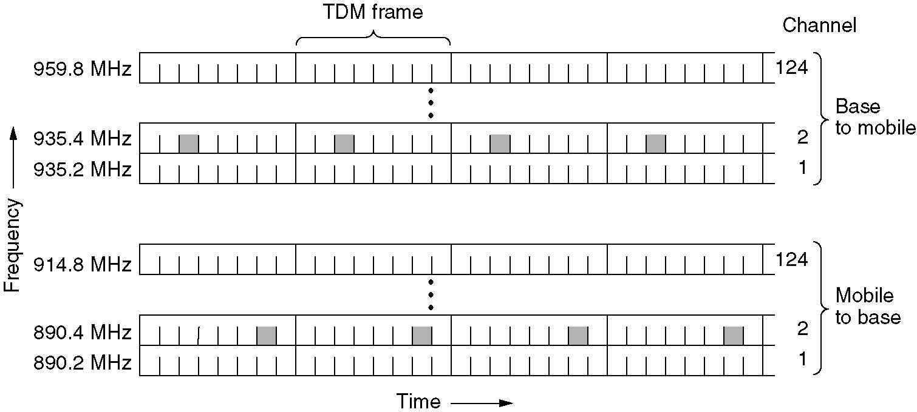
STANDARDS: MOBILE TELEPHONE SYSTEMS
12
GSM (Global System for Mobile communication)
The most widely used 2nd generation system
Similar to D-AMPS, but with different format

Slide 46
STANDARDS: MOBILE TELEPHONE SYSTEMS
13
IS-95 (Narrowband CDMA)
Code Division Multiple Access
All users Tx simultaneously using the same frequency and same time.
Different codes are used to separate the signals from different users.
CDMA
Each user is assigned a unique code
The code is known at both transmitter (Tx) and receiver (Rx)
All users Tx at the same frequency and time
Receiver uses codes to pick up desired signals
Also called spread spectrum
(details will be discussed in Ch. 9)

Slide 47
STANDARDS: MOBILE TELEPHONE SYSTEMS
14
WCDMA (Wideband CDMA)
Also called UMTS (Universal Mobile Telephone System)
Proposed by Ericsson, Standardized in 3GPP
Will mainly be used in Europe
Data: HSDPA (High Speed Downlink Packet Access, 1.8 Mbps-7.2 Mbps)
cdma2000
Proposed by Qualcomm, Standardized in 3GPP2
Will mainly be used in North America
Data: 1xEV-DO (Evolution Data Optimization, 1x: one 1.25 MHz channel, up to 4.9 Mbps in the downlink)
Both standards use CDMA
Only some detailed technical differences

Slide 48
STANDARDS: MOBILE TELEPHONE SYSTEMS
15
4G: LTE (long term evolution)
Standard finalized in 2008
First LTE service in North America launched by Verizon in 2010.
An upgrade of 3G UMTS
Some main features
OFDMA (orthogonal frequency division multiple access) for downlink; FDMA for uplink
Scalable carrier bandwidth: 1.4 MHz, 3 MHz, 5 MHz, 10 MHz,
15 MHz and 20 MHz
Low latency: sub-5 ms latency for small packets in optimal conditions
Peak download rate: 299.6 Mbps; Peak upload rate: 75.4 Mbps
Cell size: tens of meters radius (femto and picocells) up to 100 km (62
miles) radius marcocells. (Typical radius 5 – 30 kms)

Slide 49
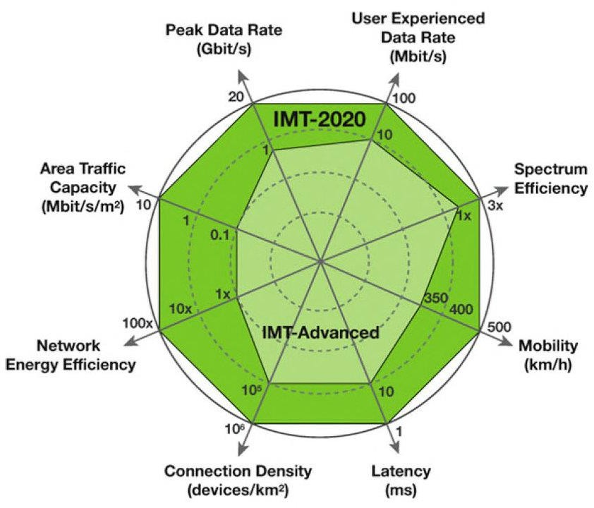
STANDARDS: MOBILE TELEPHONE SYSTEMS
16
5G
IMT 2020: issued in 2015, expected to be completed in 2020
3GPP Release-15 completed in 2019, release-20 to be completed in 2020

Slide 50
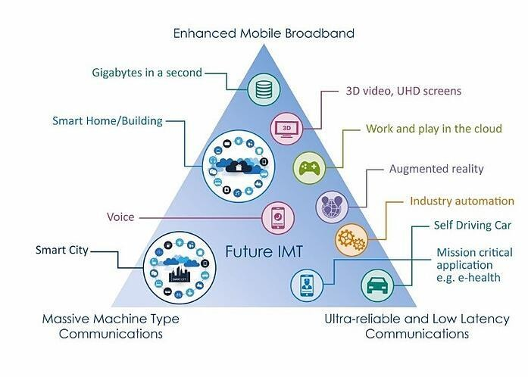
STANDARDS
17
5G usage scenarios
Enhanced Mobile Broadband (eMBB)
Ultra-Reliable Low-Latency Communications (URLLC)
Massive Machine-Type Communications (mMTC)

Slide 51
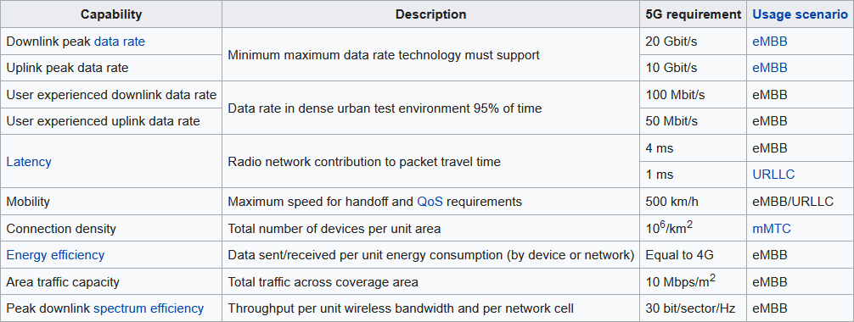
STANDARDS
18
5G requirements

Slide 52
STANDARDS: WIRELSS LAN
19
IEEE 802.11 (WiFi)
– IEEE 802.11a (Oct. 1999)
Operating at 5.8GHz, up to 54Mbps
Orthogonal Frequency Division Multiplex (OFDM)
– IEEE 802.11b (Oct. 1999)
Operating at 2.4GHz, up to 11Mbps
Direct Sequence Spread Spectrum (DSSS, CDMA)
– IEEE 802.11g (Jun. 2003)
Operating at 2.4GHz, up to 54Mbps
OFDM
– IEEE 802.11n (2009)
Operating at 2.4 GHz or 5.8 GHz, up to 540 Mbps
Channel bandwidth up to 40 MHz
MIMO (Multiple input multiple output, up to 4 x 4)
IEEE 802.11ac (2011 to present)
Operating at 5.8 GHz, up to 1 Gbps for multi-station WLAN, upto 500 Mbps
for a single link
Wider bandwidth (up to 160 MHz), MIMO (up to 8x8), multi-user MIMO, high density modulation (upto 256 QAM)
– IEEE 802.11ad (2014 to present)
60 GHz carrier frequency, upto 7 Gbps (WiGig)

Slide 53
OUTLINE
20
Background
Major modern wireless communication standards
Basic concepts
Block diagrams of a wireless communication system

Slide 54
CONCEPTS
21
In most wireless communication systems, the wireless communication occurs between mobile station (MS) and base station (BS)
MS: Cell phone, wireless laptop, wireless PDA, etc.
BS: wireless access point, wireless router, etc.
Downlink
Radio channel for transmission from BS to MS
Also called forward link
Uplink
Radio channel for transmission from MS to BS
Also called reverse link

Slide 55
CONCEPTS: SIMPLEX AND DUPLEX
22
Simplex
Communication occurs only in one direction
E.g. paging system
Half Duplex
Tx can occur in either direction, but only one way at a time.
E.g. Walki-Talki (police radio)
Full Duplex
Tx can occur at both direction simultaneously
E.g. Telephone.
Two simplex ➔ One Full Duplex

Slide 56
CONCEPTS:FDD V.S TDD
23
Frequency Division Duplex (FDD)
– Two distinct frequencies are used for downlink and uplink.
e.g. AMPS: forward link: 824 ~ 849 MHz
reverse link: 869 ~ 894 MHz
Time Division Duplex (TDD)
Two distinct sets of time slots at the same frequency are used for downlink and uplink
TDD ≠ TDMA, FDD ≠ FDMA
TDMA or FDMA: multiple users use different time/frequency
TDD or FDD: uplink and downlink (belonging to same user) use different time/frequency
TDD can be used in FDMA, TDMA, and CDMA systems
FDD can be used in FDMA, TDMA, and CDMA systems
E.g. FDD and TDMA can be in one system.

Slide 57
CONCEPTS: CELLUAR
24
Motivations
Early mobile phone system uses a single high Tx tower to cover a
large spatial area (high tower, high power)
Limited spectrum can only support a small number of users.
How can we support simultaneous communications of practically
unlimited number of users?
Solution: cellular concept with frequency reuse
Many Tx towers (base station)
Each covers a certain area: cell
Frequencies can be reused from area to area

Slide 58
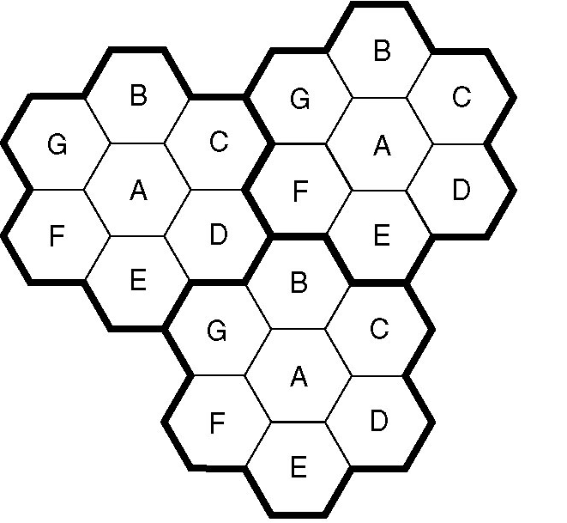
CONCEPTS: CELLULAR
25
Cellular Concept with Frequency Reuse
The entire coverage area is divided into cells
A base station (BS) in the center of each cell.
Communication occurs between BS and Mobile Stations (MS) in cell.
The same frequency (channels) can be reused by nearby cells ➔
Frequency Reuse
But not by adjacent cells!➔Reduce co-channel interference (CCI).
Hexagonal shape only for the
convenience of analysis
Circle leaves gaps
Actual cell “footprint” is amorphous
No specific shape

Slide 59
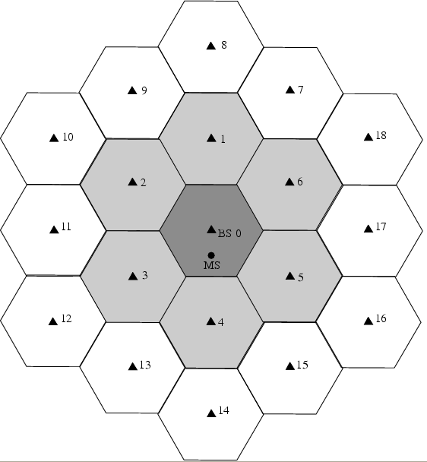
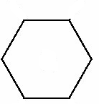
CONCEPTS: CELLULAR
26
Cluster
Cluster: Group of N cells using complete set of available channels.
Cells belonging to the same clusters use different frequencies
For hexagonal cells, the cluster size N must satisfy
N = i^2 + i j + j^2 where i, j ≥ 1
typical N values → 3, 7, 12
(i, j) = (1,1) ➔ N = 1+1+1 = 3
(i, j) = (1, 2) ➔ N = 1+2+4 = 7
(i, j) = (2, 2) ➔ N = 4+4+4 = 12
(i, j) = (2, 3) ➔ N = 4+6+9 = 19
Cell radius R:
x=?
AMPS: 10 ~ 20 km
WCDMA: 1 ~ 2 km
R

Slide 60
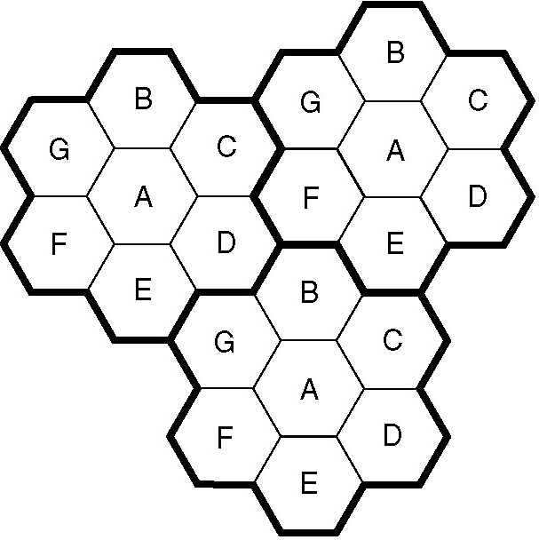
CONCEPTS: CELLULAR
27
Reuse factor Q:
Q = ^{D}
R
D: distance between cells using the same
frequency
R: cell radius
For hexagonal cells,
R
D
Q = ^{D} = 3N
R
cluster size
– E.g. N = 7, Q =
21 = 4.58
Q ↑ ➔ spatial separation relative to cell coverage ↑ ➔ CCI ↓ ➔ Good
Q ↑ ➔ N ↑ ➔ bigger cluster size ➔ less frequency reuse (or, less clusters)
➔ smaller capacity ➔ less users can be served ➔ Bad
Tradeoff between: voice quality and system capacity

Slide 61
CONCEPTS: CELLULAR
29
Advantages of Cell with Frequency Reuse
Limited frequency resource can be reused to support unlimited number of
users
Each cell support only limited number of users
The number of users supported by system increase linearly with the number of cells
Each BS only covers one cell
Smaller Tx power at BS ➔ Less interference to other systems
Smaller Tx power at MS ➔ Longer battery life
A cell can be further divided into smaller cells to support more users
Upgradability
Disadvantage:
Cells sharing same frequency will interfere with each other ➔ co-channel interference (CCI)
We want cells sharing same frequencies to be as further away as possible.

Slide 62
OUTLINE
30
Background
Major modern wireless communication standards
Basic Concepts
Block diagrams of a wireless communication system

Slide 63
Department of Electrical Engineering
University of Arkansas
ELEG 5693 Wireless Communications
Propagation and Noise Part I
Dr. Jingxian Wu
wuj@uark.edu

Slide 64
OUTLINE
2
Wireless channel
Path loss
Shadowing
Small scale fading
Channel classifications
Noise and interference
Simulation model

Slide 65
BLOCK DIAGRAM of WIRELESS COMMUNIICATION SYSTEM
31
Source Coding
Channel Coding
Modulation
Transmitter
Channel
Source Decoding
Channel Decoding
Demodulation
Equalization
Receiver

Slide 66



CHAPTER 2: Path Loss, Shadowing, and Multipath
3

Slide 67
CHANNEL: PROPAGATION MODES
4
Free-space (line-of-sight)
There is a clear transmission path between transmitter (Tx) and
receiver (Rx).
E.g. satellite
Reflection
The bouncing of electromagnetic waves from surrounding objects
Size of reflecting objects must be large compared to the wavelength of signal
Reflecting surface must be smooth compared to the wavelength of
signal
E.g. ground, building, walls, windows, lakes

Slide 68
CHANNEL: PROPAGATION MODES
5
Diffraction
The bending of electromagnetic waves around objects (such as buildings), or through objects (such as trees).
Due to diffraction, signals can propagate
Around curved surface of Earth
Beyond LOS horizon
Behind obstructions
Scattering
Electromagnetic waveforms incident upon rough or complex surfaces are scattered in many directions
Relfection: smooth surface, one direction
Refraction (not common in terrestrial wireless communication).
Electromagnetic waves bend as they move from one medium to another.

Slide 69
CHANNEL
6
Channel: a collection of propagation effects and other signal impairments caused by the environments
Wireless channel: propagation, noise and interference
Propagation effects: line-of-sight, reflection, diffraction, scattering
Induced by the transmission of desired signals itself
Impairments: large scale fading (path loss, shadowing), small
scale fading
Unique to wireless communication
Noise and interference: unwanted electrical signals interfering with
desired signal.
Thermal noise (movements of electrons)
Automobile ignition, electrical machinery, etc.
Present in all communication systems
Interferences from other users operating on the same frequency.

Slide 70
OUTLINE
7
Wireless channel
Path loss Models
Shadowing
Multipath Fading
Small scale fading
Channel classifications
Noise and interference
Simulation model

Slide 71
PATH LOSS
8
Path loss: the power loss during signal propagation from Tx to Rx
– Only a portion of the power from Tx will be captured by the receiver.
Path loss is defined as the ratio between the signal power at
transmitter (PT) and signal power at receiver (PR).
₌ P_{T}
R
L
p
P
P_{T}
10 _{P}
L (dB) = 10 log
= 10 log
P −10 log P
p
10 T
10 R
R

Slide 72
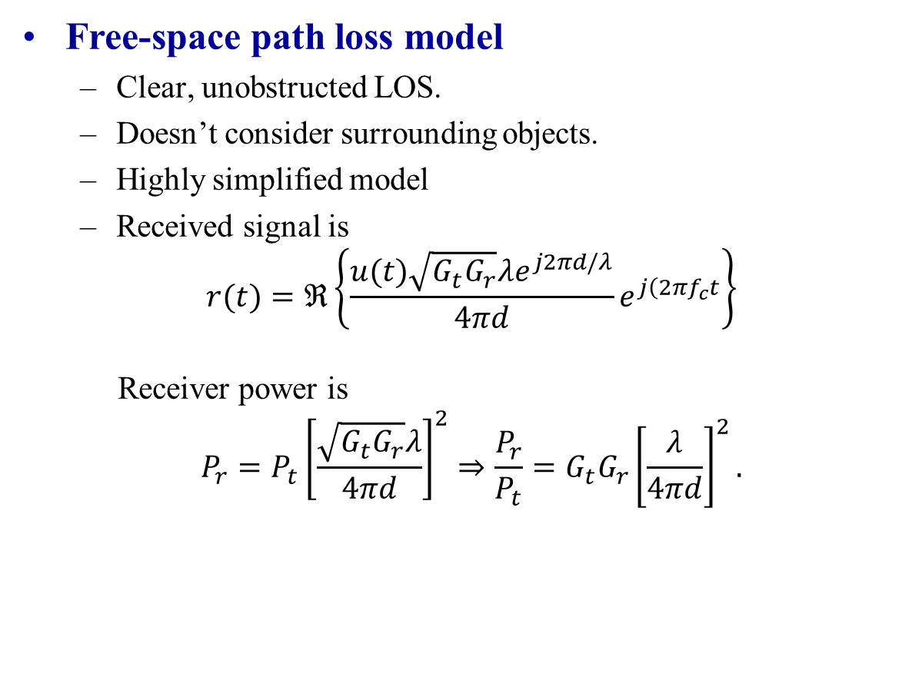
PATHLOSS: MODELS
9
Free-space path loss model
Clear, unobstructed LOS.
Doesn’t consider surrounding objects.
Highly simplified model
Received signal is
$$r(t)=ℜ\left\{\frac{u(t)\sqrt{G_{t}G_{r}}λe^{j2πd/λ}}{4πd}e^{j\left(2πf_{c}t\right.}\right\}$$
Receiver power is
$$P_{r}=P_{t}{\left[\frac{\sqrt{G_{t}G_{r}}λ}{4πd}\right]}^{2}⇒\frac{P_{r}}{P_{t}}=G_{t}G_{r}{\left[\frac{λ}{4πd}\right]}^{2}.$$
Notes:
Gt and Gr are, respectively, the transmit and receive antenna power gains in the LOS direction relative to a unity gain isotropic antenna, τl = d/c is the signal propagation delay of the LOS signal traveling the distance d, and the phase shift e −j2πd/λ is due to the distance d that the wave travels2

Slide 73
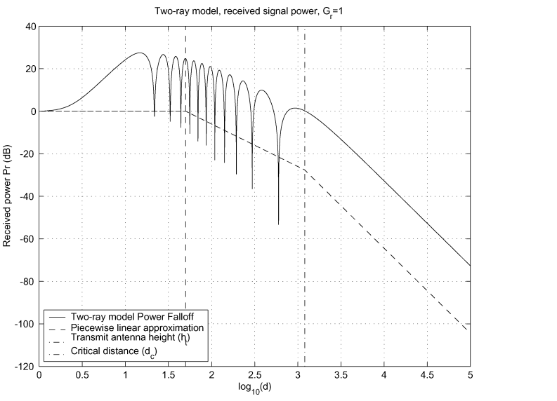
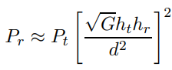
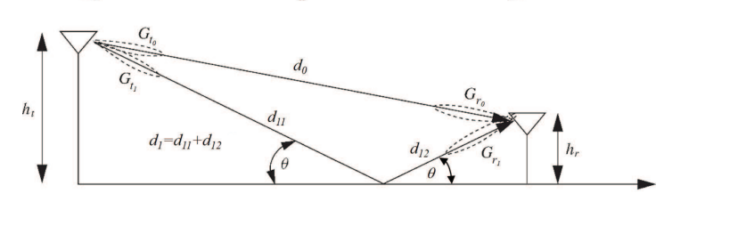
PATHLOSS: MODELS
9
Two Ray-tracing models
Consider the effects of reflection, diffraction from surrounding environment
More complex, depends on site geometry
At small distances, power falls off proportional to d2 (free space loss on both paths). for asymptotically large d, d1 ≈ d0 ≈ d, G1 ≈ G0, received power given by Pr
Above dc, power falls off proportional to d 4 and is independent of signal wavelength (frequency)

Slide 74

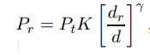

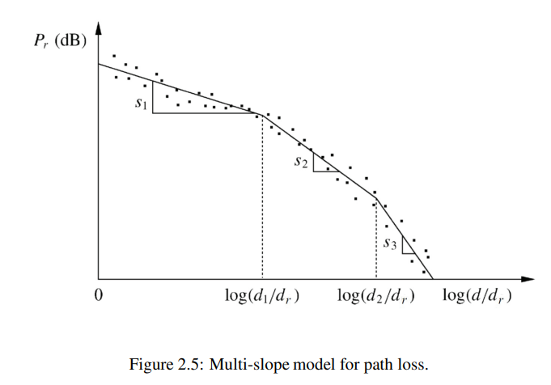
PATH LOSS: EXPONENT MODEL
16
A general model capturing the essence of path loss in various environment
d_{r}
: reference distance (typically 1 meter)
^{β}0 : a unitless constant equal to the path gain Pr/Pt at distance d = dr
γ : path loss exponent (can be obtained through measurement)
d : distance between transmitter and receiver
Multi Slope
– The multi-slope path loss model, which is piecewise linear in dB, generalizes the single-slope model by allowing for different path loss exponents at different distances

Slide 75
OUTLINE
19
Wireless channel
Path loss
Shadowing
Small scale fading
Channel classifications
Noise and interference
Simulation model

Slide 76
SHADOWING
20
Shadowing:
Caused by large obstructions that are distant from MS
Effects of shadowing is random due to random # and type of obstructions.
The existence of shadowing is verified through field measurement.
Typically follows a log-normal distribution

Slide 77
21
COMBINED PATH LOSS AND SHADOWING
dB representation
•
S(dB) = 10log₁₀ S : follows Gaussian distribution (normal distribution)
⎛
₎2 ⎞
1 (x − m
f_{S (dB)} (x) = exp ⎜− ^{dB} ⎟
2πσ
⎜
2σ
⎟
⎝ ² ⎠
dB
dB
S(dB) follows normal distribution➔ the log of S follows normal distribution
➔ The distribution of S is called lognormal distribution
Shadowing is called lognormal shadowing

Slide 78
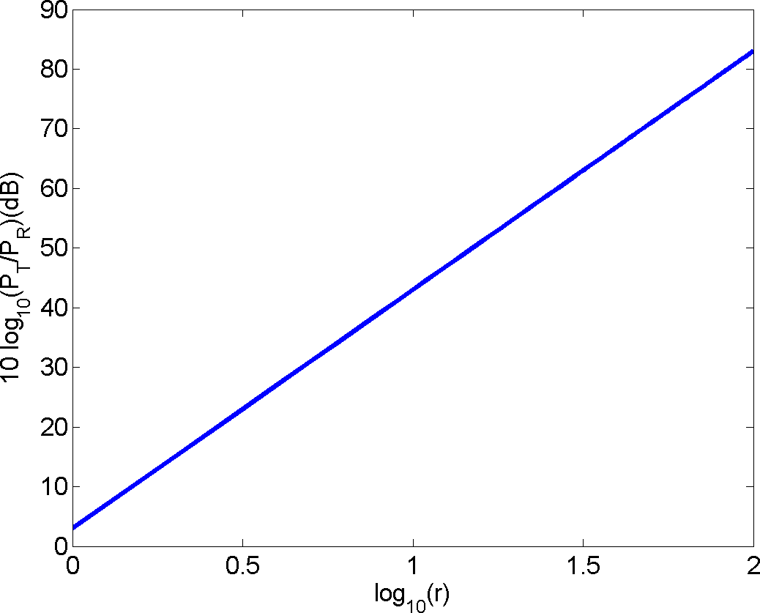
COMBINED PATH LOSS AND SHADOWING
22
path loss with shadowing (random)
path loss only
combined effects of path loss and shadowing (red curve)

Slide 79
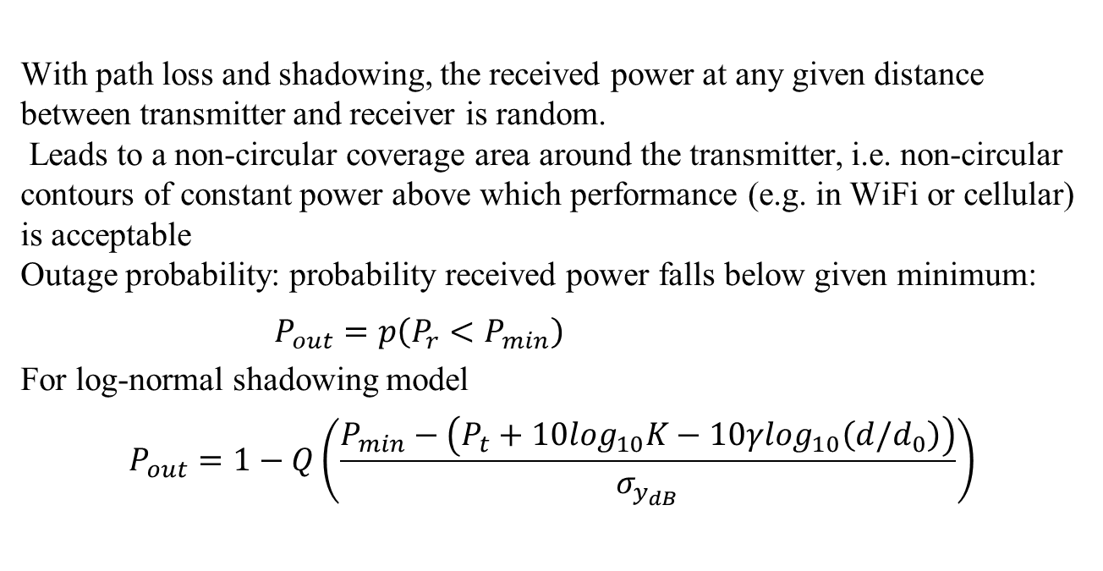
OUTAGE PROBABILITY
22
With path loss and shadowing, the received power at any given distance between transmitter and receiver is random.
Leads to a non-circular coverage area around the transmitter, i.e. non-circular contours of constant power above which performance (e.g. in WiFi or cellular) is acceptable
Outage probability: probability received power falls below given minimum:
$P_{out}=p\left(P_{r}<P_{min}\right)$
For log-normal shadowing model
$$P_{out}=1−Q\left(\frac{P_{min}−\left(P_{t}+10\log_{10}K−10γ\log_{10}\left(d/d_{0}\right)\right)}{σ_{y_{dB}}}\right)$$

Slide 80
CHAPTER 3: Statistical Multipath Channel Models
3
Notes:
Chapter 2 for deterministic channels, we rarely have sufficiently precise knowledge about wireless propagation environments to characterize them deterministicallyThis chapter develops a statistical characterization of Wireless channel model and describes its important properties.

Slide 81
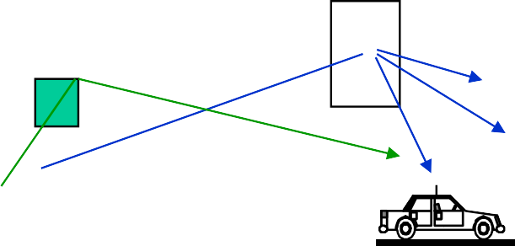


FADING: WHAT IS FADING?
4
Random # of multipath components
– The amplitude, phase, and frequency of each component change
w.r.t. the movement of MS.
The signal at the receiver is the summation of all the multipath components ➔ the amplitude, phase, and frequency of the received signal at receiver change w.r.t. the movement of MS.
The movement of surrounding objects (e.g. vehicles) will also cause the time variation of the signals.

Slide 82






DOPPLER
6
What is Doppler?
The whistle of the train coming from opposite direction sounds different with the train passing by.
The pitch of the sound (determined by sound frequency) is changing.
Rx signal frequency will change if the Rx is moving w.r.t. Tx.
Signal frequency change due to the relative movement between Tx and Rx is called Doppler effects.
t=0
c
b
a
c
b
a
t=0.5s
b
a
c
c
b
a
t=1s
c
b
a
c b
a
T = 1s
T = 0.5s

Slide 83
DOPPLER
7
Consider Tx sends out a sinusoid with frequency 1Hz
If Rx moves toward Tx, the signal observed by Rx will have a
shorter period ➔ frequency increased
If Rx moves away from Tx, the signal observed by Rx will have a longer period ➔ frequency decreased
The amount of frequency change is called Doppler shift
Doppler shift depends on
Relative speed between Tx and Rx
The frequency of the original signal

Slide 84
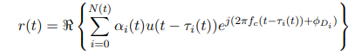
Statistical Multipath Model
• At each time instant there are a random number N(t) of multipath signal components.
• At time t the ith component has a random amplitude αi(t), angle of arrival θi(t), Doppler shift fDi = (v /λ) cos θi(t) and associated phase shift φDi and path delay relative to the LOS component τi(t) = (xi(t))/c.
• Thus, the received signal is given by the following expression, which implies the channel has a time-varying impulse response

Slide 85
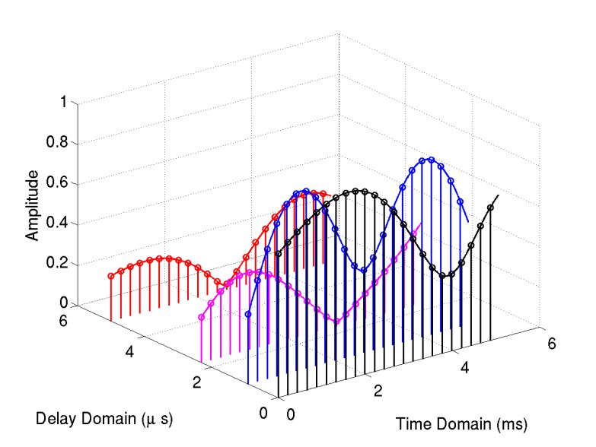
10
FADING: IMPULSE RESPONSE
The impulse response of fading is time-varying!
Relative multipath delay τ
Time variation t
N multipath components
N
c(t,τ ) = ∑α_{n} (t) cos[2πf_{c}t + ϕ_{n} (t)]×δ (τ −τ _{n} )
n=1
f_{c} : system operating frequency (e.g. 900MHz, 1.8GHz)
t: the time variation (both amplitude and phase changes with respect to time)
τ : relative delay between multipath components
ϕ_{n} (t) : depends on path distance and Doppler shift (2πf_{D}t )

Slide 86
Received Signal Characteristics
• The received signal consists of N multipath components scaled by amplitude αn(t) and phase φn(t) = 2πfcτn(t) − φDn (t).
• The amplitude term αn(t) varies slowly (due to shadowing).
• The phase φn(t) varies rapidly due to small shifts in the signal component path delays.
• The phase variation causes rapid variation in the received signal amplitude due to constructive and destructive interference of the multipath components.

Slide 87
FADING: WHAT IS FADING?
3
Path loss and shadowing is caused by large objects that are distant from MS.
Even the MS is moving, the change in the relative position between MS
and those distant large objects is small.
Therefore, the impairments caused by those large distant objects change very slow with respect to (w.r.t.) time and position.
Shadowing is also referred to as large scale fading.
Small scale fading is caused by the effects of objects that are close
to MS.
The movement of MS w.r.t. nearby small objects will dramatically change the reflection or diffractions of propagated signals.
The signal at receiver (sum of the signals from all multiple paths) will change rapidly with the movement of MS.
Small scale fading: rapid fluctuation of the received signals over short distance.

Slide 88
12
FADING: FLAT FADING (Narrowband Model)
Flat fading
Maximum delay spread τ _{max} << system symbol period Ts
Relative to the symbol period, all the multipath components arrive at almost the
same time ➔ Doesn’t need to consider the delay variable τ
N N
N
∑ n
= α (t) cos
n=1
[ϕ (t)]+ j ⋅ α (t) sin[
ϕ (t)]
h(t) = α
(t)e
jϕ (t )
∑ n
∑ n n=1
n
n
n
n=1
– Inphase component
N
h (t) = α (t) cos[
ϕ (t)]
∑ n n=1
I
n
– Quadrature component
N
h (t) = α (t) sin[
ϕ (t)]
∑ n n=1
Q
n
Maximum delay spread
– The time interval between the first multipath and the last multipath
^{τ} max
= τ_{N} −τ₁

Slide 89
FADING: FLAT FADING
13
h(t) = h_{I} (t) + j ⋅ h_{Q} (t)
Both hI(t) and hQ(t) are the sum of many multipath components
Each multipath component is a random process
hI(t) and hQ(t) are random processes
Central limit theorem
The sum of N independent and identically distributed (i.i.d.) random variables tends to Gaussian distribution when N is large enough.
Based on central limit theorem, at time time t, both hI(t) and hQ(t) are
Gaussian distributed!

Slide 90
14
FLAT FADING: RAYLEIGH FADING
If there is no LOS between Tx and Rx
hI(t) and hQ(t) are zero-mean Gaussian distributed
The amplitude (or envelope) of h(t)
~ N (0,σ ² )
h(t) = h² (t) + h² (t)
I Q
– The fading envelope |h(t)| follows Rayleigh distribution
_{z}2
z
⎛ ⎞
f (z) =
exp ⎜−
⎝
⎟
⎠
h(t )
σ
2
2σ
2
– Average power of fading
E[h(t) ]=
E[h (t)]+
E[h (t)]= σ
2
2
2
2
2
I
Q

Slide 91
FLAT FADING: RICIAN FADING
15
If there is LOS component
hI(t) and hQ(t) are non-zero-mean Gaussian distributed
The fading envelope
~ N (s,σ ² )
h(t) = h² (t) + h² (t)
I Q
follows Rician distribution

Slide 92
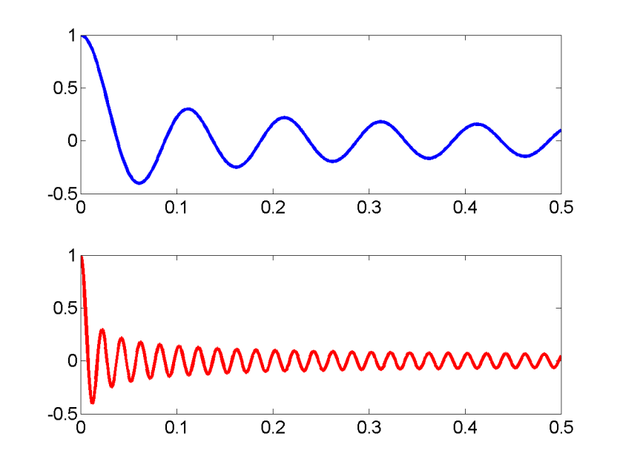
16
FLAT FADING: TIME DOMAIN CORRELATION
The time domain correlation of h(t) is
R (α) = E[h(t +α )h (t)]= P ⋅ J (2
*
πf α )
h h 0
D
– J0(x): zero-order Bessel function of the first kind
Fd = 10Hz
Fd = 50Hz
Generally speaking, for given time interval α
Larger speed v ➔ larger fD ➔ smaller| R_{h} (α ) | .

Slide 93
SIMULATOR
20
How to generate flat Rayleigh fading with computer program?
Method 1: Filtered Gaussian noise
Rely on low-pass filter to introduce the time-domain correlation among symbols
White
Gaussian
Low-pass
Filter
hI(t)
hQ(t)
White
Gaussian
Low-pass
Filter
– The low-pass filter is hard to design.

Slide 94
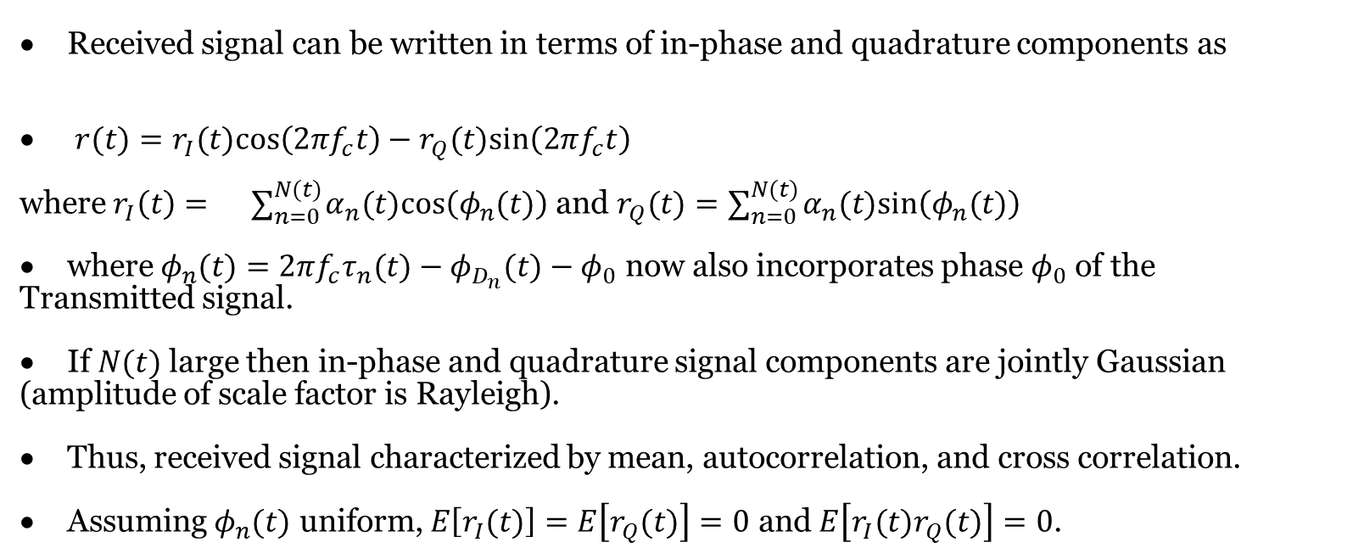
In-Phase and Quad Signal Components under CLT
Received signal can be written in terms of in-phase and quadrature components as
$r(t)=r_{I}(t)cos⁡\left(2πf_{c}t\right)−r_{Q}(t)sin⁡\left(2πf_{c}t\right)$
where $r_{I}\left(t\right)=$ $∑_{n=0}^{N(t)} α_{n}(t)cos⁡\left(φ_{n}(t)\right)$ and $r_{Q}(t)=∑_{n=0}^{N(t)} α_{n}(t)sin⁡\left(φ_{n}(t)\right)$
where $φ_{n}(t)=2πf_{c}τ_{n}(t)−φ_{D_{n}}(t)−φ_{0}$ now also incorporates phase $φ_{0}$ of the
Transmitted signal.
If $N(t)$ large then in-phase and quadrature signal components are jointly Gaussian
(amplitude of scale factor is Rayleigh).
Thus, received signal characterized by mean, autocorrelation, and cross correlation.
Assuming $φ_{n}(t)$ uniform, $E\left[r_{I}(t)\right]=E\left[r_{Q}(t)\right]=0$ and $E\left[r_{I}(t)r_{Q}(t)\right]=0$.

Slide 95
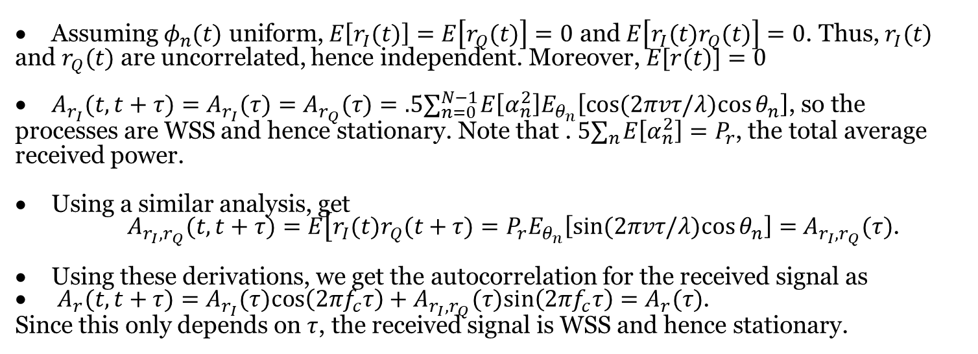
Mean, Autocorrelation, and Cross Correlation in Flat Fading
Assuming $φ_{n}(t)$ uniform, $E\left[r_{I}(t)\right]=E\left[r_{Q}(t)\right]=0$ and $E\left[r_{I}(t)r_{Q}(t)\right]=0$. Thus, $r_{I}(t)$
and $r_{Q}(t)$ are uncorrelated, hence independent. Moreover, $E[r(t)]=0$
$A_{r_{I}}(t,t+τ)=A_{r_{I}}(τ)=A_{r_{Q}}(τ)=.5∑_{n=0}^{N−1} E\left[α_{n}^{2}\right]E_{θ_{n}}\left[cos⁡(2πvτ/λ)cos⁡θ_{n}\right]$, so the
processes are WSS and hence stationary. Note that . $5∑_{n} E\left[α_{n}^{2}\right]=P_{r}$, the total average
received power.
Using a similar analysis, get
$A_{r_{I},r_{Q}}(t,t+τ)=E\left[r_{I}(t)r_{Q}(t+τ)=P_{r}E_{θ_{n}}\left[sin⁡(2πvτ/λ)cos⁡θ_{n}\right]=\right.$ $A_{r_{I},r_{Q}}(τ)$.
Using these derivations, we get the autocorrelation for the received signal as
$A_{r}(t,t+$ $τ)=A_{r_{I}}(τ)cos⁡\left(2πf_{c}τ\right)+A_{r_{I},r_{Q}}(τ)sin⁡\left(2πf_{c}τ\right)=A_{r}(τ)$.
Since this only depends on $τ$, the received signal is WSS and hence stationary.

Slide 96
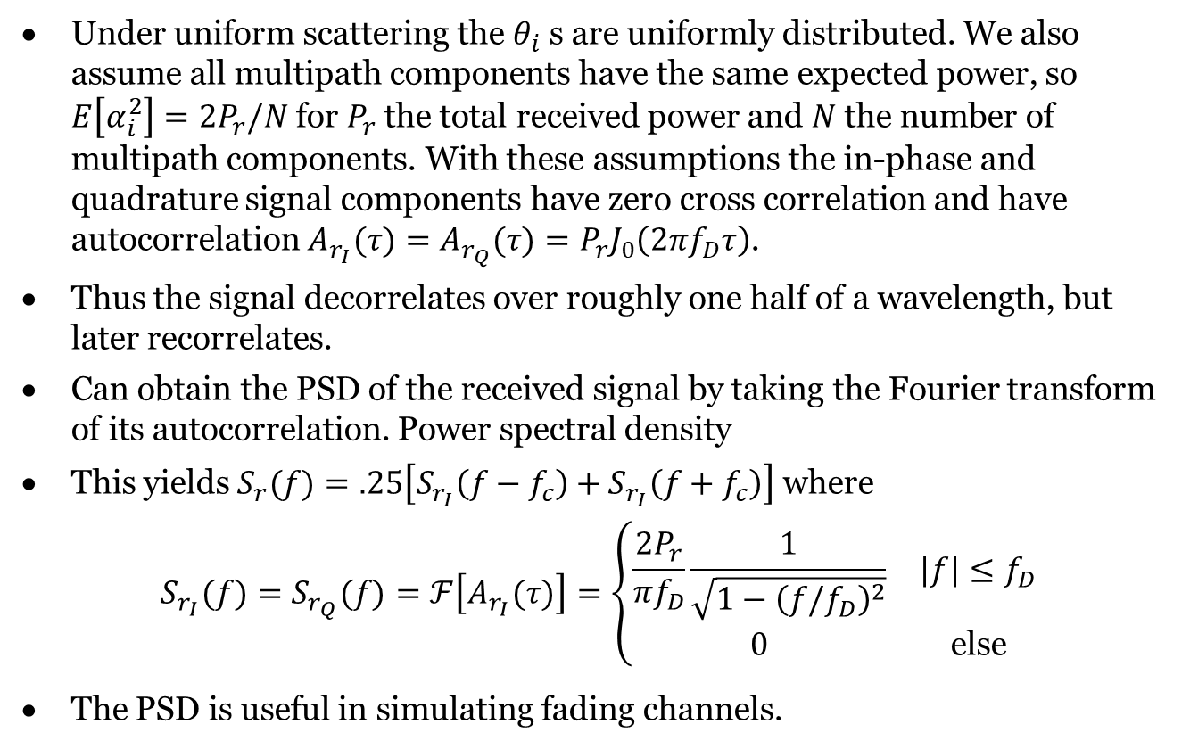
Correlation and PSD under Uniform Scattering
Under uniform scattering the $θ_{i}$ s are uniformly distributed. We also assume all multipath components have the same expected power, so $E\left[α_{i}^{2}\right]=2P_{r}/N$ for $P_{r}$ the total received power and $N$ the number of multipath components. With these assumptions the in-phase and quadrature signal components have zero cross correlation and have autocorrelation $A_{r_{I}}(τ)=A_{r_{Q}}(τ)=P_{r}J_{0}\left(2πf_{D}τ\right)$.
Thus the signal decorrelates over roughly one half of a wavelength, but later recorrelates.
Can obtain the PSD of the received signal by taking the Fourier transform of its autocorrelation. Power spectral density
This yields $S_{r}(f)=.25\left[S_{r_{I}}\left(f−f_{c}\right)+S_{r_{I}}\left(f+f_{c}\right)\right]$ where
$$S_{r_{I}}(f)=S_{r_{Q}}(f)=ℱ\left[A_{r_{I}}(τ)\right]=\left\{\begin{matrix}\frac{2P_{r}}{πf_{D}}\frac{1}{\sqrt{1−{\left(f/f_{D}\right)}^{2}}} & |f|≤f_{D} \\ 0 & \text{else} \end{matrix}\right.$$
The PSD is useful in simulating fading channels.

Slide 97
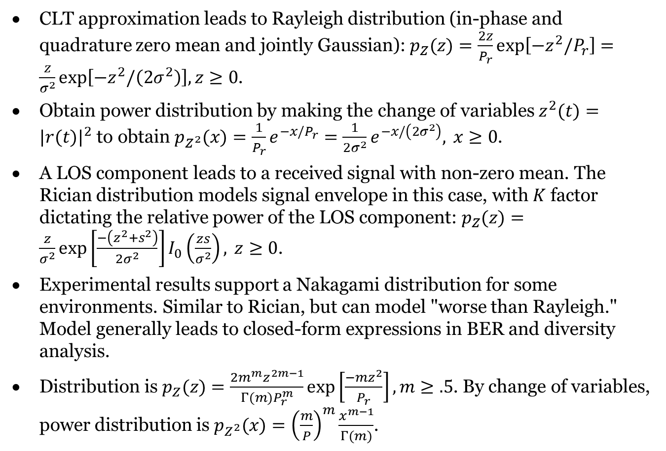
. Signal Envelope Distributions
CLT approximation leads to Rayleigh distribution (in-phase and quadrature zero mean and jointly Gaussian): $p_{Z}(z)=\frac{2z}{P_{r}}exp⁡\left[−z^{2}/P_{r}\right]=\frac{z}{σ^{2}}exp⁡\left[−z^{2}/\left(2σ^{2}\right)\right],z≥0$.
Obtain power distribution by making the change of variables $z^{2}(t)=|r(t)|^{2}$ to obtain $p_{Z^{2}}(x)=\frac{1}{P_{r}}e^{−x/P_{r}}=\frac{1}{2σ^{2}}e^{−x/\left(2σ^{2}\right)}, x≥0$.
A LOS component leads to a received signal with non-zero mean. The Rician distribution models signal envelope in this case, with $K$ factor dictating the relative power of the LOS component: $p_{Z}(z)=\frac{z}{σ^{2}}exp⁡\left[\frac{−\left(z^{2}+s^{2}\right)}{2σ^{2}}\right]I_{0}\left(\frac{zs}{σ^{2}}\right), z≥0$.
Experimental results support a Nakagami distribution for some environments. Similar to Rician, but can model "worse than Rayleigh." Model generally leads to closed-form expressions in BER and diversity analysis.
Distribution is $p_{Z}(z)=\frac{2m^{m}z^{2m−1}}{Γ(m)P_{r}^{m}}exp⁡\left[\frac{−mz^{2}}{P_{r}}\right],m≥.5$. By change of variables, power distribution is $p_{Z^{2}}(x)={\left(\frac{m}{P}\right)}^{m}\frac{x^{m−1}}{Γ(m)}$.

Slide 98
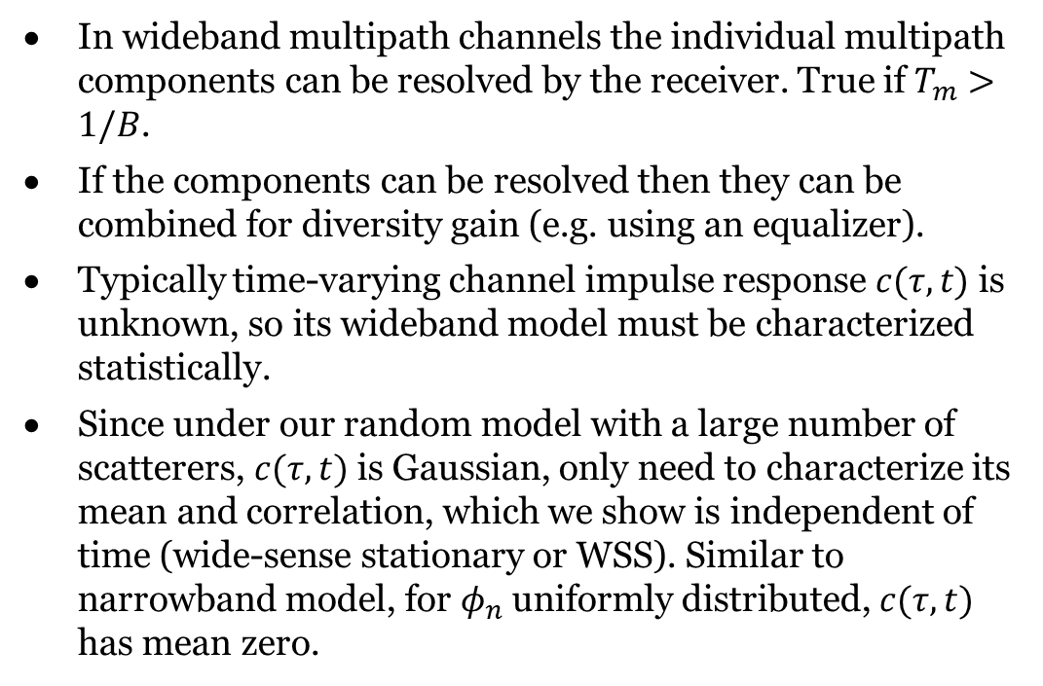
wideband
In wideband multipath channels the individual multipath components can be resolved by the receiver. True if $T_{m}>1/B$.
If the components can be resolved then they can be combined for diversity gain (e.g. using an equalizer).
Typically time-varying channel impulse response $c(τ,t)$ is unknown, so its wideband model must be characterized statistically.
Since under our random model with a large number of scatterers, $c(τ,t)$ is Gaussian, only need to characterize its mean and correlation, which we show is independent of time (wide-sense stationary or WSS). Similar to narrowband model, for $φ_{n}$ uniformly distributed, $c(τ,t)$ has mean zero.

Slide 99
CLASSIFICATION
23
Fading
Amplitude and phase distortions of transmitted signal
Classification criterions
Scale
Large scale fading, small scale fading
Small scale fading
Flat fading v.s. frequency selective fading
Fast fading v.s. slow fading
Rayleigh fading v.s. Rician fading

Slide 100
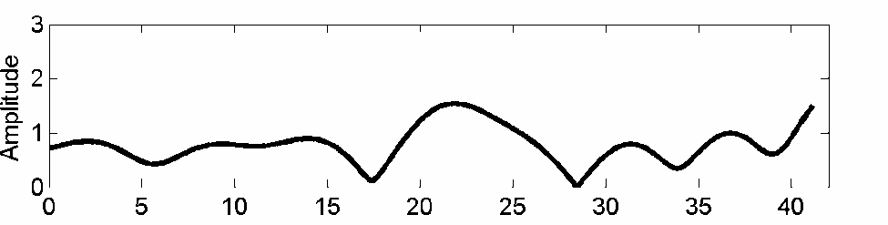
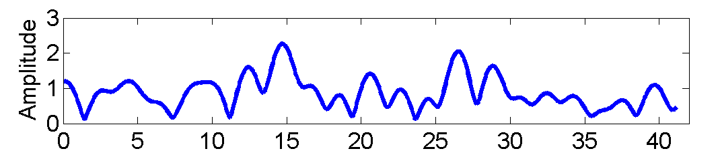
CLASSIFICATION: FAST FADING V.S. SLOW FADING
25
The time domain variation of fading is determined by maximum Doppler spread fD
Doppler shift: signal frequency change due to relative movement between Tx and Rx.
Larger speed v ➔ larger fD ➔ channel varies faster.
Coherence time Tc
The time period over which the channel is strongly correlated (didn’t change
too much)
– Inverse proportional to fD
1
2 f
T ≈
c
D
Tc
Tc

Slide 101
29
CLASSIFICATION: FLAT V.S. FREQUENCY SELECTIVE
Coherence bandwidth Bc
The bandwidth over which the channel is strongly correlated (didn’t change too much)
The spectrum over coherence bandwidth is almost “flat”
Inverse proportional to rms delay spread
1
B ≈
c
2τ
rms
f
Bc
(Coherence bandwidth Bc, rms delay spread τ _{rms} ) is related to fast fading or slow fading

Slide 102
CLASSIFICATION: FAST FADING V.S. SLOW FADING
26
System symbol period v.s. signal bandwidth
0 1 0 0 1 0 1
0
Symbol Period = T_{s}
Signal BW = B_{s} ≈ 1 / T_{s}
Fast fading
If Ts > Tc, or Bs < fD
Ts > Tc: channel changes within one symbol period➔ fast fluctuation
Slow fading
If Ts << Tc, or Bs >> fD
Ts << Tc : channel keeps constant during several symbol periods ➔
slow amplitude fluctutation.
(Coherence time Tc, Doppler spread fD) is related to fast fading or slow fading

Slide 103
28
CLASSIFICATION: FLAT V.S. FREQUENCY SELECTIVE
Maximum delay spread
– The time interval between the first multipath and the last multipath
^{τ} max
= τ_{N} −τ₁
Mean delay spread
N
P
P : the average power of the nth multipath
τ =
∑
n=1
n
⋅τ
n
P
n
N
total ∑ n
total
P =
P :
the total power of the all multipath
n=1
Root mean square (rms) delay spread
N
P_{n}
total
⋅ (τ −τ ) =
N
P_{n}
total
rms ∑
2
∑
τ =
⋅τ ² −τ ²
P
n
P
n
n=1
n=1

Slide 104
30
CLASSIFICATION: FLAT V.S. FREQUENCY SELECTIVE
Flat fading – Narrowband Model
If Bs << Bc, or Ts >> τ rms
Bs << Bc: signal bandwidth << channel bandwidth
Ts >> τ _{rms} : relative arrival time between multipath components is negligible
Doesn’t need to consider delay variable h(t,τ ) ➔ h(t)
B_{c}
B_{s}
f
f_{c}
Frequency selective fading - Wideband model
If Bs >> Bc, or Ts << τ _{rms}
Bs >> Bc: signal bandwidth >> channel bandwidth
Signal spectrum will be seriously distorted by channel!
Ts << τ _{rms} : symbol period smaller than rms delay spread
The relative arrival time between the multipath components is no longer negligible!

Slide 105
CLASSIFICATION: FREQUENCY SELECTIVE FADING
31
Frequency selective fading
– rms delay spread
^{τ} rms
> system symbol period Ts
The relative arrival time between the multipath components is no longer negligible!
The N multipath components are divided into L clusters
Within each cluster, there are still many multipath components
Multipath components belonging to the lth cluster arrives at approximately the same time τ _{l} .
h(t,τ ) = ∑h (t) ×δ (τ −τ ) = ∑[h (t) + jh
(t)]×δ (τ −τ )
L L
l l Il Ql l
l =1 l =1
hl(t) is the sum of all the multipath components within the same cluster
Resolvable multipath component
The inphase and quadrature components of hl(t) are Gaussian distributed.
The frequency selective fading can be viewed as the combination of multiple flat fading
Each branch (cluster) hl(t) can be viewed as flat fading

Slide 106
32
CLASSIFICATION: FREQUENCY SELECTIVE FADING
Each branch of frequency selective fading can be viewed as a flat fading
All the properties discussed for flat fading can be directly applied
to each branch of frequency selective fading
E.g. Inphase and quadrature components are Gaussian distributed.
fading envelope: Rayleigh v.s. Rician

Slide 107
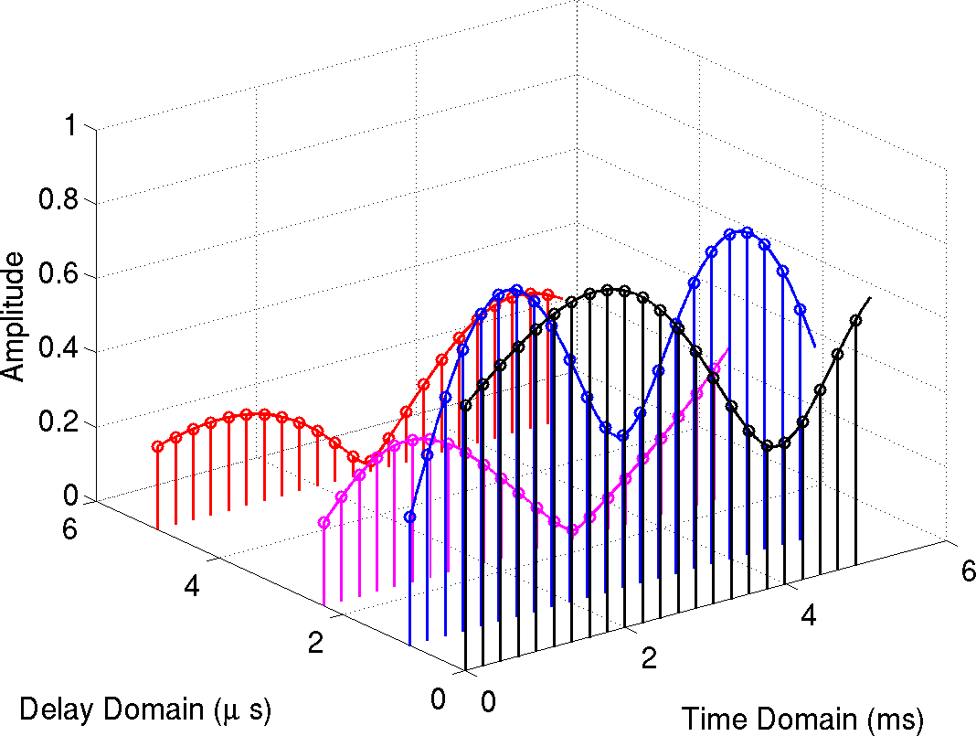
33
CLASSIFICATION: FREQUENCY SELECTIVE FADING
Relative multipath delay τ
Time variation t

Slide 108
CLASSIFICATION: RAYLEIGH V.S. RICIAN
36
Fading envelope
h(t) = h² (t) + h² (t)
I Q
Rayleigh fading
Fading envelope |h(t)| follows Rayleigh distribution
Non LOS (no dominant multipath components)
Rician fading
Fading envelope |h(t)| follows Rician distribution
One dominant component (LOS) along with weaker multipath signals

Slide 109
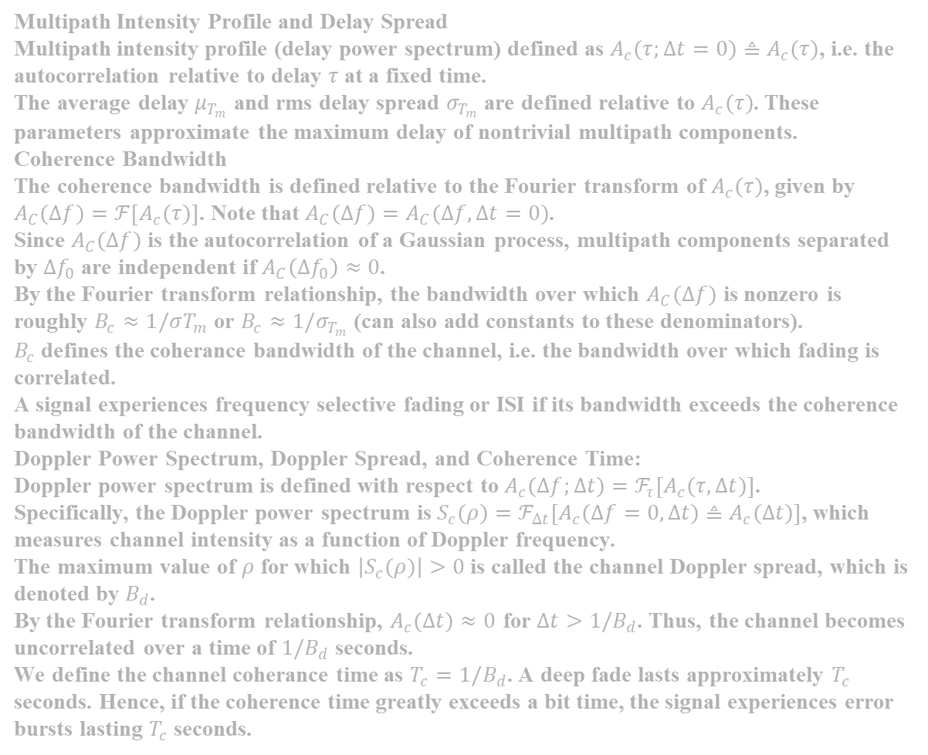
Multipath Intensity Profile and Delay Spread
Multipath intensity profile (delay power spectrum) defined as $A_{c}(τ;Δt=0)≜A_{c}(τ)$, i.e. the autocorrelation relative to delay $τ$ at a fixed time.
The average delay $μ_{T_{m}}$ and rms delay spread $σ_{T_{m}}$ are defined relative to $A_{c}(τ)$. These parameters approximate the maximum delay of nontrivial multipath components.
Coherence Bandwidth
The coherence bandwidth is defined relative to the Fourier transform of $A_{c}(τ)$, given by $A_{C}(Δf)=ℱ\left[A_{c}(τ)\right]$. Note that $A_{C}(Δf)=A_{C}(Δf,Δt=0)$.
Since $A_{C}(Δf)$ is the autocorrelation of a Gaussian process, multipath components separated by $Δf_{0}$ are independent if $A_{C}\left(Δf_{0}\right)≈0$.
By the Fourier transform relationship, the bandwidth over which $A_{C}(Δf)$ is nonzero is roughly $B_{c}≈1/σT_{m}$ or $B_{c}≈1/σ_{T_{m}}$ (can also add constants to these denominators).
$B_{c}$ defines the coherance bandwidth of the channel, i.e. the bandwidth over which fading is correlated.
A signal experiences frequency selective fading or ISI if its bandwidth exceeds the coherence bandwidth of the channel.
Doppler Power Spectrum, Doppler Spread, and Coherence Time:
Doppler power spectrum is defined with respect to $A_{c}(Δf;Δt)=ℱ_{τ}\left[A_{c}(τ,Δt)\right]$.
Specifically, the Doppler power spectrum is $S_{c}(ρ)=ℱ_{Δt}\left[A_{c}(Δf=0,Δt)≜A_{c}(Δt)\right]$, which measures channel intensity as a function of Doppler frequency.
The maximum value of $ρ$ for which $\left|S_{c}(ρ)\right|>0$ is called the channel Doppler spread, which is denoted by $B_{d}$.
By the Fourier transform relationship, $A_{c}(Δt)≈0$ for $Δt>1/B_{d}$. Thus, the channel becomes uncorrelated over a time of $1/B_{d}$ seconds.
We define the channel coherance time as $T_{c}=1/B_{d}$. A deep fade lasts approximately $T_{c}$ seconds. Hence, if the coherence time greatly exceeds a bit time, the signal experiences error bursts lasting $T_{c}$ seconds.
Notes:
Fama hajet zidhom note 6

Slide 111
NOISE
38
Noise and interference
Unwanted electrical signals interfering with the desired signal
Arises from outside natural or artificial sources
Artificial source: noise from automobile ignition, signal from other communication system, etc.
Natural source: thermal noise, atmospheric disturbances.
Noise v.s. fading
Noise arises from outside sources
fading arises from the signal propagation itself
Noise is added to the desired signal ➔ the desired signal is buried by noise
(noise only has negative effects on signal).
Fading results in signal power fluctuation ➔ signal power may become larger or become smaller (fading might benefit system performance).
Noise is present in all communication systems.
Fading is unique to wireless communications.

Slide 112
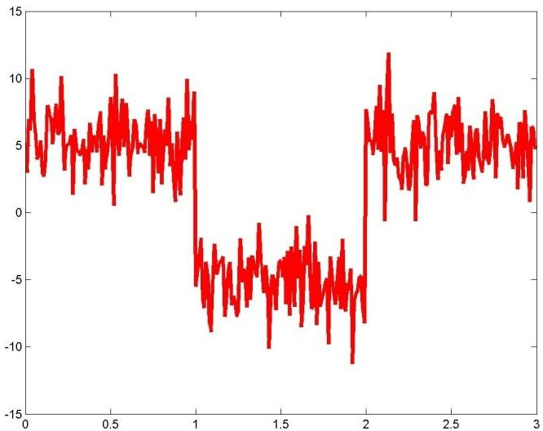
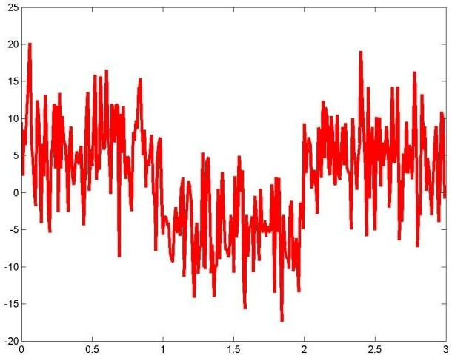
NOISE: SIGNAL TO NOISE RATIO
39
Signal to noise ratio (SNR):
the ratio of the signal power to the noise power at the receiver.
SNR = S/N, with S being the signal power, and N being the noise
power observed by the receiver.
High SNR ➔ Signal is strong, and noise is weak ➔ Better communication quality.
Improve SNR ➔ Improve Tx power ➔ More power consumption
High SNR
Low SNR

Slide 113
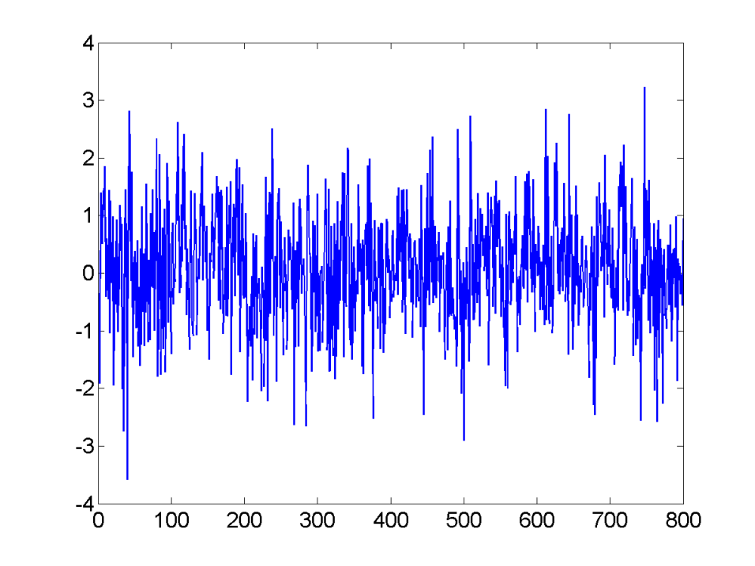
NOISE: THERMAL NOISE
41
Thermal noise is a random process
At any time instant, the random voltage due to thermal noise follows Gaussian distribution with zero mean.
The random voltage is caused by the sum of the motions of a large number of electrons (central limit theorem).
The noise samples at any two different time instants are uncorrelated. Auto- correlation function
R (τ ) = E[n(t)n (t −τ )]=
N
δ (τ )
*
0
x
2

Slide 114
42
NOISE: THERMAL NOISE
Power spectral density
– Fourier transform of autocorrelation function
+∞ N
N
S ( f ) =
∫−∞
⁰ δ (τ )e^{− j 2πfτ} dτ =
0
x
2
2
R_{X} (τ )
S_{X} [ f ]
N0/2
N0/2
τ
f
white spectrum
Additive White Gaussian Noise (AWGN)

Slide 115
NOISE: COCHANNEL INTERFERENCE
43
Cochannel interference (CCI)
Due to frequency reuse, cells using the same frequency range will
generate interference with each other.
Unique to cellular system.

Slide 116
3
CHAPTER 4: Capacity of Wireless Channels

Slide 117
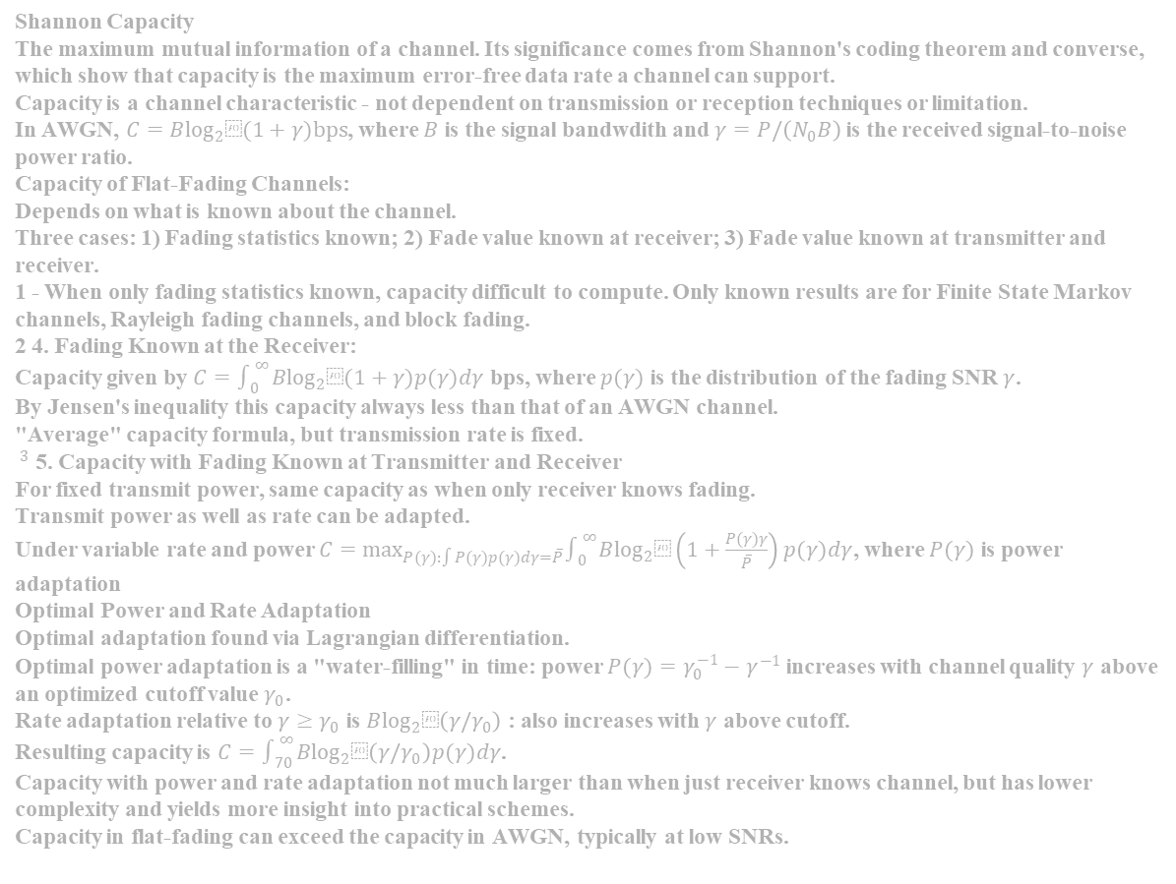
Shannon Capacity
The maximum mutual information of a channel. Its significance comes from Shannon's coding theorem and converse, which show that capacity is the maximum error-free data rate a channel can support.
Capacity is a channel characteristic - not dependent on transmission or reception techniques or limitation.
In AWGN, $C=B\log_{2}⁡(1+γ)bps$, where $B$ is the signal bandwdith and $γ=P/\left(N_{0}B\right)$ is the received signal-to-noise power ratio.
Capacity of Flat-Fading Channels:
Depends on what is known about the channel.
Three cases: 1) Fading statistics known; 2) Fade value known at receiver; 3) Fade value known at transmitter and receiver. 1 - When only fading statistics known, capacity difficult to compute. Only known results are for Finite State Markov channels, Rayleigh fading channels, and block fading. 2 4. Fading Known at the Receiver:
Capacity given by $C=∫_{0}^{∞} B\log_{2}⁡(1+γ)p(γ)dγ$ bps, where $p(γ)$ is the distribution of the fading SNR $γ$.
By Jensen's inequality this capacity always less than that of an AWGN channel.
"Average" capacity formula, but transmission rate is fixed. $^{3}$ 5. Capacity with Fading Known at Transmitter and Receiver
For fixed transmit power, same capacity as when only receiver knows fading.
Transmit power as well as rate can be adapted.
Under variable rate and power $C=\max_{P(γ):∫P(γ)p(γ)dγ=\overset{‾}{P}} ∫_{0}^{∞} B\log_{2}⁡\left(1+\frac{P(γ)γ}{\overset{‾}{P}}\right)p(γ)dγ$, where $P(γ)$ is power adaptation
Optimal Power and Rate Adaptation
Optimal adaptation found via Lagrangian differentiation.
Optimal power adaptation is a "water-filling" in time: power $P(γ)=γ_{0}^{−1}−γ^{−1}$ increases with channel quality $γ$ above an optimized cutoff value $γ_{0}$.
Rate adaptation relative to $γ≥γ_{0}$ is $B\log_{2}⁡\left(γ/γ_{0}\right)$ : also increases with $γ$ above cutoff.
Resulting capacity is $C=∫_{70}^{∞} B\log_{2}⁡\left(γ/γ_{0}\right)p(γ)dγ$.
Capacity with power and rate adaptation not much larger than when just receiver knows channel, but has lower complexity and yields more insight into practical schemes.
Capacity in flat-fading can exceed the capacity in AWGN, typically at low SNRs.

Slide 122
3
CHAPTER 5: Digital Modulation and Detection

Slide 123
OUTLINE
2
Modulation
Linear Modulation I
Complex Signal Representation
Pulse Shaping
Linear Modulation II
Non-linear Modulation
FDMA

Slide 124
3
MODULATION: DEFINITION
What is modulation?
The process of modifying a carrier signal (usually a sinusoid) in accordance with an information-bearing signal (modulating signal), such that the modified carrier signal (modulated signal) can be used to convey information.
Carrier signal:
c(t) = A_{c} sin(2πf_{c}t +θ )
Three parameters: amplitude, frequency, phase
One or all of them can be modified to carry information.
– E.g. the amplitude is modified to carry information m(t)
s(t) = m(t)A_{c} sin(2πf_{c}t +θ )
m(t)
Modulator
s(t)

Slide 125
MODULATION: DEFINITION
4
What is modulation? (cont’d)
Modulating signal m(t)
Original electrical information-bearing signal
E.g. electrical waveform representing voice, ASCII, digital video, etc.
Usually at low frequency
Also called baseband signal
Carrier signal c(t)
High frequency sinusoid to carry the information.
Modulated signal s(t)
Carrier signal modified by modulating signal
At the output of the modulator.
Also called bandpass signal, or RF signal
m(t)
Modulator
s(t)
c(t)

Slide 126
MODULATION: WHY?
5
Why modulation?
Shift the frequency of the message signal to the pre-allocated channel.
For example:
speech signal: 300 ~ 3100 Hz m(t)
Shift the signal to the allocated frequency range: 900MHz c(t)
Transfer the message into a form more suitable for wireless
transmission.
Limited bandwidth
Make better use of the limited spectrum
High frequency signals are more suitable for wireless transmission.
Enables multiple access
Signals from different users can be shifted to different frequencies.
Modulation allows the simultaneous transmission of multiple users.

Slide 127
MODULATION: TERMS
6
Demodulation
Recover the original message signal m(t) from the modulated signal s(t).
Modulator
Device used to perform modulation
Demodulator
Device used to perform demodulation.
s(t) r(t)
m(t)
mˆ (t)
Modulator
Demodulator
r(t): modulated signal impaired by fading and noise.

Slide 128
MODULATION: CLASSIFICATIONS
7
Linear modulation v.s. non-linear modulation
Analog modulation v.s. Digital modulation
Amplitude modulation v.s. Angle modulation

Slide 129
8
MODULATION: LINEAR V.S. NON-LINEAR
Principle of superposition
mi(t)
si(t)
Modulator
If input is m₁ (t) + m₂ (t) , then output is
If input is a ⋅ m₁ (t) , then output is a ⋅ s₁ (t)
s₁ (t) + s₂ (t)
If the input-output of the modulator satisfies principle of superposition, then the modulator is called linear modulator.
– E.g.
s(t) = m(t)A_{c} sin(2πf_{c}t +θ )
If the principle of superposition is not satisfied, the modulator is
non-linear modulator.

Slide 130
MODULATION: ANALOG V.S. DIGITAL
9
Analog modulation
m(t) is an analog signal
m(t) is a continuous function of time t.
m(t) can take infinite number of values
Analog modulation is also called continuous-wave (CW) modulation.
AM radio, FM radio, first generation cell phone system
Digital modulation
m(t) is a digital signal
Take finite number of values
E.g. {-1, 1}, {-2, -1, 1, 2}, …
2nd generation cell phone system
Digital modulation systems have become more and more popular.

Slide 131
MODULATION: AMPLITUDE V.S. ANGLE
10
Amplitude modulation
The amplitude of the carrier, A_{c} , is modified by the message
signal m(t).
Angle modulation
The angle of the carrier is modified by the message signal m(t).
ψ (t) = 2πf_{c}t +θ
Frequency modulation: frequency is modified by m(t).
Phase modulation: phase is modified by m(t)

Slide 132
OUTLINE
11
Modulation
Linear Modulation Techniques I
Complex Signal Representation
Pulse Shaping
Linear Modulation Techniques II
Non-linear modulation
FDMA

Slide 133
LINEAR MODULATION: AM
12
Amplitude modulation (AM)
– The term, AM, is usually used when m(t) is analog
s(t) = A_{c}m(t) cos(2πf_{c}t)
message signal
carrier frequency
Spectrum of AM
–
m(t) M ( f )
➔
A
[δ ( f − f ) + δ ( f + f )]
–
A_{c} cos(2πf_{c}t) ➔
c
2
c
c
– s(t) ➔ S(f) = ?

Slide 134
LINEAR MODULATION: AM
13
Spectrum of AM
M(f)
Baseband signal
0
W
f
-W
S(f)
bandpass signal
f
− f_{c} −W
− f_{c}
− f_{c} +W
f_{c} −W
f_{c} f_{c} +W
Center frequency shifted from 0 to
The bandwidth is doubled from W to 2W
f_{c}

Slide 135


LINEAR MODULATION: AM
14
Bandwidth
Baseband bandwidth (bandwidth of baseband signal): from 0 to W
Passband bandwidth (bandwidth of modulated signal): from Fc-W to Fc+W.
Passband bandwidth is twice of baseband bandwidth.
How do we define bandwidth?
There are many different definitions of bandwidth
B’: half power bandwidth (3dB bandwidth).
B’’: null-to-null bandwidth
B’’’: absolute bandwidth
FCC definition: bandwidth contains 99% of signal power
1
B’
0.5
f
power spectrum
f_{c}
B” B”’

Slide 136
LINEAR MODULATION: BPSK
15
Binary phase shift keying (BPSK) ➔ Digital modulation
A_{c} cos(2πf_{c}t)
for binary 1
for binary 0
s(t) = ⎧
⎨A cos(2πf t + π )
⎩ c c
– Or alternatively
_{s(t) =} ⎧ A_{c} cos(2πf_{c}t)
for binary 1
for binary 0
⎨− A cos(2πf t)
⎩ c c
– Also called binary amplitude shift keying (BASK)

Slide 137
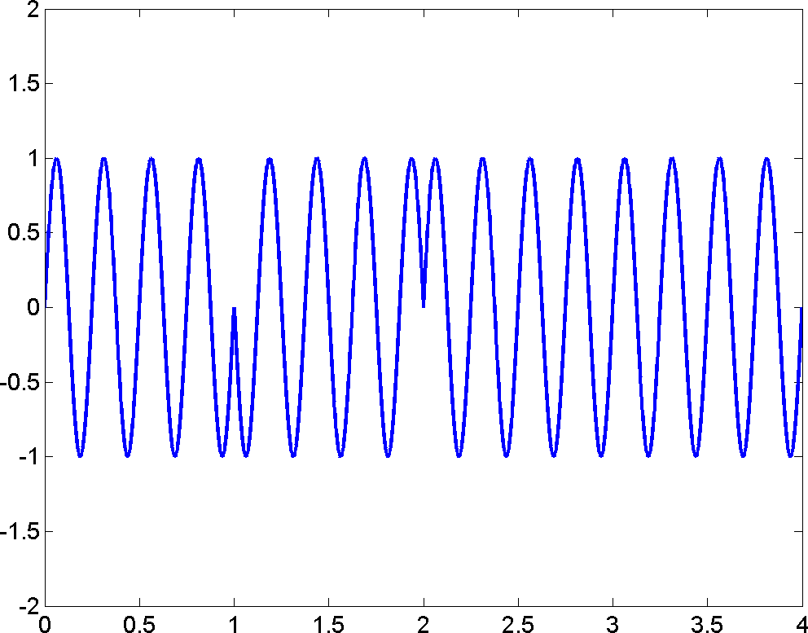
LINEAR MODULATION: BPSK
16
s(t)
1
0
1
1
1
m(t)
-1
s(t) = m(t) ⋅sin(2πf_{c}t)

Slide 138
17
LINEAR MODULATION: BPSK
m(t) = ∑b_{k} p(t − kT_{s} )
k =1
∞
0 ≤ t ≤ T
⎩0 o.w.
b = ^{⎧ 1}
p(t) = ^{⎧1}
⎨
k
⎨−1
⎩
p(t)
p(t-kTs)
0 Ts
kTs
(k+1)Ts
Ts: symbol period. (The time duration to carry one symbol)
usually inverse proportional to signal BW

Slide 139
LINEAR MODULATION: MASK
18
M-ary amplitude shift keying (MASK)
– The information can take
M = 2^{n}
values
m(t) = ∑m_{k} p(t − kT_{s} )
k =1
∞
0 ≤ t ≤ T
⎩0 o.w.
m_{k} ={s₁, s₂ ,☹, s_{M} }
p(t) = ^{⎧1}
⎨
E.g. 4-ary amplitude shift keying (4ASK)
m_{k} = {−3,−1,1,3}

Slide 140
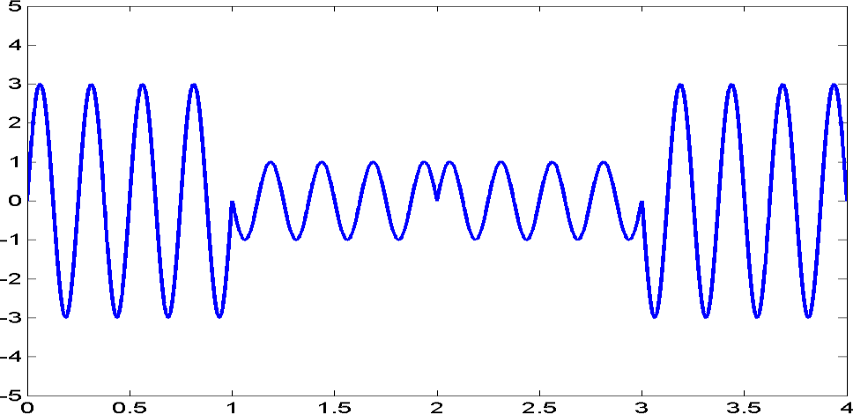
LINEAR MODULATION: MASK
19
s(t)
3
(00)
-1
1
-3
3
(10)
1
m(t)
-1
-3
(11)
(01)

Slide 141
LINEAR MODULATION: MASK
20
Each symbol can take M values
➔Each symbol can represent n = log₂ M bits of information.
E.g.
4ASK ➔ M = 4 ➔ 2 bits/sym
8ASK ➔ M = 8 ➔ 3 bits/sym
16ASK ➔ M = 16 ➔ 4 bits/sym
Symbol rate (baud) Rs :
# of modulation symbols/second
Generally, signal bandwidth is proportional to symbol rate!
Bit rate Rb:
Bits/second
Rb = Rs x (# of bits/sym)

Slide 142
LINEAR MODULATION: MASK
21
M-ary modulation
At the same symbol rate, (or fixed bandwidth)
Larger M ➔ more bits/symbol ➔ larger bit rate
M-ary modulation is good for band-limited system
In wireless systems, spectrum is precious
M-ary modulation is widely used in wireless systems!
Typical values used in wireless system: M = 2, 4, 8, 16
Why don’t we use a very large M?
If M ➔ infinity, then analog signal
At the same SNR
Larger M ➔ signals are more closed to each other ➔ it’s harder to distinguish between all signals at receiver due to noise ➔ probability of error becomes larger!

Slide 143
22
LINEAR MODULATION: QPSK
Quadrature phase shift keying (QPSK)
Combination of two BPSK streams
Quadrature: orthogonal (two carriers that are 90 degree apart)
m₁ (t)
s(t)
A_{c} cos(2πf_{c}t)
m₂ (t)
A_{c} sin(2πf_{c}t)
s(t) = A_{c}m₁ (t) cos(2πf_{c}t) + A_{c}m₂ (t)sin(2πf_{c}t)
Inphase signal
quadrature signal

Slide 144
23
LINEAR MODULATION: QPSK
Demodulator
– How could these two signals not interfere with each other?
m₁ (t)
low pass filter
s(t)
A_{c} cos(2πf_{c}t)
m₂ (t)
low pass filter
A_{c} sin(2πf_{c}t)
s(t) cos(2π
f t) =
2
πf t) +
πf t) cos(2
πf t)
A m (t) cos (2
A m (t)sin(2
c
c 1
c
c 2
c
c
A
A
A
=
c
m (t) +
c
m (t) cos(4
πf t) +
c
m (t) sin(4
πf t)
2
1
2
1
c
2
2
c
A
After low pass filter:
c
m (t)
2
1

Slide 145
LINEAR MODULATION: QPSK
24
At each symbol period, two bits of information are transmitted
2 bits/symbol
Inphase signal s_{I} (t) = A_{c}m₁ (t) cos(2πf_{c}t) has the same bandwidth as BPSK
Quadrature signal s_{Q} (t) = A_{c}m₁ (t) sin(2πf_{c}t) has the same bandwidth as BPSK
The sum has the same bandwidth as BPSK
s(t) = s_{I} (t) + s_{Q} (t)
Sum in time domain ➔ sum in frequency domain ➔ bandwidth unchanged.
The same bandwidth as BPSK, but twice the bit rate of BPSK!
No interference between quadrature and inphase
Inphase has the same error performance as BPSK
Quadrature has the same error performance as BPSK
QPSK has the same error performance of BPSK!
One of the rare occasions that increase bit rate without sacrificing error performance!

Slide 146
OUTLINE
25
Modulation
Linear Modulation Techniques I
Complex Signal Representation
Pulse Shaping
Linear Modulation Techniques II
Non-linear modulation
FDMA

Slide 147
26
COMPLEX REPRESENTATION
Band-pass signal
s(t) = s_{I} (t) cos(2πf_{c}t) − s_{Q} (t)sin(2πf_{c}t)
Complex base-band signal (also called the complex envelope of the
signal)
~s (t) = s (t) + js (t)
I Q
Relationship between complex baseband and band-pass
s(t) = Re{~s (t) exp( j2πf_{c}t)}

Slide 148
COMPLEX REPRESENTATION
27
Modulation can be decomposed into two steps:
1. complex baseband modulation, 2. frequency upconversion
The complex representation completely preserves the information of the modulating signal except the carrier frequency
It’s suffice for us to examine baseband modulation only!
s(t) = Re{~s (t) exp( j2πf_{c}t)}
Baseband
modulation
Frequency
upconversion
Modulation

Slide 149
28
COMPLEX REPRESENTATION: BASEBAND MODULATION
BPSK
s_{I} (t) ∈{−1,1}
s_{Q} (t) = 0
~s (t) ∈{−1,1}
(M = 2)
QPSK
s (t) ∈{−1,1}
s_{Q} (t) ∈{−1,1}
I
~s (t) ∈{−1− j,−1+ j,1− j,1+ j}
(M = 4)
Baseband
modulation
Frequency
upconversion
Modulation

Slide 150
29
COMPLEX REPRESENTATION: CONSTELLATION
Modulation Constellation
The collection of all modulation symbols in their complex representation.
E_{s} : the energy of one symbol
Im
Im
01
00
0
1
E_{s}
Re
Re
− E_{s}
E_{s}
10
11
BPSK
QPSK
⎧
π
⎛
3π ⎞ ⎫
{ E_{s} exp( j0),
E_{s} exp( jπ )}
⎪
E_{s} exp( j ),
E_{s} exp ⎜ j
⎟, ⎪
~
4
5π
4
⎝ 4 ⎠ ⎪
s (t) ∈
~s (t) ∈ ⎨
⎪
⎛
7π ⎞⎬
E_{s} exp( j
), E_{s} exp ⎜ j
⎟⎪
⎪
⎝
4 ⎠⎪⎭
⎩

Slide 151
COMPLEX REPRESENTATION
30
Baseband modulation examples
Im
Im
01
00
0
1
E
s
Re
− E_{s}
E_{s}
Re
10
11
BPSK
0010110111
BPSK:
QPSK:

Slide 152
31
COMPLEX REPRESENTATION: SYMBOL ENERGY
Symbol energy Es
– If modulation symbol is
~s (t) =
E_{s} exp[ jθ (t)]
The energy of one symbol is E_{s}
Proof:
.
Bit energy Eb
The energy of one bit
# of bits per symbol:
log₂ M
E_{b} = E_{s} / log₂ M

Slide 153
COMPLEX REPRESENTATION
32
Signals pass through channel with flat fading and AWGN
h
~
h (t) = h (t) + jh (t)
: time-varying flat fading
I Q
n~(t) = n (t) + jn (t)
I Q
: AWGN
Both the inphase component and quadrature component are going to be distorted.

Slide 154
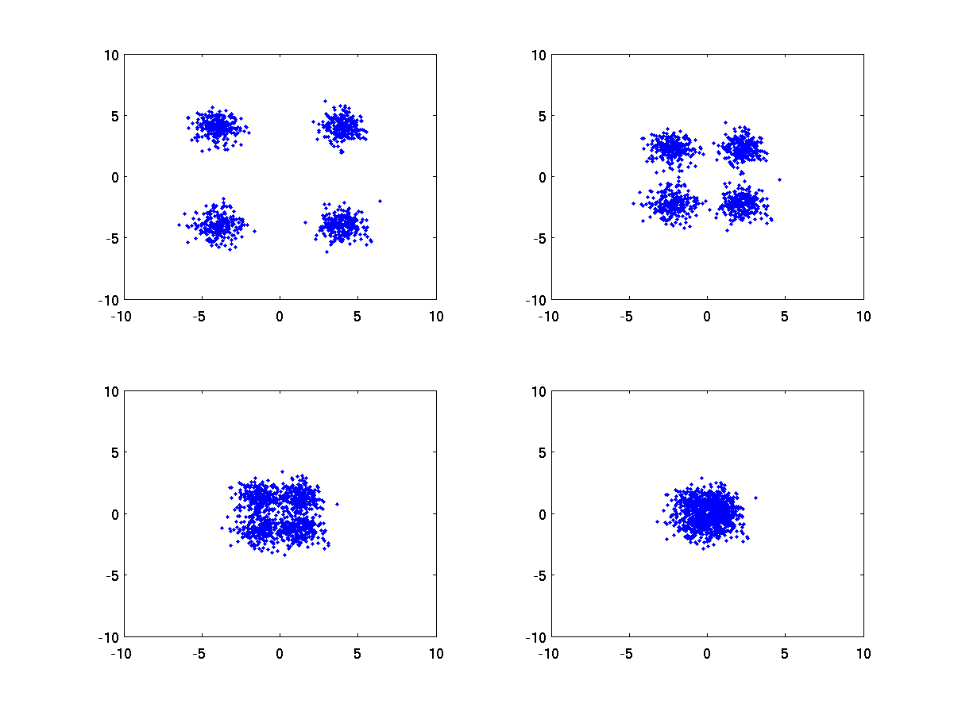
COMPLEX REPRESENTATION: SNR
33
Signal to noise ratio (SNR)
The ratio between signal power and noise power
E.g. same level of noise, signal power becomes smaller
SNR=15dB
SNR=10dB
SNR=5dB
SNR=0dB
QPSK:
~y(t) = ~s (t) + n~(t)

Slide 155
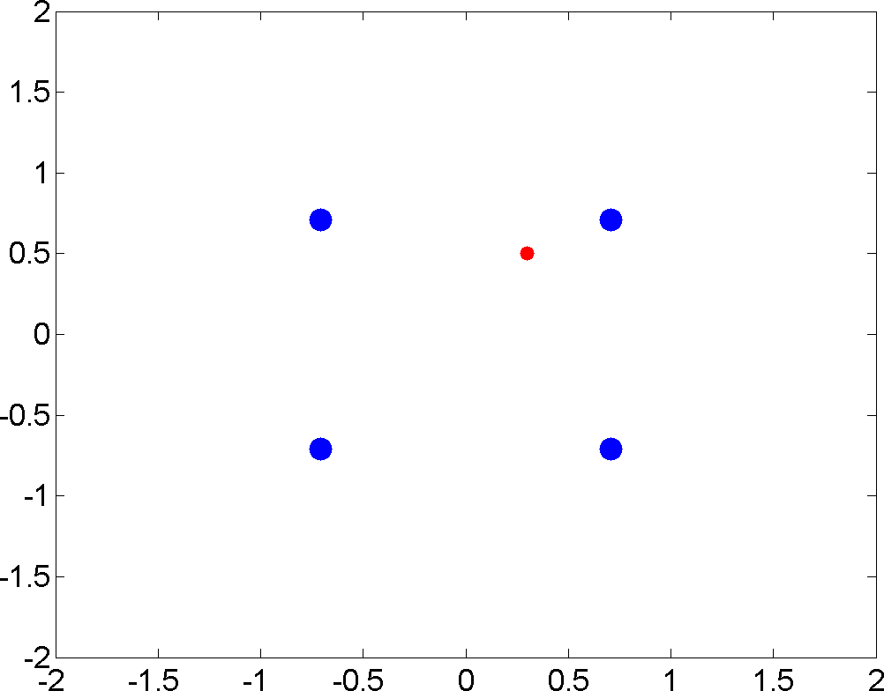
COMPLEX REPRESENTATION: SNR
34
Baseband demodulation
Find the modulation symbol that has the smallest Euclidean distance with the
received signal.
E.g. QPSK: r = x + n
r = 0.3 + j 0.5
Im
| 0.3 + j0.5 − exp( jπ / 4) |² = 0.2086
| 0.3 + j0.5 − exp( j3π / 4) |² = 1.0572
| 0.3 + j0.5 − exp( j5π / 4) |² = 2.4714
Re
| 0.3 + j0.5 − exp( j7π / 4) |² = 1.6228

Slide 156
COMPLEX REPRESENTATION: SNR
35
SNR
– The ratio between signal power and noise power
P_{s} E_{s} / T_{s}
Symbol period
SNR =
=
P_{n} N₀ B
Power spectral density of noise
Signal bandwidth
Symbol rate Rs = 1/Ts
Bit rate Rb
⋅ R_{s =} E_{b ⋅} R_{s} log₂ M ₌ E_{b ⋅} R_{b}
SNR = ^{Es}
N₀ B N₀ B N₀ B

Slide 157
COMPLEX: BANDWIDTH EFFICIENCY
36
Bandwidth efficiency
– How many bits can be accommodated in unit bandwidth (bps/Hz)
R
bit rate
_{ηB =} b
B
bandwidth
Measures the ability of the modulation technique to accommodate data in a limited bandwidth
Larger bandwidth efficiency ➔ more data can be transferred in limited bandwidth
Generally, the bandwidth is proportional to symbol rate
B ∝ R_{s}
For M-ary modulation, fixed bandwidth B ➔ fixed symbol rate R_{s}
Larger M ➔ larger R_{b} = R_{s} log₂ M ➔ larger bandwidth efficiency

Slide 158

COMPLEX: ENERGY EFFICIENCY
37
Energy efficiency
At given noise level, how much energy is required to achieve a
certain bit error rate.
Measured as the value of Eb/N0 required for certain bit error rate (BER).
Eb: energy per bit. N0: noise power spectral density.
BER v.s. Eb/N0 is the most important
measure of digital communication systems!
BER
Eb/N0 (dB)

Slide 159
OUTLINE
38
Modulation
Linear Modulation Techniques I
Complex Signal Representation
Pulse Shaping
Linear Modulation Techniques II
Non-linear modulation
FDMA

Slide 160

PULSE SHAPING
39
Why pulse shaping?
– In previous discussions, the message m(t) is represented as a series
rectangular pulses.
0 ≤ t ≤ T
∞
∑ k s
p(t) = ^{⎧1}
m(t) = m p(t − kT )
⎨
k =1
⎩0 o.w.
1 0
1
1
1
m(t)
-1
– Rectangular pulse has unlimited bandwidth!
t
f
Fourier Transform

Slide 161
PULSE SHAPING
40
Why pulse shaping? (Cont’d)
Baseband signal has unlimited bandwidth.
Spectrum of pass-band signal is shifted from baseband signal.
Thus, pass-band signal has unlimited bandwidth.
In wireless channel, only limited bandwidth resource is available!
We want to choose a non-rectangular pulse shape that is limited in
bandwidth!
Baseband
Modulation
Pulse shaping
Frequency Upconversion

Slide 162

PULSE SHAPING
41
Sampling rate Ts
Tx filter
Channel
Rx filter
p_{T} (t) = 1
p_{R} (t) = 1
Continuous time waveform
Discrete time samples
Nyquist criterion
– Design the overall response of Tx filter and Rx filter,
p(t) = p_{T} (t) ⊗ p_{R} (t)
such that
p(0) = 1 , and
p(nT_{s} ) = 1 n ≠ 0
– Avoid one symbol interferes with other symbols (Intersymbol interference)
1 1
-1

Slide 163

PULSE SHAPING
42
1
1
-1
1
1
Waveform at Rx

Slide 164


PULSE SHAPING
43
Raised cosine (RC) pulse
⎛ πt ⎞
⎛ παt ⎞
sin⎜ ⎟ cos⎜ ⎟
T T
_{p(t) =} ⎝ s ⎠ ⋅ ⎝ s ⎠
P_{RC} ( f )
πt T
⎛ 4αt ⎞²
1− ⎜ ⎟
2T
s
⎝ ⎠
s
BW = (1+α )R_{s}
Time (Ts)
Satisfy Nyquist criterion
α / 2
Frequency (Rs)
α :
Roll-off factor

Slide 165
44
PULSE SHAPING
Root raised cosine (RRC) pulse
– The frequency domain response of RRC filter is the square root of the
frequency response of RC filter
P_{RRC} ( f ) = P_{RC} ( f )
– RRC filter has the same bandwidth as RC filter
The overall response is RC filter
– Satisfy Nyquist criterion
x(n)
P_{RRC} ( f )
Channel
P_{RRC} ( f )
xˆ(n)
^{P}overall^{( f ) =}
P_{RC} ( f ) ×
P_{RC} ( f ) = P_{RC} ( f )

Slide 166
45
PULSE SHAPING
Root Raised Cosine (RRC)
cos[
(1+ α )
πtR ]+ sin[
(1−α )
πtR ](4αtR )
−1
p(t) = 4α
s
s
s
π T [ α t R ]
1−16
2 2 2
s
s
RRC filter is used at both Tx and Rx
Overall response is Raised Cosine
Signal bandwidth is (1+ α )R_{s}
Symbol rate:
R_{s} = 1/ T_{s}
Signal bandwidth is proportional to symbol rate

Slide 167
OUTLINE
46
Modulation
Linear Modulation Techniques I
Complex Signal Representation
Pulse Shaping
Linear Modulation Techniques II
Non-linear modulation
FDMA

Slide 168

LINEAR MODULATION II: 16-QAM
47
16 Quadrature amplitude modulation (16QAM)
Inphase: 4 amplitude shift keying
Quadrature: 4 amplitude shift keying
s(t) = s_{I} (t) cos(2πf_{c}t) − s_{Q} (t) sin(2πf_{c}t)
~s (t) = s (t) + j ⋅ s (t)
I Q
s (t) ∈{−3,−1,1,3}
s_{Q} (t) ∈{−3,−1,1,3}
I
16-QAM symbols
 |  | Im
0010 | 0110 | 1110 | 1010
0011 | 0111 | 1111 | 1011
0001 | 0101 | 1101 | 1001
0000 | 0100 | 1100 | 1000
Total 4 x 4 = 16 possible combinations.
M = 16 ➔ bits/sym
log M = 4
Gray mapping
2
Two adjacent symbols differ only in 1 bit
The most common error is that the receiver decide in favor of the neighbor of the correct symbol.
With Gray mapping, only 1 bit error.
Re

Slide 169

LINEAR MODULATION II: OQPSK
48
Offset quadrature phase shift keying (OQPSK)
– Motivation:
QPSK ( π / 4 , 3π / 4 , 5π / 4 , 7π / 4 )
00 10 01 11 ➔ π / 4 , 7π / 4 , 3π / 4 , 5π / 4
Rapid phase change ( e.g. 7π / 4 ➔ 3π / 4 ) could result in amplitude fluctuation ➔ carries
(01)
(00)
(11)
(10)
information in amplitude ➔ high requirement in amplifier
➔ increase error in wireless communication systems.
We want to avoid phase change of
π
– Avoid two bits (inphase, quadrature) change at the same time !
– OQPSK: Delay the quadrature component by half symbol period such that the
inphase bit and quadrature bit don’t change at the same time.

Slide 170
LINEAR MODULATOIN II: OQPSK
49
QPSK
OQPSK
OQPSK
Delay the quadrature component by half symbol period
It’s guaranteed at any moment, only one bit is changing
The phase shift of π is completely avoided!
~s (t) = s (t) + j ⋅ s (t −T / 2)
I Q s
Disadvantage: phase change every Ts/2 ➔ larger bandwidth
BPSK
× j
BPSK
Delay Ts/2

Slide 171
50
LINEAR MODULATION II: MPSK
Multi-ary Phase Shift Keying (MPSK)
– Phase modulation: use phase to carry information.
m(t) ∈{0,1,☹, M −1}
~s (t) = E exp ⎛− j2π ^{m(t)} +θ ⎞
s
⎜ ₀ ⎟
⎝
M
⎠
θ = ^{π} m(t) ∈{0,1,2,3}
M = 4: QPSK.
0
4
~s (t) = ⎧ E exp ⎛− j ^{π ⎞}
⎛_{− j} 3π ⎞ ⎛_{− j} 5π ⎞
⎛_{− j} 7π ⎞ ⎫
⎨
s
⎜
₄ ⎟, E_{s} exp ⎜ ₄ ⎟, E_{s} exp ⎜ ₄ ⎟,
E_{s} exp ⎜ ₄ ⎟,⎬
⎩
⎝
⎠
θ₀ = 0
⎝
⎠
⎝
⎠
⎝
⎠ ⎭
M = 8: 8PSK.
– 3 bits/sym
010
000
110
100
111
QPSK
101
011
8PSK
001

Slide 172
LINEAR MODULATION II: MPSK
51
MPSK demodulation
– Find the modulation symbol that has the smallest Euclidean
distance with the received signal.
010
000
110
π
8
100
111
011
₋ π
8
101
001

Slide 173
LINEAR MODULATION II: MPSK
52
Tradeoff between spectral efficiency and energy efficiency
Spectral efficiency: data rate that is accommodated in unit bandwidth
(bps/Hz) = data rate/bandwidth
Given fixed bandwidth ➔ fixed symbol rate
Large M ➔ large # bits/sym ➔ large data rate ➔ large spectral efficiency
Energy efficiency: at given noise level, how much signal power is required to achieve a certain bit error rate.
Measured as the value of Eb/N0 required for certain bit error rate (BER).
Given fixed bandwidth ➔ fixed symbol rate
Large M ➔ constellation symbols are more “dense” ➔ more sensitive to noise ➔ low energy efficiency
Increase modulation level M ➔ Increase spectral efficiency
Increase modulation level M ➔ Decrease energy efficiency

Slide 174
OUTLINE
53
Modulation
Linear Modulation Techniques I
Pulse Shaping
Complex Signal Representation
Linear Modulation Techniques II
Non-linear modulation
FDMA

Slide 175
54
NON-LINEAR MODULATION: FREQUENCY MODULATION
Frequency modulation (FM)
The term, FM, is usually used when m(t) is analog
E.g. FM radio
Use frequency to carry information
f (t) = f_{c} + k _{f} m(t)
Relationship between phase and frequency
Fixed frequency
ψ (t) = 2πf_{c}t +θ
Variable frequency
_{f (t) =} 1 dψ (t)
ψ (t) =
∫
t
2π f (t)dt
2π dt
0
– FM
ψ (t) = 2πf t + k
∫
t
m(t)dt
0
c
f

Slide 176

55
NON-LINEAR MODULATION: FREQUENCY MODULATION
FM
s(t) = A cos⎡2πf t + k
∫
m(t)dt⎤
t
c
⎢⎣
c
f
0
⎥⎦

Slide 177
56
NON-LINEAR MODULATION: FREQUENCY MODULATION
FM bandwidth
The spectrum of FM is much more complicated than the spectrum of AM
Pass-band Bandwidth of FM signal can be approximated by Carson’s rule.
B_{T} ≈ 2(β +1)B_{s}
β :modulation index.
B_{s} :Bandwidth of baseband signal
E.g.
– AMPS,
β = 3, B_{s} = 4kHz
– Bandwidth: 32 KHz

Slide 178

57
NON-LINEAR MODULATION: BFSK
Binary frequency shift keying (BFSK)
– Constant envelope
⎧A_{c} sin[2π ( f_{c} − Δf )t], 0
+ Δf )t], 1
^{s(t) = ⎨}A sin[2π ( f
⎩ c c
If continuous phase (CP) ➔
CP FSK ➔
No abrupt phase change!
0
1
0

Slide 179
58
NON-LINEAR MODULATION: MSK
Minimum shift keying (MSK)
– A special case of CP BFSK
⎧
⎪ c
⎡
⎛
R_{s} ⎞ ⎤
A sin 2
π f −
t
⎢
⎜
⎟
⎥
c
, 0
₊ R_{s} ⎞ ⎤ , 1
⎣
⎝
4
⎠ ⎦
s(t) = ⎨
⎪A sin⎡2π ⎛ f
₄ ⎟t⎥
⎢
⎜
⎪⎩
c
⎣
⎝
c
⎠ ⎦
– CP BFSK with
Advantages:
Δf = ^{Rs}
4
bandwidth much smaller than BPSK/QPSK
Constant envelope
Very popular modulation scheme for mobile radio
Usually used with Gaussian pulse shaping filter
– GMSK (used by GSM)

Slide 180
NON-LINEAR MODULATION: PRACTICAL ISSUE
59
Power amplifier non-linearity
Power amplifier: amplify signal power before transmission
To meet the SNR requirement at receiver.
Amplifier categories: Class A, Class B, Class AB, Class C, Class D
Class A: linear amplifier
Signals amplitude at the operational range is amplified linearly.
The information in amplitude is preserved.
Should be used for amplitude modulation.
Requires more transmission power ➔ short battery life.
Class C: non-linear amplifier
Different amplitude range are amplified by different factors
The amplitude of the signals is distorted.
CANNOT be used for amplitude modulated systems. CAN be used for frequency modulated systems.
Requires less transmission power ➔ longer battery life
From A to B to C to D, linearity becomes worse.

Slide 181
OUTLINE
60
Modulation
Linear Modulation Techniques I
Pulse Shaping
Complex Signal Representation
Linear Modulation Techniques II
Non-linear modulation
FDMA

Slide 182
FDMA
61
Frequency division multiple access (FDMA)
Available spectrum is divided into a set of frequency bands, and each
frequency band is assigned to a user
FDMA is not FDD
FDD: frequency division duplex
The downlink and uplink of one user is using different frequencies.
Example: AMPS
FDMA
Analog voice: FM
Digital control: BFSK (one frequency for ‘0’, one frequency for ‘1’).

Slide 183
FDMA: ACI
62
Adjacent Channel Interference (ACI)
Interference from adjacent channels.
For some modulations (FM, FSK), the modulated signal has unlimited bandwidth.
The signal in one channel will leak into adjacent channels.
To reduce ACI, introduce some guard bands between adjacent
channels.
To improve overall bandwidth efficiency, we want to have as many channel as possible in a limited spectrum.
Tradeoff between bandwidth efficiency and power efficiency.

Slide 184
ELEG 5693 Wireless Communications
Ch 4. Coding
Department of Electrical Engineering
University of Arkansas
Dr. Jingxian Wu
wuj@uark.edu

Slide 185
OUTLINE
2
Introduction
Source Coding
Channel Coding: Convolutional Code
Interleaving

Slide 186
INTRODUCTION
3
Coding
Source coding
Convert analog information into digital representation
Reduce the redundancy in the digital signal (compression)
Channel coding
Protect the information from channel distortions by adding
redundancy.
Cyclic Redundancy Check (CRC), Linear Block Code, Convolutional Code (CC), Turbo Code, Low Density Parity Check (LDPC), etc.
Coding can only be used in digital communication systems.
Analog or digital information
Source
Coding
Channel Coding

Slide 187
OUTLINE
4
Introduction
Source Coding
Channel Coding: Linear Block Code
Channel Coding: Convolutional Code
Interleaving

Slide 188
SOURCE CODE
5
Why source code?
Convert analog signal into digital signal
Sampling and quantization, speech coding.
Reduce redundancy in digital signal representation (compression)
To save bandwidth ➔ improve bandwidth efficiency.
E.g. Winzip
Source code can be classified into two categories
Lossless source code
No information is lost during compression
The original information can be perfectly recovered from the
compressed information.
Source code with loss
Some information is lost during compression
The original information cannot be perfectly recovered after compression.
Analog to digital conversion, JPEG, MPEG.

Slide 189
SOURCE CODE: SAMPLING
6
Sampling and quantization
Convert analog information bearing signal to digital signal without
significant loss of information.
Sampling theorem
A band-limited signal with highest frequency W Hertz can be completely recovered from its samples if the sampling rate Fs is higher than 2W Hertz.
Sampling in time-domain ➔ repetition in frequency domain.
-W
W
f
-Fs
-W
W
Fs
f
-Fs -W
W
Fs
f
Fs > 2W
Fs < 2W

Slide 190


SOURCE CODE: PCM
7
Pulse Code Modulation (PCM): sampling and quantization
Sampling: 8000 Samples/second (125 us/sample)
Bandwidth of speech signal in telephone system: 4KHz.
Quantization: represent each sample by 8-bit sequence (256 discrete levels)
Data rate: 8000 x 8 = 64 kbps
Sampling
64kbps used in wired telephone system: too high for wireless communication!
Quantization

Slide 191
SOURCE CODE: ENTROPY
8
There is redundancy in the representation of information.
Wirxlxss Commuxication (21 characters)
For efficient information transmission, we want reduce the redundancy
Given random data sequence, what is the maximum redundancy in the sequence?
OR: what is the minimum # of bits that can be used to represent the original data without loss of information at receiver?
OR: what is the maximum compression rate?
Entropy
Entropy: the minimum # of bits required to represent one symbol from an information source
H = ∑ p_{k} log₂ (1/ p_{k} )
k =0
K
(bit/sym)
– K: total # of possible symbols (e.g. 26 English characters) –
p_{k}
: the probability that the k-th character is generated by the source.

Slide 192
SOURCE CODE: ENTROPY
9
E.g. 1: two symbols: ‘0’, ‘1’
– p0 = 0.5, p1 = 0.5
H =
If there are 100 binary symbols, it can be represented with
bits.
E.g. 2: two symbols: ‘0’, ‘1’
– p0 = 0.9, p1 = 0.1
H =
If there are 100 symbols, they can be represented with
bits.
E.g. 3: two symbols: ‘0’, ‘1’
– p0 = 0, p1 = 1
H =
If there are 100 symbols, they can be represented with
bits.
E.g. 4: the entropy of English is 1.1 ~ 1.6
bits/character
26 characters log2(26) = 4.7 bits
Approximately 2/3 are redundant
If there are 100 English characters, they can be represented by 160 bits
Against: 470 bits

Slide 193
SOURCE CODE: SPEECH CODING
10
Speech coding
Convert analog speech signal into digital signal.
To reduce the bit rate R as much as possible.
R ↓ ➔ BW ↓ ➔ more users in limited spectrum
R ↓ ➔ voice quality ↓ (in general)
Tradeoff between bandwidth efficiency and voice quality.

Slide 194
SOURCE CODE: SPEECH CODING
11
Two basic speech coding schemes
Waveform coders:
Strive to reproduce time or frequency domain signal waveform as
precisely as possible.
Source independent
Moderate complexity and data rates (30 ~ 50 kbps)
e.g. PCM. Usually used in wired telephone system.
Vocoders (also called “source code”)
Analyze & extract key parameters using a priori knowledge of speech characteristics
Extract speech model parameters
Synthesize voice in Rx using model parameters
Signal specific parameters ➔ depends on user and is less robust
Produces very low data rates (~ 5−15 kbps)
Very complex & computationally intensive
Cellular & PCS applications where minimizing user BW → more users supported in finite spectrum → more $$

Slide 195
SOURCE CODE: SPEECH CODING
12
Vocoders
Model the speech generation process of vocal tract of human
Parameters of speech
Voice pitch ➔ difficult to extract, usually < 300 Hz
Pole frequencies ➔ resonant frequencies of vocal tract – Centered around: 500, 1500, 2500, 3500
Pole amplitudes ➔ relative strength at different pole frequencies
Speech type ➔ voiced or unvoiced
Voiced: “m”, “n”, “v” ➔ voice chord vibrations
Unvoiced: “f”, “s” ➔ air flow through constriction
These parameters are transmitted by the sender
Rx uses these parameters to synthesize the human speech
Very complicated, but low data rate: 5 ~ 13 kbps
Source dependent
Suitable for human speech, but not suitable to other sound (e.g. music)

Slide 196
SOURCE CODE: SPEECH CODING
13
Linear Predictive Coders (LPC)
A kind of time-domain vocoder
Extract the time domain parameters of signal.
Transmit the parameters of the signal instead of the actual waveform.
Linear predictive: predict the future value based on current values.
Time domain speech waveform: x = [x₁, x₂ ,☹, x_{N} ]
The current values and future values are correlated!
N
N +1 ∑ n n n=1
T
xˆ =
a x = a x
a = [a , a ,☹, a ]^{T}
1 2 N
x = [x , x ,☹, x ]^{T}
1 2 N
The coefficients a are calculated at Tx based on the statistical properties of x.
x is a random process.
Instead of transmitting x, transmit a!
How to calculate the coefficients? – choose a to minimize the mean square
error (MSE).

Slide 197
OUTLINE
14
Introduction
Source Coding
Channel Coding: Convolutional Code
Interleaving

Slide 198
CHANNEL CODING: OVERVIEW
15
Channel coding
Protect the transmitted information by adding redundancy.
E.g. repetition code:
‘0’: ‘000’
‘1’: ‘111’
Error detection
Include only enough redundant information such that the Rx can detect an error
by looking at the Rx data.
E.g. repeat ‘1’ 2 times. Tx (1 1), Rx (0 1) ➔ Receiver knows there is an error, but couldn’t guess what is transmitted
Send back Negative Acknowledgement (automatic-repeat request: ARQ)
Error correction
Include enough redundant information such that the Rx can recover the original information by looking at the Rx data.
E.g. repeat ‘1’ 3 times. Tx (1 1 1), Rx (0 1 1) ➔ Receiver will guess that (1
1 1) is transmitted ➔ detect ‘1’
Majority decision rule ➔ minimize the probability of error.

Slide 199
CHANNEL CODING: CHANNEL CAPACITY
16
For an AWGN channel with bandwidth B, the maximum data rate that can be supported by the channel is
C(bps) = B log₂ (1+ SNR)
Shannon’s coding theorem
– For a channel with capacity C bps and an information source generates information at a rate less than C, then there exists a channel coding technique such that the output of the source can be transmitted by the channel with arbitrarily low error rate.
Source
H < C
Channel coding
Channel Capacity C

Slide 200
CHANNEL CODING: LBC
17
Linear block code (LBC)
Every k bits of information corresponds to a codeword of length n bits
E.g. repetitionon code 1-bit of information, 3-bit codeword
n > k: there are (n-k) bits of redundancy
The code is called: (n, k) linear block code
Definition: code rate = (information block length)/(codeword length)
r = k/n
Measures the efficiency of the code (1-r: the percentage of redundancy)
E.g.: (3, 1) repetition code: r = 1/3. (2, 1) repetition code: r = 1/2.
k bits information
LBC
n bits codeword

Slide 201
CONVOLUTIONAL CODING
18
What is convolutional code (CC)
n-bit codeword depends on not only current input, but also previous input
The encoder has memory
linear block code: n-bit codeword determined uniquely by the k-bit information
Compared to linear block code
Can achieve larger d_{min} with higher coding rate.
– Better power efficiency with larger bandwidth efficiency
More complex than LBC
Parameters
(n, k, K)
Every k-bit input leads to n-bit output
Coding rate r = k/n
K: constraint length (related to memory depth of the encoder)

Slide 202
CC: ENCODER
19
Register representation
c1
r1 |  | r2 | r3
m
c2
m: current 1-bit input.
r1, r2, r3: contents in shift register. Depends on current input and previous input
r1 = m: current input
r2, r3: previous inputs
c1 and c2: 2-bit output. Depends on r1, r2, r3
c1 = r1 + r2 + r3
c2 = r1 + r3
– (n = 2, k = 1, K = 3)

Slide 203
CC: ENCODER
20
Example: m = [1 1 0 0], initially (r1=0, r2=0, r3=0)
1+1+0=0
1+0+0=1
1 |  | 1 | 0
1 |  | 0 | 0
1
1
1+0=1
1+0=1
second input bit: 1 (shift 1 bit to the right)
first input bit: 1
1+0+0=1
1+0+0=1
0 |  | 1 | 1
0 |  | 0 | 1
0
0
0+1=1
0+1=1
third input bit: 1
(shift 1 bit to the right)
fourth input bit: 1 (shift 1 bit to the right)

Slide 204
CC: ENCODER
21
State
Every input depends on current input r1=m, and previous inputs (r2, r3)
State: (r2, r3): state a: 00; state b: 10; state c: 01; state d: 11
Input-output table representation
Input | Current state (r2, r3) now | (r1, r2, r3) | Next state (r2, r3) after shift | Output (c1, c2)
0 | a (0 0) | 0 0 0 | a ( 0 0) | (0, 0)
0 | c (0 1) | 0 0 1 | a (0 0) | (1, 1)
0 | b (1 0)
0 | d (1 1)
1 | a (0 0)
1 | c (0 1)
1 | b (1 0)
1 | d (1 1)

Slide 205
CC: ENCODER
(n, k, K)
n = 2: 2-bit of output
k = 1: 1-bit of input
K = 3: output depends on current input, and two previous inputs
State:
Every output depends not only current input, but also (K – 1) = 2 previous inputs ➔ the encoder remembers the previous (K – 1) inputs ➔ the encoder has a memory depth of (K-1)
For a particular 1-bit of input, the encoder might be in one of 4
possible states ➔ there are four possible outputs
Output depends on:
1. current input
2. state of the encoder
22
– # of states:
₂( K −1)⋅k

Slide 206
CC: ENCODER
23
State transition representation
a: 00
b: 10
c: 01
d: 11
– (2, 1, 3)-CC, 2^{( K −1)⋅k}
= 4 states
0/00
a=00
1/11
0/11
input/output
1/00
b=10
c=01
0/10
d=11
: input 0
: input 1
1/01
0/01
1/10

Slide 207
CC: ENCODER
24
Example: encoding by using state transition diagram
Initial state: a
Input bits: (1 1 0 0 0 1 0)
1st bit: (state = a, input = 1) ➔ (next state = b, output = 11)
2nd bit: (state = b, input = 1) ➔ (next state = d, output = 01)
3rd bit: (state = d, input = 0) ➔ (next state = c, output = 01)
4th bit: (state = c, input = 0) ➔ (next state = a, output = 11)
5th bit: (state = a, input = 0) ➔
6th bit:
7th bit:

Slide 208
CC: ENCODER
25
Trellis diagram representation
a: 00
b: 10
c: 01
d: 11
0/00 1/11
0/00
0/00
a = 00
1/11
1/11
0/11
input/output
b = 10
0/10
1/00
0/10
c = 01
1/01
0/01
1/10
1/01
d = 11

Slide 209
CC: ENCODER
26
Example:
initial state: a
Input bits: (1 1 0 0 0 1 0)
1st bit: (state = a, input = 1) ➔ (next state = b, output = 11)
2nd bit: (state = b, input = 1) ➔
3rd bit:
4th bit:
5th bit:
6th bit:
7th bit:
_{a} 0/00
1/11
0/11
b
1/00
0/10
c
0/01
1/10
1/01
d

Slide 210
CC: ENCODER
27
Four alternative encoder representations:
Register representation
Usually used by hardware implementation of CC encoder
Input-output table representation
State transition diagram representation
Trellis diagram representation
Mainly used by decoder for decoding
The 4 alternative representations are equivalent
Given one representation, we can easily find out the other three representations.

Slide 211
CC: DECODER
28
Optimum hard decoding
s c x
y
cˆ
sˆ
CC
Encoder
Modulator
Channel
Demodulator
CC
Decoder
s: length m information vector (sequence of 0’s and 1’s)
c: length n = m/r CC codeword (sequence of 0’s and 1’s)
x: modulated symbols (modulation symbols)
y: received symbols (distorted by channels)
cˆ: length n = m/r demodulated information (sequence of 0’s and 1’s)
sˆ: decoded length r information vector (sequence of 0’s and 1’s).
If the block length is m, there are 2^{m} possible codewords
Decoding: find the codeword that has the smallest Hamming
distance with cˆ

Slide 212
CC: DECODER
29
Example: block length m = 3, initial state a (0 0)
– Input (0 0 0) ➔ output (0 0 0 0 0 0)
– Input (0 0 1) ➔ output (0 0 0 0 1 1)
– Input (0 1 0) ➔ output (0 0 1 1 1 0)
– Input (0 1 1) ➔ output (0 0 1 1 0 1)
– Input (1 0 0) ➔ output (1 1 1 0 1 1)
– Input (1 0 1) ➔ output (1 1 1 0 0 0)
– Input (1 1 0) ➔ output (1 1 0 1 0 1)
– Input (1 1 1) ➔ output (1 1 0 1 1 0)
– If the vector after demodulator is
cˆ = [1 0 0 1 0 1]
Distance with the 8 possible codewords
– c1: 3, c2: 3, c3: 4, c4:
Winner:
Decoded information:
, c5: , c6: , c7:
, c8:

Slide 213
CC: DECODER
30
Optimum hard decoding: find the codeword with the smallest Hamming distance
Exhaustive searching works fine when information block length is small
m = 3 ➔ 2^3 = 8 possible codewords
m = 8 ➔ 2^8 = 256 possible codewords
The computational complexity becomes inhibitively expensive when information block length is large
Typical information block length: 100
m = 20 ➔
m = 100 ➔
2²⁰ = 1,048,576
2¹⁰⁰ = 1.27×10³⁰
When m is large, it’s impossible to find the optimum codeword by exhaustive searching all the possible codewords!
The optimum hard decoding can be performed by exploiting the trellis
structure of the encoder
Viterbi algorithm

Slide 214
CC: DECODER
31
Optimum decoding by using Viterbi algorithm
The process of CC encoding is equivalent to find a path along the trellis
transition diagram.
E.g. Input of CC encoder (1 1 0) ➔ codeword: (11 01 01)
Decoding: find out the path with the smallest Hamming distance with received codeword.
0/00 0/00 0/00 1/11 1/11 0/11
a = 00
1/11
b = 10
0/10
1/00
0/10
c = 01
1/01
0/01
1/10
1/01
d = 11

Slide 215
CC: DECODER
32
Optimum decoding by using Viterbi algorithm
– At each transition, for each ending state, find the branch minimizing the accumulated Hamming distance (survival branch)
d_{k} = d_{k −1} + d(current output,branch output)
dk −1 : accumulated Hamming distance from the previous transition
d(current output,branch output): the Hamming distance of this branch
0/00
1/11
0/11
One survival branch for each ending state!
1/00
0/10
0/01
1/10
1/01

Slide 216
CC: DECODER
33
Viterbi algorithm: example (first transition)
01
11
Output of demodulator:
10
01
0/00 (1)
a = 00
1/11 (1)
b = 10
c = 01
d = 11
a: d1 = 0+d(10, 00) = 1
b: d1 = 0+d(10, 11) = 1

Slide 217
CC: DECODER
34
Viterbi algorithm: example (second transition)
01
0/00 (2)
01
11
Output of demodulator:
10
0/00 (1)
a = 00
1/11 (1)
1/11 (2)
b = 10
0/10 (3)
c = 01
1/01 (1)
d = 11
a: d2 = 1+d(01, 00) = 2
b: d2 = 1+d(01, 11) = 2 c: d2 = 1+d(01, 10) = 3
d: d2 = 1+d(01, 01) = 1

Slide 218
CC: DECODER
35
Viterbi algorithm: example (third transition)
01
0/00 (2)
01
0/00 (3)
11
Output of demodulator:
10
0/00 (1)
a = 00
1/11 (1)
1/11 (2)
b = 10
0/11 (4)
0/10 (3)
c = 01
1/01 (1)
d = 11
a: d3 = 2+d(01, 00) = 3
d3 = 3+d(01, 11) = 4

Slide 219
CC: DECODER
36
Viterbi algorithm: example (third transition)
01
0/00 (2)
01
0/00 (3)
11
Output of demodulator:
10
0/00 (1)
a = 00
1/11 (1)
1/11 (2)
1/11 (3)
b = 10
0/10 (3)
1/00 (4)
c = 01
1/01 (1)
d = 11
a: d3 = 2+d(01, 00) = 3
d3 = 3+d(01, 11) = 4
b: d3 = 2+d(01, 11) = 3
d3 = 3+d(01, 00) = 4

Slide 220
CC: DECODER
37
Viterbi algorithm: example (third transition)
01
0/00 (2)
01
0/00 (3)
11
Output of demodulator:
10
0/00 (1)
a = 00
1/11 (1)
1/11 (2)
1/11 (3)
b = 10
0/10 (3)
0/10(4)
c = 01
1/01 (1)
0/01 (1)
d = 11
a: d3 = 2+d(01, 00) = 3
d3 = 3+d(01, 11) = 4
b: d3 = 2+d(01, 11) = 3
d3 = 3+d(01, 00) = 4
c: d3 = 2+d(01, 10) =
d3 = 1+d(01, 01) =

Slide 221
CC: DECODER
38
Viterbi algorithm: example (third transition)
01
0/00 (2)
01
0/00 (3)
11
Output of demodulator:
10
0/00 (1)
a = 00
1/11 (1)
1/11 (2)
1/11 (3)
b = 10
0/10 (3)
1/01(2)
c = 01
1/01 (1)
0/01 (1)
1/10 (3)
d = 11
a: d3 = 2+d(01, 00) = 3
d3 = 3+d(01, 11) = 4
b: d3 = 2+d(01, 11) = 3
d3 = 3+d(01, 00) = 4
c: d3 = 2+d(01, 10) =
d3 = 1+d(01, 01) =
d: d3 = 2+d(01, 01) =
d3 = 1+d(01, 10) =

Slide 222
CC: DECODER
39
Viterbi algorithm: example (fourth transition)
01
0/00 (2)
01
0/00 (3)
11
Output of demodulator:
10
0/00 (1)
0/00 (5)
a = 00
1/11 (1)
1/11 (2)
1/11 (3)
b = 10
0/11(1)
0/10 (3)
1/01(2)
c = 01
1/01 (1)
0/01 (1)
d = 11
a: d4 = 3+d(11, 00) = 5
d4 = 1+d(11, 11) = 1

Slide 223
CC: DECODER
40
Viterbi algorithm: example (fourth transition)
01
0/00 (2)
01
0/00 (3)
11
Output of demodulator:
10
0/00 (1)
a = 00
1/11 (1)
1/11 (2)
1/11 (3)
1/11 (3)
b = 10
0/11(1)
0/10 (3)
1/01(2)
1/00 (3)
c = 01
1/01 (1)
0/01 (1)
d = 11
a: d4 = 3+d(11, 00) = 5
d4 = 1+d(11, 11) = 1
b: d4 = 3+d(11, 11) = 3
d4 = 1+d(11, 00) = 3

Slide 224
CC: DECODER
41
Viterbi algorithm: example (fourth transition)
01
0/00 (2)
01
0/00 (3)
11
Output of demodulator:
10
0/00 (1)
a = 00
1/11(3)
1/11 (1)
1/11 (2)
1/11 (3)
b = 10
0/10 (3)
0/11(1)
1/01(2)
c = 01
1/01 (1)
0/01 (1)
0/01(3)
1/10(3)
d = 11
a: d4 = 3+d(11, 00) = 5
d4 = 1+d(11, 11) = 1
b: d4 = 3+d(11, 11) = 3
d4 = 1+d(11, 00) = 3
c: d4 = 3+d(11, 10) = 4
d4 = 2+d(11, 01) = 3
d: d4 = 3+d(11, 01) = 4
d4 = 2+d(11, 10) = 3

Slide 225
CC: DECODER
42
Viterbi algorithm: example: survival path
01
0/00 (2)
01
0/00 (3)
11
Output of demodulator:
10
0/00 (1)
a = 00
1/11(3)
1/11 (1)
1/11 (2)
1/11 (3)
b = 10
0/11(1)
0/10 (3)
0/10(4)
1/01(2)
c = 01
1/01 (1)
0/01 (3)
0/01 (1)
1/10 (3)
d = 11
a: d4 = 3+d(11, 00) = 5
d4 = 1+d(11, 11) = 1
1/01 (3)
d: d4 = 3+d(11, 01) = 4
d4 = 3+d(11, 10) = 4
b: d4 = 3+d(11, 11) = 3
d4 = 1+d(11, 00) = 3
c: d4 = 3+d(11, 10) = 4
d4 = 3+d(11, 01) = 4

Slide 226
CC: DECODER
43
Viterbi algorithm: example: survival path
01
0/00 (2)
01
0/00 (3)
11
Output of demodulator:
10
0/00 (1)
a = 00
1/11(3)
1/11 (1)
1/11 (2)
1/11 (3)
b = 10
0/11(1)
0/10 (3)
0/10(4)
1/01(2)
c = 01
1/01 (1)
0/01 (3)
0/01 (1)
1/10 (3)
d = 11
1/01 (3)
Output of decoder: 1 1 0 0

Slide 227
OUTLINE
44
Introduction
Source Coding
Channel Coding: Linear Block Code
Channel Coding: Convolutional Code
Interleaving

Slide 228
INTERLEAVING
45
Motivation
In fading channel, error usually occurs in burst:
a sequence of consecutive error bits.
Some channel coding scheme can only correct a few bits of error in one block
E.g. (5, 2) linear block code can correct only 1 bit error in one block.
What if the number of error bits in one block exceeds the correction ability of the channel code?
Solution: interleaving!
Interleaving
Spread out bits of one codeword in time such they are undergoing independent fading.
Two kinds of interleaver:
block interleaving
Convolutional interleaving.

Slide 229
INTERLEAVING
46
Channel
coding
Interleaving
Modulation
Channel
Channel
Decoding
Deinterleaving
demodulation
Block interleaving
Spread the encoded data into a rectangular matrix of m row and n
columns.
The matrix is filled row-wise
•
b₁ → (1,1),b₂ → (1,2),☹, b_{n} → (1, n) b_{n+1} → (2,1),☹☹☹☹, b_{2n} → (2, n)
– The matrix is readout column-wise

Slide 230
INTERLEAVING
47
Block interleaving
– E.g. before interleaving: [b1, b2, b3, b4, b5, …, b11, b12]
b1 | b2 | b3 | b4
b5 | b6 | b7 | b8
b9 | b10 | b11 | b12
After interleaving
– [b1, b5, b9, b2, b6, b10, b3, b7, b11, b4, b8, b12]
The bits are transmitted in this order
One codeword is spread out in time
Block deinterleaving
At the receiver, the deinterlever performs the reverse operation
Fill the matrix with the received bits column wise
Read out the matrix row wise.

Slide 231
INTERLEAVING
48
How could interleaving help?
E.g. if 3-bit burst error happens during transmission
[b1, b5, b9, b2, b6, b10, b3, b7, b11, b4, b8, b12]
After deinterleaving
[b1, b2, b3, b4, b5, b6, b7, b8, b9, b10, b11, b12]
– the 3-bit error is spread out to three codewords!
The system can correct 3-bit error !
b1 | b2 | b3 | b4
b5 | b6 | b7 | b8
b9 | b10 | b11 | b12

Slide 232
INTERLEAVING
49
Block interleaving
The burst of m consecutive errors results in isolated 1-bit error at
the output of the deinterleaver
The number of rows m is called the interleaver depth
The correction capability of channel coding is multiplied by m
times!
Cost:
longer delay:
decoding cannot be performed until all mn bits are received. (delay improved by a factor of m)
Tradeoff between power efficiency and delay
Larger memory
mn bits
(without interleaver: n bits)

Slide 233
SUMMARY
50
Source coding
Why? Convert analog information into digital; reduce redundancy.
Lossless source code, source code with loss.
PCM, Entropy, speech coding (waveform, vocoder)
Channel coding
Add redundancy to protect information (error correction, error detection) ➔
tradeoff between bandwidth efficiency and power efficiency
Channel capacity
Linear block code
Generation matrix, parity check matrix, syndrome decoding
Coding rate, Hamming distance, Minimum Hamming distance
Convolutional code
Four representations (shift register, input-output table, state transition, trellis)
Decoding: Viterbi algorithm
Interleaving
Spread out the bits of one codeword in time
Block interleaver.
Tradeoff between power efficiency and processing delay.

Slide 234
Department of Electrical Engineering
University of Arkansas
ELEG 5693 Wireless Communications
Ch. 5 Equalization
Dr. Jingxian Wu
wuj@uark.edu

Slide 235
OUTLINE
2
Introduction
Maximum Likelihood Sequence Estimation (MLSE)

Slide 236
3
INTRODUCTION
Frequency selective fading
Frequency domain: Signal bandwidth >> channel coherence bandwidth
Time domain: symbol period << rms delay spread
Relative arrival time of the multipath components is no longer negligible!
h(t,τ ) = ∑h_{l} (t) ×δ (τ −τ_{l} )
l =1
L
t: time variation, τ : relative delay between multipath component.
– Power delay profile:
The relative power and delay of the multipath component.
E.g.
0.5 0.5
0
Ts t
If the first multipath component arrives at receiver at time 0, then the second
multipath component arrives at receiver at time Ts.

Slide 237
INTRODUCTION: ISI
4
Intersymbol interference (ISI)
– E.g. two resolvable multipath components with relative delay Ts.
1st multipath component:
2nd multipath component:
h₀ (1), h₀ (2), h₀ (3),☹, h₀ (k), h₀ (k +1),☹
h₁ (1), h₁ (2), h₁ (3),☹, h₁ (k ), h₁ (k +1),☹
– Tx symbol:
x₁, x₂ , x₃ ,☹, x_{k} , x_{k +1},☹
– In the channel
the 1st multipath:
the 2nd multipath:
h (1)x , h (2)x , h (3)x ,☹
0 1 0 2 0 3
0, h₁(2)x₁, h₁(3)x₂ , h₁(4)x₃ ,☹,
– Rx symbols are the combination of the two multipath components
y₁ = h₀ (1)x₁ + 0 + n₁
AWGN
y = h (2)x + h (2)x + n
2 0 2 1 1 2
y₃ = h₀ (3)x₃ + h₁(3)x₂ + n₃ y_{k} = h₀ (k)x_{k} + h₁(k)x_{k −1} + n_{k}

Slide 238
INTRODUCTION: ISI
5
ISI (Cont’d)
y_{k} = h₀ (k)x_{k} + h₁(k)x_{k −1} + n_{k}
The received symbol is a combination of two or more information symbols!
x_{k} : desired symbol. x_{k −1} : Interference from multipath component.
Intersymbol interference:
Interference caused by multipath components of frequency selective
fading.
ISI model
– L resolvable multipath components with relative delay Ts.
y_{k} = h₀ (k)x_{k} + h₁(k)x_{k −1} +☹+ h_{L−1}(k)x_{k −L+1} + n_{k}
y_{k} = ∑h_{l} (k)x_{k −l} + n_{k}
l =0
L−1

Slide 239

INTRODUCTION: DISCRETE-TIME MODEL
6
What if the relative delay between multipath component is not an integer multiply of symbol period T_{s} ?
– Discrete-time model can convert the channel impulse response into desired form
Discrete-time model
Continuous-time System Representation
v(t)
T_{c}
x
y(t)
y
k
p_{T} (t)
g(t,τ )
p_{R} (t)
k
pulse shaping
fading
receiver filter
Discrete-time Input
Discrete-time Output
Statistical Continuous-time System Representation
Can we replace the continuous-time system with an equivalent discrete-time system
without changing system input-output relationship?

Slide 240
INTRODUCTION: DISCRETE-TIME MODEL
7
Composite impulse response
h(t,τ ) = p_{T} (τ ) ⊗ g(t,τ ) ⊗ p_{R} (τ )
v(t) ⊗ p_{R} (t)
– System model
x(t) = ∑ x_{k}δ (t − kT_{s} ),
k =−∞
– After sampling
+∞
y(t) = x(t) ⊗ h(t,τ ) = ∑ x_{k} h(t,τ − kT_{s} ) + n(t)
k =−∞
+∞
y(mT_{s} ) = ∑ x_{k} h(mT_{s} , (m − k)T_{s} ) + n(mT_{s} )
k =−∞
– Represent with discrete-time variables
y_{m} = ∑ x_{k} h_{m−k} (m) + n_{m}
k =−∞
+∞
h_{l} (m) = h(mT_{s} ,lT_{s} )
+∞
y_{m} = ∑h_{l} (m)x_{k −l} + n_{m}
l =0
L

Slide 241
INTRODUCTION: EQUALIZATION
8
What is equalization?
Signal processing operation employed at receiver to mitigate the effects of ISI.
Adaptive equalization
Time-varying frequency-selective fading ➔Channel impulse response varies with time
The equalizer should vary with time as well! ➔ adaptive equalization.
A possible equalization method:
– At time 1, y₁ = h₀ (1)x₁ + 0 + n₁
(no ISI) ➔ xˆ₁ = y₁ / h₀ (1)
y₂ = h₀ (2)x₂ + h₁(2)x₁ + n₂ ➔ xˆ₂ = [y₂ − h₁(2)xˆ₁ ]/ h₀ (1)
At time 2,
At time 3,
y₃ = h₀ (3)x₃ + h₁(3)x₂ + n₃
➔ xˆ₃ = [y₃ − h₁(3)xˆ₂ ]/ h₀ (3)
Problem:xˆi₁f
is in error, all the remaining symbols will be affected!
Error propagation.

Slide 242
INTRODUCTION: CLASSIFICATION
9
Classification
Linear equalization: only linear operations are employed in equalizer.
Zero Forcing (ZF), least mean square error (LMS), minimum mean
square error (MMSE), etc
Advantages: simple
Not commonly used in wireless communication system.
Non-linear equalization:
Decision feedback equalization (DFE), Maximum Likelihood Sequence Estimation (MLSE), Delayed Decision Feedback Equalization (DDFE), Reduced State Sequence Estimation (RSSE), Turbo Equalization, ……
More complex than linear equalization
Better performance
Widely used in wireless communication systems.
MLSE is the optimum equalizer
It has the best performance among all the equalizers
It has the highest computational complexity.

Slide 243
OUTLINE
10
Introduction
Maximum Likelihood Sequence Estimation (MLSE)

Slide 244
11
MLSE
System model
Symbols are transmitted in block (assume N symbols per block)
x =[x₁, x₂ ,☹, x_{N} ]
The kth symbol at receiver
y_{k} = ∑h_{l} (k)x_{k −l} + n_{k}
l =0
L−1
L−1
– n_{k} is AWGN with variance
_{σ} 2 ➔
y − ∑h (k)x
is Gaussian distributed
k l k −l
l =0
2 ⎤
⎥
⎥⎦
⎡
y_{k} − ∑h_{l} (k)x_{k −l}
l =0
1 1
L−1
p( y_{k} | x) = p(n_{k} ) = _{πσ2} exp⎢− _{σ 2}
⎢⎣

Slide 245
MLSE
Likelihood function
– White noise ➔ n_{j} is independent of
12
n_{i}
➔
p(n_{i} , n_{j} ) = p(n_{i} ) p(n_{j} )
p( y₁, y₂ ,☹, y_{N} | x) = p(n₁) p(n₂ )×☹× p(n_{N} )
2 ⎤
⎥
⎥⎦
1
N
⎡
1
y_{k} − ∑h_{l} (k)x_{k −l}
l =0
L−1
=
exp −
(πσ ) ∏
k =1
⎢
⎢⎣
2
N
σ
2
2 ⎤
⎥
⎦
1
(πσ² )^{N}
⎡
exp⎢−
⎢⎣
1
N L−1
=
∑ k ∑ l
y − h (k)x
σ
2
k −l
k =1 l =0
Maximum Likelihood
– Find
x =[x₁, x₂ ,☹, x_{N} ]
that maximize
p( y₁, y₂ ,☹, y_{N} | x)
– Equivalent to: minimize
N L−1
J = ∑ y_{k} − ∑h_{l} (k)x_{k −l}
k =1 l =0
2

Slide 246
MLSE: COST FUNCTION
13
Maximum Likelihood Sequence Estimation
– Based on the information of the received symbols
y = [ y₁, y₂ ,☹, y_{N} ]
and the channel impulse response, find the sequence that minimizes the following cost function
x =[x₁, x₂ ,☹, x_{N} ]
N
J = ∑ y − r
2
L−1
∑
l =0
k k
where r_{k} =
h_{l} (k)x_{k −l}
k =1
Most direct way: exhaustive searching
M-ary modulation
Modulation constellation size: M ➔ each x_{k}
possible values.
can take one of M
N symbols per block
There are totally possibilities of
If N = 100, M = 8, then we need to search
x =[x₁, x₂ ,☹, x_{N} ]
possibilities

Slide 247
MLSE: STATE REPRESENTATION
14
State representation of frequency selective fading
y_{k} = h₀ (k)x_{k} + h₁(k)x_{k −1} + n_{k} = r_{k} + n_{k}
r_{k}
h₀ (k)
h₁ (k )
x_{k}
x_{k}
^{x}k −1
N
J = ∑ y − r
2
Cost function:
k k
Im
k =1
(s2) ₁₀
₀₀ (s1)
E.g. QPSK
– How many states?
E_{s}
Re
11
(s3)
⁰¹ (s4)

Slide 248
MLSE: STATE REPRESENTATION
15
State representation
E.g. QPSK (four symbols: s1, s2, s3, s4), L = 2
M^(L-1) = 4 states: a: (s1), b: (s2), c: (s3), d: (s4).
Input | Current state x_{k −1} now | Register contents | Next state x_{k −1} after shift
s1 | a (s1) | (s1, s1) | a (s1)
s1 | b (s2) | (s1, s2) | a (s1)
s1 | c (s3) | (s1, s3) | a (s1)
s1 | d (s4) | (s1, s4) | a (s1)
s2 | a (s1) | (s1, s1) | b (s2)
s2 | b (s2) | (s1, s2) | b (s2)
s2 | c (s3) | (s1, s3) | b (s2)
s2 | d (s4) | (s1, s4) | b (s2)

Slide 249
MLSE: STATE REPRESENTATION
16
State representation
Input | Current state x_{k −1} now | Register contents | Next state x_{k −1} after shift
s3 | a (s1) | (s3, s1) | c (s3)
s3 | b (s2) | (s3, s2) | c (s3)
s3 | c (s3) | (s3, s3) | c (s3)
s3 | d (s4) | (s3, s4) | c (s3)
s4 | a (s1) | (s4, s1) | d (s4)
s4 | b (s2) | (s4, s2) | d (s4)
s4 | c (s3) | (s4, s3) | d (s4)
s4 | d (s4) | (s4, s4) | d (s4)

Slide 250
MLSE: TRELLIS REPRESENTATION
17
s1/(s1,s1)
a (s1)
s2/(s2,s1)
input/(register contents)
s3/(s3,s1)
b (s2)
c (s3)
s4/(s4,s1)
d (s4)

Slide 251
MLSE: TRELLIS REPRESENTATION
18
Example
– For a BPSK system with channel length three, how many states do
we have? Draw the trellis diagram.

Slide 252
MLSE: VITERBI ALGORITHM
19
Viterbi algorithm
– Each state transition corresponds to one pair of
(x_{k} , x_{k −1})
E.g. (state a → state c) ➔
(x_{k} = s3, x_{k −1} = s1)
Thus, for each state transition, we can calculate
r_{k} = h₀ (k)x_{k} + h₁(k)x_{k −1}
For each transition, we can find out the Euclidean distance between y_{k} and r_{k}
2 2
J = y − r = y − h (k)x − h (k)x
k k k k 0 k 1 k −1
– Utilizing the trellis diagram, find out the path with the minimum accumulated Euclidean distance
N N
J = ∑ J = ∑ y − r
2
k k k
k =1
k =1

Slide 253
MLSE: VITERBI ALGORITHM
20
Example
BPSK
Channel
s₁ = −1
s₂ = 1
h₀ (1) 0.3 + 0.5 j | h₀ (2) 0.4 + 0.6 j | h₀ (3) 0.5 + 0.7 j
h₁ (1) 0.8 + 0.4 j | h₁ (2) 0.7 + 0.2 j | h₁ (3) 0.6 + 0.3 j
– Rx symbols
y₁
0 − 0.3 j
y₂
− 0.4 +1.3 j
y₃
1.7 + 0.8 j
– Using Viterbi algorithm finding out what are the sending
symbols ?
x₁ x₂ x₃

Slide 254
MLSE: VITERBI ALGORITHM
21
Trellis diagram
– # of states M^(L-1) = 2^(2-1) = 2
s1/(s1,s1)
s1/(s1,s1)
s2/(s2,s1)
s2/(s2,s1)
s1/(s1,s2)
s2/(s2,s2)

Slide 255
MLSE: VITERBI ALGORITHM
22
h₀ h₁ y
0.3 + 0.5 j
0.8 + 0.4 j
0 − 0.3 j
s1/(s1,s1)
0.4 + 0.6 j
0.7 + 0.2 j
− 0.4 +1.3 j
0.5 + 0.7 j
0.6 + 0.3 j
1.7 + 0.8 j
2.65
s2/(s2,s1)
0.41
a: (s1, s1) → r₁ = −1⋅ h₀ −1⋅ h₁ = −1.1− 0.9 j
b: (s2, s1) → r₁ = 1⋅ h₀ −1⋅ h₁ = −0.5 + 0.1 j
J = y − r ² = 0 − 0.3 j − (−1.1− 0.9 j) ² = 2.65
1 1 1
J = y − r ² = 0.41
1 1 1

Slide 256
MLSE: VITERBI ALGORITHM
23
h₀ h₁ y
0.3 + 0.5 j
0.8 + 0.4 j
0 − 0.3 j
s1/(s1,s1)
0.4 + 0.6 j
0.7 + 0.2 j
− 0.4 +1.3 j
0.5 + 0.7 j
0.6 + 0.3 j
1.7 + 0.8 j
2.65
2.65+4.9=7.55
0.41+3.38=3.79
s2/(s2,s1)
0.41
a→a: (s1, s1) → r₁ = − h₀ − h₁ = −1.1− 0.8 j
J = y − r ² = − 0.4 +1.3 j − (−1.1− 0.8 j) ² = 4.9
b→a:
r₁ = −h₀ + h₁ = 0.3 − 0.4 j
J = − 0.4 +1.3 j − (0.3 − 0.4 j) ² = 3.38
1
1
1
1

Slide 257
MLSE: VITERBI ALGORITHM
24
h₀ h₁ y
0.3 + 0.5 j
0.8 + 0.4 j
0 − 0.3 j
s1/(s1,s1)
0.4 + 0.6 j
0.7 + 0.2 j
− 0.4 +1.3 j
0.5 + 0.7 j
0.6 + 0.3 j
1.7 + 0.8 j
2.65
3.79
s2/(s2,s1)
0.41
2.65+0.82=3.47
0.41+2.5=2.91
r₁ =
b→a:
r₁ = h₀ + h₁ = 1.1+ 0.8 j
a→b: (s2, s1) → h₀ − h₁ = −0.3 + 0.4 j
J = y − r ² = − 0.4 +1.3 j − (−0.3 + 0.4 j) ² = 0.82
J = − 0.4 +1.3 j − (1.1+ 0.8 j) ² = 2.5
1
1
1
1

Slide 258
MLSE: VITERBI ALGORITHM
25
h₀ h₁ y
0.3 + 0.5 j
0.8 + 0.4 j
0 − 0.3 j
s1/(s1,s1)
0.4 + 0.6 j
0.7 + 0.2 j
− 0.4 +1.3 j
0.5 + 0.7 j
0.6 + 0.3 j
1.7 + 0.8 j
3.79+11.08=14.87
2.65
3.79
2.91+4=6.91
s2/(s2,s1)
0.41
2.91
a→b: (s2, s1) →
r₁ =
− h₀ − h₁ = −1.1−1.0 j
b→a:
r₁ = −h₀ + h₁ = 0.1− 0.4 j
J = y − r = 1.7 + 0.8 j − (−1.1−1.0 j) ² = 11.08
J = 1.7 + 0.8 j − (0.1− 0.4 j) ² = 4
2
1
1 1
1

Slide 259
MLSE: VITERBI ALGORITHM
26
h₀ h₁ y
0.3 + 0.5 j
0.8 + 0.4 j
0 − 0.3 j
s1/(s1,s1)
0.4 + 0.6 j
0.7 + 0.2 j
− 0.4 +1.3 j
0.5 + 0.7 j
0.6 + 0.3 j
1.7 + 0.8 j
3.79
6.91
2.65
s2/(s2,s1)
0.41
3.79+3.4=7.19
2.91
2.91+0.4=3.31
a→b: (s2, s1) →
r₁ =
h₀ − h₁ = −0.1+ 0.4 j
b→a:
r₁ = h₀ + h₁ = 1.1+1 j
J = y − r = 1.7 + 0.8 j − (−0.1+ 0.4 j) ² = 3.4
J = 1.7 + 0.8 j − (1.1+1 j) ² = 0.4
2
1
1 1
1

Slide 260
MLSE: VITERBI ALGORITHM
27
h₀ h₁ y
0.3 + 0.5 j
0.8 + 0.4 j
0 − 0.3 j
s1/(s1,s1)
0.4 + 0.6 j
0.7 + 0.2 j
− 0.4 +1.3 j
0.5 + 0.7 j
0.6 + 0.3 j
1.7 + 0.8 j
3.79
6.91
2.65
s2/(s2,s1)
0.41
2.91
3.31

Slide 261
MLSE: VITERBI ALGORITHM
28
h₀ h₁ y
0.3 + 0.5 j
0.8 + 0.4 j
0 − 0.3 j
s1/(s1,s1)
0.4 + 0.6 j
0.7 + 0.2 j
− 0.4 +1.3 j
0.5 + 0.7 j
0.6 + 0.3 j
1.7 + 0.8 j
3.79
6.91
2.65
s2/(s2,s1)
0.41
2.91
3.31
1
1
1

Slide 262
MLSE
29
States
– M = 4, L = 3
# of states:
– M = 8, L = 2
# of states:
– M = 8, L = 3
# of states:
– M = 8, L = 4
# of states:
# of states = M^(L-1)

Slide 263
Department of Electrical Engineering
University of Arkansas
ELEG 5693 Wireless Communications
Ch. 6 Diversity
Dr. Jingxian Wu
wuj@uark.edu

Slide 264
OUTLINE
2
Introduction
Classification
Space Diversity Techniques
Space Time Block Code

Slide 265

INTRODUCTION
3
What is diversity?
E.g. Transmit the same signal several times.
Receiver has multiple copies of the same signal.
Each copy of the signal undergoes independent fading.
The probability that all the signals are severely distorted (deeply faded) simultaneously is small.
– Diversity: Transmitting multiple replicas of the same signal at statistically independent fading channel to improve communication quality.
The probability that all the signals are distorted by channel is smaller compared to the non-diversity case.

Slide 266
INTRODUCTION
4
Diversity can be achieved by utilizing the properties of fading
So far, all of our discussions treat fading as a pure negative factor to reliable high speed wireless communication.
Time-varying, frequency-selective
Degrade system performance
If properly handled, fading can also benefit system performance!!!
E.g. Time-varying fading:
Coherent time
– the time period over which the channel is strongly correlated.
Transmit the same signal at different time periods with interval larger than coherent time
Achieve diversity in the time domain ➔ Time diversity
Classifications:
Time diversity
frequency diversity
space diversity.

Slide 267
OUTLINE
5
Introduction
Classification
Space Diversity Techniques
Space Time Block Code

Slide 268
CLASSIFICATION: TIME DIVERSITY
6
Time diversity
Repeatedly transmit the information bearing signal at time spacing that exceeds the coherence time of the channel. (time varying fading)
Signals undergo statistically independent fading in the time domain.
If one copy of the signal is deeply faded, it’s likely that the other copies can still be detected by the receiver.
Using redundancy in the time domain to tradeoff performance
Tradeoff between bandwidth efficiency and power efficiency!
Example: channel coding with interleaving
Channel coding ➔ information + redundancy
Interleaving ➔ spread out the codeword over time.
If the interleaving depth is large enough, every bit of the codeword undergoes independent fading
– If one or more bit are in error, while the other bits are right, the information can still be recovered.

Slide 269
CLASSIFICATION: FREQUENCY DIVERSITY
7
Frequency diversity (multipath diversity)
Transmitting the same information at different frequency bands with spacing larger than the coherent bandwidth (frequency selective fading)
Signals at different frequency undergo independent fading
Explanation from time domain:
Frequency selective fading ➔ multiple copies of the same signal arrive at the receiver at different time due to multipath fading.
Multipath components are independent ➔ signals propagating through different path are undergoing independent fading ➔ multipath diversity!
Frequency selective fading ➔ ISI ☹
Frequency selective fading ➔ mulitpath (frequency) diversity ☺
Frequency diversity can be achieved by using equalization in frequency selective fading
After ISI is partially removed, what is remaining is frequency
diversity.

Slide 270
CLASSIFICATION: SPACE DIVERSITY
8
Space diversity (antenna diversity)
Multiple antennas are used at transmitter and/or receiver, with spacing between two adjacent antennas being chosen to ensure the independence of fading.
Most popular diversity technique.
To ensure independence
Mobile station: antennas are separated half wavelength or more.
– and
are independent
^{h}11 ^{h}12
Base station: antenna spacing need to be several tens of wavelengths.
– and
are independent
^{h}11
^{h}21
^{h}11 ^{h}12
^{h}21
^{h}22
BS
MS

Slide 271
CLASSIFICATION: SPACE DIVERSITY
9
Space diversity classifications
Receive diversity
Single transmit antenna, multiple receive antenna
SIMO (single input multiple output)
Transmit diversity
Multiple transmit antenna, single receive antenna
MISO (multiple input signal output)
Diversity on both transmitter and receiver
Multiple transmit antennas, multiple receive antennas
MIMO (multiple input multiple output)

Slide 272
OUTLINE
10
Introduction
Classification
Space Diversity Techniques
Space Time Block Code

Slide 273
SPACE DIVERSITY
11
Instantaneous SNR of non-diversity system
System model
y = h ⋅ x + n
Signal power
2
2
h ⋅ x = h E_{s}
Power of modulation symbol
– Noise power
2 ]
E [n = σ
2
n
– Instantaneous SNR: (signal power/noise power)
E _{s}
2
= h γ
γ = h ²
_{σ} 2
0
n
SNR without fading

Slide 274

SPACE DIVERSITY
12
Instantaneous SNR
– Fading h varies with time ➔ SNR
γ
varies with time
The fluctuation of SNR degrades the performance of wireless communication system
If there is no fading (AWGN only), the SNR is constant
Space diversity will make the SNR more “flat”

Slide 275
SPACE DIVERSITY: COMMON TECHNIQUES
13
Common receive diversity techniques
Selection diversity
Maximal Ratio Combining (MRC)
Equal Gain (EG) diversity
Common transmit diversity techniques
Transmit diversity with feedback
Space time block code
Space time trellis code
MIMO
Space time block code
Space time trellis code

Slide 276
SPACE DIVERSITY: RECEIVE DIVERSITY
14
System model for receive diversity
1Tx antennas, N Rx antennas.
The signal at the kth Rx antenna:
System equation in matrix format
y_{k} = h_{k} ⋅ x + n_{k}
⎡ y₁ ⎤ ⎡ h₁ ⎤
⎡ n₁ ⎤
⎢ _{y} ⎥ ⎢ _{h} ⎥
⎢ _{n} ⎥
⎢ ² ⎥ ₌ ⎢
^{2 ⎥} ⋅ x + ⎢
2 ⎥
⎢ ⁝ ⎥ ⎢ ⁝ ⎥
⎢ ⁝ ⎥
⎢ ⎥
⎢ ⎥ ⎢ ⎥
⎣ ^{y} N ⎦ ⎣ ^{h} N ⎦ ⎣ ^{n} N ⎦
The same signal is received by N antennas.
Each signal undergoes independent fading
Rx 1
h
1
⁝
h _{N}
Rx N

Slide 277
SPACE DIVERSITY: SELECTION DIVERSITY
15
Selection diversity
Out of the N received signals, at each symbol period, choose the one with the maximum instantaneous SNR.
Demodulation and decoding is performed for the signals with the maximal SNR.
Signals on other antennas are discarded.
y₁
Logic Circuits
Measure SNR
Output r
⁝
y _{N}
Measure SNR
SNR of the kth Rx antenna
2
γ _{k} = h_{k} ⋅ γ ₀
SNR after selection diversity
^{γ} sel
= max {γ , γ ,☹ , γ }
1 2 N

Slide 278

SPACE DIVERSITY: SELECTION DIVERSITY
16
SNR after selection diversity (N = 3)
γ ₁
γ ₂
γ ₃
^{γ} sel

Slide 279
17
SPACE DIVERSITY: MAXIMAL RATIO COMBINGING
Maximal Ratio Combining (MRC)
_{h} *
y
1
r₁
1
∑
Output r = r₁
+ r₂ + ☹ + r_{N}
⁝
_{h} *
N
r_{N}
y _{N}
The signals from all Rx antennas are processed and combined together
The output on the kth branch
2
*
r = h ⋅ x + h ⋅ n
k k
k
k
– The output of the MRC receiver
r = ∑ h ⋅ x +
k =1
N
2
N
∑
k =1
(h ⋅ n )
*
k
k
k

Slide 280
SPACE DIVERSITY: MRC
SNR of MRC
18
r = ∑ h ⋅ x +
k =1
N
2
N
∑
k =1
(h ⋅ n )
*
k
k
k
– Power of signal component
⎡
N
2
⎤
⎢∑ ^{h}k
2
⋅ E _{s}
⎥
⎣ k =1
⎦
– Power of noise
N
∑
k =1
(h ⋅ n )
2
N
∑
k =1
E
*
=
2
h ⋅ σ ²
k
k
k
n
– SNR
⎡ N
2 ⎤
2
γ = ∑ h ² ⋅ γ = ∑ γ
k =1 k =1
⎢∑ ^{h}k
⎥
⋅ E _{s}
N
N
_{γ =} ⎣ k =1 ⎦
∑ h
k =1
k
0
k
N
2
⋅ σ ²
k n
The SNR of MRC equals to the sum of SNRs of individual branches!
– MRC is the optimum diversity receiver (highest SNR among all diversity receivers.)

Slide 281

SPACE DIVERSITY: MRC
19

Slide 282
20
SPACE DIVERSITY: EQUAL GAIN COMBINING
Equal gain combining (EGC)
_{e} − jθ ₁
y₁
r₁
∑
Output r = r₁
+ r₂ + ☹ + r_{N}
⁝
_{e} − jθ _{N}
y _{N}
r_{N}
: the phase of h_{k} , i.e.,
–
– The output of the kth branch:
_{e} jθ _{k}
θ _{k}
h_{k} = h_{k}
r = h ⋅ x + e ^{− jθ k} ⋅ n
k k
– The output of the Equal Gain receiver
k
r = ∑ h ⋅ x +
k =1
N
N
∑
k =1
(e ⋅ n )
− jθ
k
k
k

Slide 283

SPACE DIVERSITY: EQUAL GAIN COMBINING
21
SNR of equal gain combining
1 ⎡
N
2
⎤
γ =
⎢∑ ^{h}k
⎥
⋅ γ ₀
^{N} ⎣ k =1 ⎦
Comparison of Selection diversity, MRC, and EGC

Slide 284
OUTLINE
22
Introduction
Classification
Receiver Diversity
Space Time Block Code

Slide 285
STBC
23
Orthogonal Space Time Block Code
Proposed by Alamouti in 1998
“A simple transmit diversity technique for wireless communications”, IEEE Journal on Selected Areas of Communications, vol. 16, 1998.
Suitable for system with 2 Tx antennas and arbitrary number of receive antennas
A simple, yet powerful space diversity technique
It doesn’t require any knowledge of the channel at transmitter.
ALL transmit diversity techniques before STBC require some knowledge of the channel at the transmitter
The transmitter can learn the channel state through feedback from receiver ➔ extra bandwidth is used for feedback
It has been adopted by 3GPP HSDPA (High Speed Downlink Packet Access)

Slide 286
STBC
24
Structure (2 Tx, 1 Rx)
− x *
x
^{h}11
2
1
Space
_{x} *
x
1
2
^{h}21
time
t ₂
t₁
– Assumption: the channel keeps constant during two consecutive symbol
periods ( t₁ and ) .
t ₂
– At time
t₁
, transmit x₁ on antenna 1, transmit x₂ on antenna 2.
y₁ = h₁₁ x₁ + h₂₁ x₂ + n₁
– At time t , transmit − x * on antenna 2, transmit _{x} *
on antenna 1.
2 2
1
y = − h x * + h x * + n
2 11 2 21 1
2

Slide 287
STBC
25
System equation
⎡ y₁ ⎤ ₌ ⎡ h₁₁
^{h}21
⎤ ⎡ x₁ ⎤ ₊ ⎡ n₁ ⎤
⎢ _{y} * ⎥ ⎢ _{h} *
− h
* ⎥ ⎢ ⎥ ⎢ _{n} * ⎥
⎣ 2 ⎦ ⎣ 21
x
11 ⎦ ⎣ 2 ⎦ ⎣ 2 ⎦
y = Hx + n
Channel matrix is orthogonal
H ^{H} H =
Receiver
r = H ^{H} y =
r = [| h
|2
+ | h |² ]x + h * n + h
1 11 1
_{n} *
1
11
21
21 2
r = [| h
|2
+ | h | ]
_{n} *
2 *
x + h * n − h
2
11
21
2 21 1
11 2

Slide 288
STBC
26
2 Tx, M Rx
– At time
t₁ , transmit
x₁
on antenna 1, transmit
x₂
on antenna 2.
At the m-th Rx antenna
^{y}1m
= h_{1m} x₁ + h_{2 m} x₂ + n_{1m}
– At time
t , transmit
− x
*
on antenna 1, transmit
_{x} *
on antenna 2.
2
2
1
At the m-th Rx antenna
y _{2 m} = − h_{1 m}
_{x} *
2
+ h x * + n
2 m 1
2 m
– System equation at the m-th Rx antenna
^{⎡ y}1 m ⎤ ₌ ^{⎡ h}1 m ^{h}2 m
⎤ ⎡ x₁ ⎤ ₊ ⎡ n_{1 m} ⎤
⎢ _{y} * ⎥ ⎢ _{h} *
− h *
⎥ ⎢ _{x} ⎥ ⎢ _{n} * ⎥
⎣ 2 m ⎦ ⎣ 2 m 1 m ⎦ ⎣ 2 ⎦ ⎣ 2 m ⎦
y _{m} = H _{m} x + n _{m}

Slide 289
STBC
27
2 Tx, M Rx (Cont’d)
– System equation for all the Rx antennas
⎡ n ₁
⎤
⎢ ⎥ ₌ ⎢ ⎥ _{x +} ⎢ ⎥
⎡ y ₁ ⎤ ⎡ H ₁ ⎤
⁝ ⁝ ⁝
y = Hx + n
⎢ ⎥ ⎢ ⎥ ⎢ ⎥
⎢⎣ ^{y} M ⎥⎦ ⎢⎣ ^{H} M ⎥⎦ ⎢⎣^{n} M ⎥⎦
– Receiver
r = H ^{H} y =

Slide 290
ELEG 5693 Wireless Communications Ch. 7 Multicarrier Modulation
Department of Electrical Engineering
University of Arkansas
Dr. Jingxian Wu
wuj@uark.edu

Slide 291
OUTLINE
2
Introduction
OFDM
Challenges in Multicarrier Systems

Slide 292

INTRODUCTION
3
Multicarrier Modulation (MCM)
Achieves broadband communication by modulating a large number of
narrow-band data streams over closely spaced sub-carriers.
Divide a broadband channel into many narrow-band sub-channels in the frequency domain
Each sub-channel is called a sub-carrier
Divide the transmitted data stream into many sub-streams, and transmit one sub-stream in one sub-channel
The data is transmitted over many sub-carrier → multicarrier modulation

Slide 293
INTRODUCTION
Why MCM?
Alleviate the impairments caused by inter-symbol interference (ISI)
Single-carrier broadband communication suffers serious ISI
Multipath 1
Multipath 2
s₁ s₂ s₃ s₄ s₅ s₆ s₇ s₈
s₁ s₂ s₃ s₄ s₅ s₆ s₇
Time
s₈
s₁ will interfere with s₂ and s₃ ➔ ISI
In MCM, each subcarrier delivers a narrow-band signal
Narrow-band ➔ longer symbol period
Multipath 1
Multipath 2
s₁
s₉
^{s}17
s₁
s₉
^{s}17
Less ISI
ISI can be completely removed by using guard interval between adjacent symbols

Slide 294
INTRODUCTION
5
Why MCM (Cont’d)
Original single-carrier system experiences frequency selective fading
Data rate >> coherence bandwidth
Symbol period << rms delay spread
➔ freqeuncy selective fading
MCM: on each subcarrier: data rate decreases, the symbol period increases
data rate << coherence bandwidth
Symbol period >> rms delay spread
➔ frequency flat fading
No equalization is necessary!

Slide 295
INTRODUCTION
6
MCM techniques
Orthogonal frequency division multiplexing (OFDM)
4G cell phone systems
Most wireless LANs (IEEE 802.11x)
IEEE802.15 UWB
Digital audio and video broadcasting
The most popular MCM technique
Discrete multitone
DSL
Vector coding
…

Slide 296
OUTLINE
7
Introduction
OFDM
Challenges in Multicarrier Systems

Slide 297
OFDM
8
Orthogonal Frequency Division Multiplexing (OFDM)
Orthogonal: the subcarriers are mutually orthogonal → there is no inter-
carrier interference (ICI) among the subcarriers
The most popular MCM technique
Can be implemented with fast Fourier transform (FFT) and inverse fast Fourier transform (IFFT)

Slide 298
9
OFDM: DFT AND IDFT
Review: DFT and IDFT
– discrete Fourier transform (DFT)
N −1
X [i] = ¹ ∑
_{x[n]e}− j 2πni/ N
N
n=0
– Inverse discrete Fourier transform (IDFT)
N −1
x[n] = ¹ ∑
_{X [i]e} j 2πni/ N
N
i=0
– Linear convolution
y[n] = x[n]∗ h[n] = ∑h[k]x[n − k]
k =−∞
∞
– Circular convolution
y[n] = x[n] ⊗ h[n] = ∑h[k]x[n − k]_{N}
k =0
N −1
[k] = k modulo N
N

Slide 299
OFDM: DFT AND IDFT
10
Linear convolution v.s. circular convolution
y[n] = x[n]∗ h[n] = ∑h[k]x[n − k]
k =−∞
– Linear convolution
h[0], h[1], h[2], h[3]
x[3], x[2], x[1], x[0]
∞
y[0] = h[0]x[0]
x[3], x[2], x[1], x[0]
y[1] = h[0]x[1] + h[1]x[0]
x[3], x[2], x[1], x[0]
y[2] = h[0]x[2] + h[1]x[1] + h[2]x[0]
x[3], x[2], x[1], x[0]
y[3] = h[0]x[3] + h[1]x[2] + h[2]x[1] + h[3]x[0]
– circular convolution
y[n] = x[n] ⊗ h[n] = ∑h[k]x[n − k]_{N}
k =0
N −1
h[0], h[1], h[2], h[3]
x[0], x[3], x[2], x[1]
y[0] = h[0]x[0] + h[1]x[3] + h[2]x[2] + h[3]x[1]
x[1], x[0], x[3], x[2]
y[1] = h[0]x[1] + h[1]x[0] + h[2]x[3] + h[3]x[2]
x[2], x[1], x[0], x[3]
y[2] = h[0]x[2] + h[1]x[1] + h[2]x[0] + h[3]x[3]
x[3], x[2], x[1], x[0]
y[3] = h[0]x[3] + h[1]x[2] + h[2]x[1] + h[3]x[0]

Slide 300
OFDM: DFT AND IDFT
11
DFT and Circular Convolution
– Circular convolution in the time domain → multiplication in the frequency
domain
DFT{y[n] = x[n]⊗ h[n]}= X[i]H[i]
– Circular convolution is preferred in discrete time implementation
– However, practical system has the effect of linear convolution.

Slide 301
OFDM: CYCLIC PREFIX
12
Discrete-time model of a system with frequency selective fading
y[n] = ∑h(k)x[n − k] + z[n]
μ
Linear convolution
Can we convert linear convolution to circular convolution?
k =0
h[0], h[1], h[2], h[3] x[3], x[2], x[1], x[0], x[3], x[2], x[1]
h[0], h[1], h[2], h[3]
x[0], x[3], x[2], x[1]
x[3], x[2], x[1], x[0], x[3], x[2], x[1]
x[1], x[0], x[3], x[2]
x[3], x[2], x[1], x[0], x[3], x[2], x[1]
x[2], x[1], x[0], x[3]
x[3], x[2], x[1], x[0], x[3], x[2], x[1]
x[3], x[2], x[1], x[0]
– Linear convolution between
– Circular convolution between
h[0], h[1], h[2], h[3]
and
h[0], h[1], h[2], h[3]
x[0], x[1], x[2], x[3]
and
x[1], x[2], x[3], x[0], x[1], x[2], x[3]
x[1], x[2], x[3], x[0], x[1], x[2], x[3]
circular prefix

Slide 302

OFDM: CYCLIC PREFIX
13
Cyclic prefix
– Circular convolution between h (length: μ + 1 ) and x can be achieved if
1. Addμ circular prefix to x, get
~_{x}
2. Perform linear convolution between h and ~x
x = [x[0], x[1],☹, x[N −1]]
~x = [x[N − μ],☹, x[N −1], x[0], x[1],☹, x[N −1]]
μ cyclic prefix
N data
μ μ
y[n] = ∑h[k]~x[n − k] = ∑h[k]x[n − k]_{N} = h[n] ⊗ x[n]
k =0 k =0
In a practical system, we can
1. Add circular prefix to the data
2. Transmit the cyclic-prefixed data
3. The channel functions like a linear convolution
4. At the receiver, remove cyclic prefix, we get a circular convolution.

Slide 303

OFDM: TRANSMITTER
14
OFDM Transmitter
R
– Modulated data:
X = [X [0], X [1],☹, X [N −1]]
– After IFFT:
1
N −1
x[n] =
∑
X [i]e
j 2πni / N
N
i=0
x = [x[0], x[1],☹, x[N −1]]
– Add cyclic prefix:
~x = [x[N − μ],☹, x[N −1], x[0], x[1],☹, x[N −1]]

Slide 304

OFDM: RECEIVER
15
Receiver
μ μ
Received data sample:y[n] = ∑h[k]~x[n − k] + z[n] = ∑h[k]x[n − k]_{N} + z[n] = h[n] ⊗ x[n] + z[n]
k =0 k =0
–
– After FFT:
Y [i] = H[i]X [i] + Z[i]
i = 0,☹, N −1
X– [i] :
the data symbol transmitted on the i-th sub-carrier
H[i]: the channel coefficient of the i-th sub-carrier
The i-th sub-carrier is equivalently modeled as a flat fading channel without ISI
There is no interference among sub-carriers.

Slide 305
OFDM: MATRIX REPRESENTATION
16
Matrix representation of DFT
– Define: DFT matrix
⎡
− j 2π ^{0⋅0} − j 2π ^{0⋅1}
☹ e
☹ e
⋱
☹ e
_{− j 2π} 0⋅( N −1)
⎤
⎥
⎥
⎥
⎢ e
N
e
N
N
1
⎢
− j 2π ^{1⋅0}
− j 2π ^{1⋅1}
_{− j 2π} 1⋅N −1
Q =
⎢
e
N
e
N
N
N ⎢
⎢
⎢⎣e
⁝
⁝
⁝
⎥
_{− j 2π} ( N −1)⋅0
_{− j 2π} ( N −1)⋅1
_{− j 2π} ( N −1)⋅( N −1) ⎥
N
e
N
N
⎥⎦
– DFT
1
∑ y[n]e
n=0
Y [i] =
N −1
− j 2π ^{ni}
N
N
– DFT in matrix format
Y [0]
Y [1]
⎡
☹ e
☹ e
⋱
☹ e
_{− j 2π} 0⋅( N −1)
⎤
⎡
⎢
⎢
⎤
⎥
− j 2π ^{0⋅0}
− j 2π ^{0⋅1}
y[0] ⎤
y[1] ⎥
⎥
⎥⎢ ⁝ ⎥
⎢ e
N
e
N
N
⎥⎡
1
⎢
− j 2π ^{1⋅0}
− j 2π ^{1⋅1}
_{− j 2π} 1⋅N −1
⎥⎢
⎥ ₌
⎢
e
N
e
N
N
⎥⎢
⎢ ⁝ ⎥
N ⎢
⁝
⁝
⁝
⎢Y [N − 1]⎥
⎢
⎢⎣e
_{− j 2π} ( N −1)⋅0
_{− j 2π} ( N −1)⋅1
( N −1)⋅( N −1)
⎥
⎢
y[N − 1]
⎥
⎣
⎦
N
e
N
− j 2π
N
⎥⎦⎣
⎦
Y = Q ⋅ y

Slide 306
OFDM: MATRIX REPRESENTATION
17
Matrix representation of IDFT
– Define: IDFT matrix
⎡
_{j 2π} 0⋅0 _{j 2π} 0⋅1
_{j 2π} 0⋅( N −1)
⎤
⎥
⎥
⎥
⎢ e
⎢
e e
☹ e
☹ e
⋱
☹ e
N
N
N
1
_{j 2π} 1⋅0
_{j 2π} 1⋅1
_{j 2π} 1⋅N −1
Q^{H} =
⎢
e
N
N
N
N ⎢
⎢
⎢⎣e
⁝
⁝
⁝
⎥
_{j 2π} ( N −1)⋅0
_{j 2π} ( N −1)⋅1
_{j 2π} ( N −1)⋅( N −1) ⎥
N
e
N
N
⎥⎦
– IDFT
1
∑Y [i]e
i=0
y[n] =
N −1
j 2π ^{ni}
N
N
– IDFT in matrix format
y[0]
y[1]
⎡
_{j 2π} 0⋅0
e e
_{j 2π} 0⋅1
☹ e
☹ e
⋱
☹ e
_{j 2π} 0⋅( N −1)
⎤
⎡
⎢
⎢
⎤
⎥
Y [0] ⎤
Y [1] ⎥
⎥
⎥⎢ ⁝ ⎥
⎢ e
⎢
N
N
N
⎥⎡
1
_{j 2π} 1⋅0
_{j 2π} 1⋅1
_{j 2π} 1⋅N −1
⎥⎢
⎥ ₌
⎢
e
N
N
N
⎥⎢
⎢ ⁝ ⎥
N ⎢
⁝
⁝
⁝
⎢ y[N − 1]⎥
⎢
⎢⎣e
_{j 2π} ( N −1)⋅0
_{j 2π} ( N −1)⋅1
( N −1)⋅( N −1)
⎥
⎢
Y [N − 1]
⎥
⎣
⎦
N
e
N
j 2π
N
⎥⎦⎣
⎦
y = Q^{H} ⋅ Y

Slide 307
OFDM: MATRIX REPRESENTATION
18
Matrix representation of OFDM
– Transmitter:
Data (frequency domain):
IDFT:
Cyclic prefix:
X
x = Q ⋅ X
~_{x}
– Channel (time domain):
μ μ
y[n] = ∑h[k]~x[n − k] + z[n] = ∑h[k]x[n − k]_{N}
k =0 k =0
+ z[n]
h[1]⎤⎡ x[0]
⎥⎢ x[1] ⎥ ⎢
⁝ ⎥⎢ ⁝ ⎥ ⎢ ⁝ ⎥
x[μ] ⁺
⁝
⎡ y[0]
⎢
⎢ y[1]
⎢ ⁝ ⎥ ⎢ ⁝
⎢ =
⎢ y[μ]
☹ h[μ] h[μ − 1] ☹
h[0] ☹ h[μ] ☹
⋱ ⋱ ⋱ ⋱
☹ h[1] h[0] 0
⁝ ⋱ ⋱ ⋱ ⋱
0 0 h[μ] ☹ h[1]
z[0]
z[1]
⎤
⎡ h[0]
⎤ ⎡
⎤
⎥
⎥
⎢ h[1]
h[2]⎥⎢
⎥ ⎢
⎥ ⎢
⎥
⎥
⎢h[μ]
₀ ⎥⎢
⎥ ⎢
⎥ ⎢
⎥ ⎢
z[μ]
⁝
⎥
⎥
⎥
⎥ ⎢
⎥⎢
⎥⎢
⎢
⁝
⎥ ⎢
⁝
⎢ y[N − 1]⎦
⎥ ⎢
⎥⎢ ⎥ ⎢ ⎥
⎣
⎣
h[0]⎦⎣x[N − 1]⎦ ⎣z[N − 1]⎦
y = Hx + z
H is a cyclic matrix
– Each row is a cyclic shift of the previous row

Slide 308
OFDM: MATRIX REPRESENTATION
19
Matrix representation of OFDM (Cont’d)
Receiver
Time domain:
y = Hx + z
Frequency domain: apply DFT at the received signal
Y = Qy = QHx + Qz = QHQ^{H} ⋅ X + Z = Λ ⋅ X + Z
Proposition
The frequency domain channel matrix, Λ = QHQ^{H} , is a diagonal
matrix, with the i-th diagonal element being
H[i] = ∑h[n]e^{− j 2πni / N}
n=0
N −1
– Proof:

Slide 309
OFDM: MATRIX REPRESENTATION
20
Matrix representation of OFDM
– Transmitter:
X
x = Q ⋅ X
~_{x}
Data (frequency domain):
IDFT:
Cyclic prefix:
– Receiver:
y = Hx + z
Y = Λ ⋅ X + Z
After removal of cyclic prefix:
DFT:
Information on the i-th sub-carrier: _{Y [i] = H[i]X [i] + Z[i]}
X
x
~_{x}
y
Y
IDFT
Cyclic Prefix
Channel
Remove Prefix
DFT

Slide 310
OFDM: MATRIX REPRESENTATION
21
Example
– Consider a simple two-tap discrete-time channel with impulse response
H (z) = 1+ 0.9z⁻¹
find the matrix representation in time and frequency domain of an OFDM system with N = 8.

Slide 311

MCM: OFDM
OFDM: frequency domain
– Orthogonal in frequency domain ➔ no inter-carrier interference
(ICI) in static channel.
s0 s1
s2 s3
0
T₀
1
T₀
2
T₀
3
T₀
Frequency
22/36

Slide 312
OUTLINE
23
Introduction
OFDM
Challenges in Multicarrier Systems

Slide 313
CHALLENGES: PAPR
24
Peak-to-average power ratio (PAPR)
max | x(t) |²
PAPR = ^{t}
E[| x(t) |² ]
A low PAPR
→ the time domain amplitude does not change dramatically
→ we can use more efficient non-linear power amplifier
A high PAPR
→ there is large variation in the time domain amplitude
→ a lot of information is carried in the amplitude
→ we have to use linear power amplifier, which usually has low efficiency

Slide 314
CHALLENGES: PAPR
25
Example
– What is the PAPR of a sin wave?

Slide 315
CHALLENGE: PAPR
26
PAPR in OFDM
– The time domain samples are obtained from IDFT of modulated symbols
1
N −1
x[n] =
∑
X [i]e
j 2πni / N
N
i=0
Based on central limit theorem, when N is large, then x[n] follows zero- mean Gaussian distribution
The theoretical value of the PAPR is infinity (why?)
In practice, the PAPR increases approximately linearly with N
Large N → large PAPR ☹
Large N → small overhead due to cyclic prefix ☺
There are many ways to reduce PAPR in practical system
Clipping the peak signal
Special coding techniques
……

Slide 316

CHALLENGE: FREQUENCY AND TIMING OFFSET
27
Frequency and timing offset
cos(2πf_{c}t)
Matched Filter
Frequency offset:
Due to the inaccuracy of the carrier frequency oscillator, there might
be a small error in
f_{c}
E.g. if the oscillator is accurate to 1 part per million, then the frequency offset for a 5GHz system is
Δf = f ⋅10⁻⁶ =
c
The frequency offset will degrade the orthogonality among the subcarriers.

Slide 317
CHALLENGE: FREQUENCY AND TIMING OFFSET
28
Frequency and timing offset
cos(2πf_{c}t)
Matched Filter
Timing offset
During the sampling of the time domain signal, there might be a small
offset during the sampling
If the time offset is large, it will cause both ISI and ICI
If the time offset is small, it will cause ICI
Generally speaking, the ICI caused by the timing offset is smaller
than that caused by frequency offset.

Slide 318
CASE STUDY: IEEE 802.11a
29
IEEE 802.11a: Wireless LAN standard
Carrier frequency: 5 GHz
Total BW: 300 MHz
Channel BW: 20 MHz
Number of subcarriers: N = 64
Data: 48; zeros: 12; pilot: 4
Cyclic prefix:
Subcarrier spacing: 20 MHz/64 = 312.5 kHz
Sample period: Ts = 1/20 MHz = 50 ns
Maximum delay spread that can be handled by the system:
OFDM symbol time:
Code: convolutional code with rates 1/2, 2/3 or 3/4
Modulation: BPSK, QPSK, 16QAM, 64QAM
Minimum data rate:
μ = 16
– Maximum data rate:

Slide 319
CASE STUDY: IEEE 802.11a
30
Example
– Find the data rate of an 802.11a system with 16QAM and 2/3
convolutional coding.

Slide 320
Department of Electrical Engineering
University of Arkansas
ELEG 5693 Wireless Communications
Ch. 8 CDMA
Dr. Jingxian Wu
wuj@uark.edu

Slide 321
OUTLINE
2
CDMA Fundamentals
Pseudo-noise sequence
Rake receiver

Slide 322
FUNDAMENTALS
3
Code Division Multiple Access (CDMA)
Multiple users share the same channel and transmit at the same time.
Different codes are used to separate the signals from different users.
The signal occupies a bandwidth much larger than the minimum bandwidth necessary to send the information.
Spread Spectrum Technologies.
Classifications
Direct sequence CDMA (DS-CDMA)
Also called Direct sequence spread spectrum (DSSS)
Used in IS-95, WCDMA, cdma2000, IEEE 802.11, etc.
The most commonly used CDMA technique.
Frequency hopping CDMA (FH-CDMA)
Also called Frequency Hopping spread spectrum (FHSS)
Used in original IEEE 802.11, military applications, etc.

Slide 323
4
FUNDAMENTALS
Definitions
Inner product (correlation between two sequences):
The inner product of two length N vectors a and b is defined as
a =[a₁, a₂ ,☹, a_{N} ] b =[b₁,b₂ ,☹,b_{N} ]
1
N
1
N
N
a • b =
(a₁b₁ + a₂b₂ +☹+ a_{N}b_{N} ) =
∑
a b
i i
i=1
For binary vector a (contains either -1 or 1)
N
a • a = ¹ ∑(±1)² = ¹ ⋅ N = 1
N N
n=1
Orthogonal:
Two vectors are orthogonal if their inner product is 0.
a • b = 0 ➔ a and b are orthogonal
Example
– a = [1 -1 1 -1], b = [1 1 -1 -1]
a • b = ¹ (1−1−1+1) = 0
4

Slide 324
FUNDAMENTALS: OPERATION
5
CDMA operations: Transmitter
Each user is assigned a unique code
Each bit in the code is called a “chip”
E.g. user 1, c₁ = [−1,−1,−1,+1,+1,−1,+1,+1]
For each user, the modulation symbol s is further modulated by the code
sequence as
s ×c_{i}
(spreading)
E.g. BPSK.
To transmit BPSK symbol „1‟, signal sent out by the user in one
symbol period is
1× c₁ = [−1,−1,−1,+1,+1,−1,+1,+1]
To transmit BPSK symbol „-1‟, signal sent out by user 1 in one symbol period is
−1× c₁ = [+1,+1,+1,−1,−1,+1,−1,−1]
At each symbol period, instead of transmitting 1 symbol, N chips are transmitted
Chip period Tc: time duration of one chip
– Symbol period
T_{s} = N ⋅T_{c}

Slide 325
FUNDAMNETALS: OPERATIONS
6
CDMA operations: receiver
Despreading: at receiver, performing inner product between received signal and the code sequence of the user
Rx signal (after fading compensation)
y = s × c₁ + n
After despreading:
y • c₁ = s × c₁ • c₁ + n • c₁ = s + z
– z = n • c₁
is the noise component after despreading
Example (Assume no noise)
The Rx sequence is
y = [+1,+1,+1,−1,−1,+1,−1,−1]
•
c₁ = [−1,−1,−1,+1,+1,−1,+1,+1]
After despreading:
y • c = ¹ (−1−1−1−1−1−1−1−1) = −1
1
8

Slide 326
FUNDAMENTALS: OPERATIONS
7
CDMA operations: multiple access
Each user is assigned a unique sequence
Ideally, the sequences of different users are orthogonal to each other.
E.g user 1: c₁ = [−1,−1,−1,+1,+1,−1,+1,+1]
User 2:
c₂ = [−1,−1,+1,−1,+1,+1,+1,−1]
c • c = ¹ (1+1−1−1+1−1+1−1) = 0
1 2
8
– Signals from multiple users are transmitted at the same time and same
bandwidth.
c₁ = [−1,−1,−1,+1,+1,−1,+1,+1]
E.g. user 1 “1”:
User 2 “-1”: − c₂ = [+1,+1,−1,+1,−1,−1,−1,+1]
Signal at receiver:
r =c₁ −c₂ = [0,0,−2,+2,0,−2,0,+2]
Detect signals from user 1
c₁ • r = (0 + 0 + 2 + 2 + 0 + 2 + 0 + 2) / 8 = 1
Detect signals from user 2
c₂ • r = (0 + 0 − 2 − 2 + 0 − 2 + 0 − 2) / 8 = −1

Slide 327
8
FUNDAMENTALS: OPERATIONS
Multiple access (Cont’d): why no interference among users?
c₁ • r = c₁ • (c₁ − c₂ ) = c₁ • c₁ − c₁ • c₂ = c₁ • c₁ = 1
c₂ • r = c₂ • (c₁ − c₂ ) = c₂ • c₁ − c₂ • c₂ = −c₂ • c₂ = −1
Because the spreading codes are orthogonal with each other, there is no interference among users!
If there are M users
r = ∑s_{m} × c_{m} + n
m=1
To detect the signal of the nth user
r • c_{n} = s_{n} ×(c_{n} • c_{n} ) + ∑ s_{m} ×(c_{m} • c_{n} ) + n • c_{n} = s_{n} + z_{n}
M
m≠n
noise after despreader
To guarantee the orthogonality among users, all the M users must be synchronized.
All users in system must transmit at exactly the same time!
This requirement can be lowered by using PN code.

Slide 328
FUNDAMNETALS: PN CODE
9
PN Code (Pseudo-noise Code)
Binary sequence with random properties ➔ noise like
Approximately the same number of 0s and 1s.
Very low correlation between time-shifted version of same sequence
Auto-correlation of PN code ➔ noise like!
⇒
PSD
δ(t)
t f
E.g. [-1, -1, -1, +1, +1, -1, +1], time shift by 1: [+1, -1, -1, -1, +1, +1, -1]
– Inner product: (-1+1+1-1+1-1-1)/7 = -1/7
– Very low cross-correlation between different codes.

Slide 329
10
FUNDAMNETALS: MAI
Multiple access interference (MAI)
In practical CDMA systems
Users are not perfectly synchronized ➔ codes are time shifted ➔
codes are no longer orthogonal
The spreading codes among users are not perfectly orthogonal
MAI: interference among users in CDMA system because the codes among users are not perfectly orthogonal.
r = ∑ s_{m} × c_{m} + n
m=1
To detect the signal of the nth user
r • c_{n} = s_{n} ×(c_{n} • c_{n} ) + ∑ s_{m} ×(c_{m} • c_{n} ) + n • c_{n}
M
= s_{n} + ∑ I_{m} + z_{n}
m≠n
MAI
m≠n
– Usually: c_{m} • c_{n} << c_{n} • c_{n} = 1
2
therefore
E ∑ I << E s
2
m
n
m≠n

Slide 330
FUNDAMENTALS: MAI
11
MAI (Cont’d)
The power of MAI depends on two factors:
the cross-correlation between different PN codes
The signal power of interfering users
Near-far effect
Interfering users are close to BS (“near”) ➔ high power at Rx
Desired user is far away from BS (“far”) ➔ low power at Rx
the power of the interfering users is much higher than the power of the desired signal ➔ MAI is high ➔ signal to MAI ratio is low ➔ poor performance of desired user
Near-far effect will seriously affect the performance of CDMA system
To reduce the impairments of near-far effect, the power at Rx should be the same for all users
– Close to BS: low Tx power. Far from BS: larger Tx power
Power control is very important for CDMA system.

Slide 331
FUNDAMENTALS: SPREAD SPRECTRUM
12
Bandwidth of CDMA signals
– TDMA or FDMA system: one symbol is transmitted at one symbol period (Ts)
Each symbol passes through pulse shaping filter with parameter
Bandwidth: BW = (1+α)R_{s} = (1+α) / T_{s}
– CDMA system: N chips are transmitted at one symbol period (Ts)
(α,T_{s} )
each chip passes through pulse shaping filter with parameter (α,T_{c} )
Bandwidth: BW = (1+α)R_{c} = (1+α) / T_{c}
R_{c} = NR_{s} : chip rate
The bandwidth is proportional to chip rate (N times of symbol rate)
The bandwidth of the signal is spreaded N times ➔ spread spectrum!
Within one symbol period, signals changes N times faster due to
spreading code.
Due to the properties of PN code, signals look like noise ➔ high security
Modulation
Spreading
Pulse shaping

Slide 332



FUNDAMENTALS: SPREAD SPRECTRUM
13
Bandwidth of CDMA signals (Cont’d)
– Pulse shaping
BW = (1+α )R_{c}
α / 2
Frequency (Rc)
Time (Tc)
Chip period
bw ∝ 1 / T_{s}
Chip rate
BW ∝ 1 / T_{C}
f
f_{c}

Slide 333

FUNDAMENTALS: SPREAD SPECTRUM
14
Bandwidth after despread
After the operation of despread, each symbol period there is only one symbol ➔ BW ∝ 1 / Ts
The bandwidth of the original signal is recovered after despread.
bw ∝ 1 / T_{s}
bw ∝ 1 / T_{s}
BW ∝ 1 / T_{C}
f
Before spread after sp^{fc} read
after despread
How about noise and signals from other users?
Signals from other users: they use different codes ➔ cross-correlation
is low ➔ they remain to be wideband interference (MAI)
Noise: noise inner product with PN code ➔ noise properties remain the same.

Slide 334

FUNDAMENTALS: PROCESSING GAIN
15
Processing gain
– Narrow band interference
signal
interference
interference
f_{c}
In channel
f
f_{c}
After despread
f
signal
At receiver, perform inner product between narrow band interference and PN code
Equivalent to perform spreading operation over interference
Interference is spreaded, while signal is recovered !
Interference: BW∝ 1 / Tc
Signal: BW ∝ 1 / Ts
Most of the interference are removed!

Slide 335
FUNDAMENTALS: PROCESSING GAIN
16
Process gain (Cont’d)
– Processing gain is an approximate measure of the interference rejection capability
₌ T_{s}
PG = ^{Rc}
= N
R_{s} T_{c}
Process gain is equal to the number of chips per code.
The higher the processing gain, the greater the ability to suppress narrow
band interference.

Slide 336
FUNDAMENTALS: FHSS
17
Frequency-hopping spectrum
A wide spectrum is divided into N sub-channels
At each chip period, the carrier frequency of the signal is in one sub- channel
At next chip period, the carrier frequency of the signal is in another sub-channel
The signal “hops” from frequency to frequency
– The signal itself is still narrow band.
At each symbol period, the signal hops N times
The order of hopping is determined by the PN code.
Very good security
It‟s hard to guess which sub-channel the signal is at without the knowledge of the PN code
Usually used in military applications.

Slide 337
OUTLINE
18
CDMA Fundamentals
Pseudo-noise sequence
Rake receiver

Slide 338
PSEUDO-NOISE SEQUENCE
19
PN sequence
A binary sequence with an autocorrelation resembles the autocorrelation of white noise.
Nearly equal number of 0s and 1s
Low correlation between time shifted versions of the same sequence
Very low cross-correlation between any two sequences.
Many methods exist for the generation of PN sequences
Walsh code
m-sequence
Gold sequence
……

Slide 339
PN SEQUENCE: WALSH CODE
20
Walsh code
C₁ = 1
1 | 1 | 1 | 1 | 1 | 1 | 1 | 1
1 | 0 | 1 | 0 | 1 | 0 | 1 | 0
1 | 1 | 0 | 0 | 1 | 1 | 0 | 0
1 | 0 | 0 | 1 | 1 | 0 | 0 | 1
1 | 1 | 1 | 1 | 0 | 0 | 0 | 0
1 | 0 | 1 | 0 | 0 | 1 | 0 | 1
1 | 1 | 0 | 0 | 0 | 0 | 1 | 1
1 | 0 | 0 | 1 | 0 | 1 | 1 | 0
1 | 1
1 | 0
₌ ⎡C_{i} C_{i} ⎤
C
i+1 ⎢_{C C} ⎥
1 | 1 | 1 | 1
1 | 0 | 1 | 0
1 | 1 | 0 | 0
1 | 0 | 0 | 1
⎣ i i ⎦
Each row of the matrix is a PN sequence
The PN sequences generated by using Walsh code are perfectly orthogonal with each other.
N = 2^{m}
Sequence length:
There are N length-N sequences.

Slide 340
PN SEQUENCE: M-SEQUENCE
21
m-sequence
Also called maximal length sequence
Sequence length: N = 2^{m−1}
Generated by using shift register
(m: # of registers)
a2 = a1+a0
s(n) = a0
s(n)
a2
a1
a0
– E.g. m = 3 (N = 7)
a2 | a1 | a0 | s(n)
0 | 0 | 1 | 1
1 | 0 | 0 | 0
0 | 1 | 0 | 0
1 | 0 | 1 | 1
1 | 1 | 0 | 0
1 | 1 | 1 | 1
0 | 1 | 1 | 1
1 0 0 1 0 1 1
Periodic with period N = 7

Slide 341
PN SEQUENCE: M-SEQUENCE
22
m-sequence (Cont’d)
– 15 registers: m = 15 ➔ N = 2¹⁵ −1 = 32767
The sequence will repeat itself for every 32767 chips.
Short code
Can be used for synchronization between Tx and Rx
– Only when the clock between Tx and Rx are synchronized will the receiver gets strong signal ➔ adjust the receiver clock until a strong signal is obtained ➔ synchronization.
– 42 registers: m = 42 ➔ N = 2⁴² −1 = 4398
billions
The sequence will repeat itself for every 4398 billion chips
Long code
Can be used for scrambling (security)
Different users start the sequence from different offsets.
User data is XORed with chunks of long code with same length.
Impossible to detect the data without knowledge of long code.

Slide 342
PN SEQUENCE: IS-95 CDMA
23
1.2288 Mchips/s
N = 1.2288 M /19.2K = 64
cos(2πf t)
I-short
code
c
Pulses
shaping
19.2kbps
Source
code
Convolutional
code
interleaver
Pulses
shaping
long
code
Walsh
code
Q-short
code
sin( 2πf t)
19.2kbps
scrambling
1.2288 Mchips/s spreading
c
synchronization
upconversion

Slide 343
OUTLINE
24
CDMA Fundamentals
Pseudo-noise sequence
Rake receiver

Slide 344
RAKE RECEIVER
Rake receiver
25
Spread spectrum: signal bandwidth is very large ➔ signal BW >> channel coherence BW ➔ frequency selective fading
Relative delay among multipath components is no longer negligible.
The received signal is the combination of signals with different delays.
E.g. two path equal gain channel, space between two channel taps: 4 chips
r = h₀ × s_{m} ×c_{m} + h₁ × s_{m} ×c_{m} (4) + n
Time shifted version of code
c
_{h}*
m
0
2 _{s}
+ h h s [ • c (4)]+ z
h
*
c
r
0 m
0 1 m m m
n1
[h ² ]s
2
+ h
2 _{s}
0
0
m
h
*
[c • c (4)]+ z
+ h h s
1 m
1 0 m m
m
n2
c (4)
_{h}*
m
1
interference

Slide 345
26
RAKE RECEIVER
Rake receiver
Rake receiver is made up of several Rake fingers
Each finger corresponds to one of the multipath components.
Due to the low correlation between time shifted version of the same PN code, each finger can be treated as flat fading ➔ no equalization needed!
Delay
τ ₀
Delay
τ₁
……
Delay τ _{L−1}
h(t,τ ) = ∑h_{l} (t) ×δ (τ −τ_{l} )
l =0
L−1

Slide 346
CDMA
27
Major advantages:
Resistant to narrow band interference
Combats multipath fading (no equalization required)
Multiple users can share the same spectrum
Good security
Major disadvantages
MAI
Near-far effect.

Slide 347
ELEG 5693 Wireless Communications
Ch. 9 Wireless Netowrks
Department of Electrical Engineering
University of Arkansas
Dr. Jingxian Wu
wuj@uark.edu

Slide 348
OUTLINE
2
Ad hoc wireless networks
Protocol layers
Cross-layer design

Slide 349
AD HOC WIRELESS NETWORKS
3
Ad hoc wireless network
A collection of wireless mobile nodes that self-configure to form a
network without the aid of any established infrastructure.
Ad hoc: with little or no planning, fashioned from whatever is immediately available
Different from: infrastructure-based network (such as cellular network)
Allow people and devices to seamlessly internetwok in areas with no preexisting communication infrastructure.
No pre-installed basestations
Self-organizing, Rapidly deployed
Nodes cooperate to provide connectivity ➔ multihop relay.
Easily enable instantaneous person-to-person, person-to-machine, or machine-to-person communications.
Self-healing
Even we one or some nodes break down, the network can still operate.

Slide 350
AD HOC WIRELESS NETWORKS
4
Examples
Ad-hoc mode of IEEE 802.11
IEEE 802.11 (Wireless LAN) has two modes
Infrastructure mode: wireless router, laptops
Ad-hoc mode: no wireless router.
» Laptops can directly talk with one another without router.
Mesh extension of IEEE 802.16
Regular operation of IEEE 802.16 (WiMax) requires basestation.
Mesh extension can provide services to users that do not have good coverage from BS.
Signals are relayed from other users.
Soldiers equipped with multimode mobile communication devices on battle field
No fixed wireless base station or pre-installed infrastructrue are needed.
Small vehicular devices equipped with sensors in hostile environment to collect data.
Data are relayed by the sensor nodes.
Ship-to-ship ad-hoc communication
Doesn’t need the assistance from satellite.
Police, rescue, etc.

Slide 351
AD HOC WIRELESS NETWORKS
5
Evolution
PRNET (packet radio network) : the first MANET
Sponsored by DoD (Department of Defense), launchened in 1972
Evolved into survivable adaptive radio networks (SURAN) in 1980s
Goal: provide packet-switched networking to mobile battlefield elements in an infrastructureless, hostile environment.
MAC layer: combination of ALOHA and CSMA (carrier sensing
multiple access)
Network layer: a variation of distance vector routing.
Handled datagram traffic reasonably well.
Ad-hoc mode of IEEE 802.11: 1990s
NTDR (Near-term digital radio): sponsored by DoD
Used by U.S. Army in late 2002
Clustering, link-state routing, self-organized two-tier structure.
Still largely an R&D activity
IETF MANET workgroup: two protocols will become “proposed standards”

Slide 352
OUTLINE
6
Ad hoc wireless networks
Protocol layers
Cross-layer design

Slide 353

INTRODUCTION: SOFTWARE AND PROTOCOLS
Network software is organized as a stack of layers
– Modular architecture makes development easier and cheaper

Slide 354
INTRODUCTION: SOFTWARE AND PROTOCOLS
Layered structure: vertical
Each layer provides services to the layers above
Via the interface between layers.
Details of the implementation of each layer is hidden to the higher layers → Data Encapsulation.
Between each adjacent pair of layers is an interface
Interface clearly defines the services the lower layer makes available to the upper layer.
Clear cut interface make it simpler to change layer implementation →
different host can use different implementation.
A layer in a machine is represented by an entity in that machine.
Entity (SW or HW) does the function of that layer.

Slide 355

INTRODUCTION: SOFTWARE AND PROTOCOLS
Layered structure: horizontal
Peer Entities
Entities in the same layer, but in different machines.
Layer n on one machine carries on conversation (exchanges information) with layer n on another machine.
Peer entities communicate with each other using protocol.
Protocol: An agreement between communication parties on how
communication is to proceed.
One of the most important concepts in computer network!
Each layer has its own protocol.
The protocol of a certain layer can only be understood by its peer entities.
Physically, peer entities do not talk with each other directly.
Using the layers below them until the physical medium.
Actual communication occurs through physical medium

Slide 356













INTRODUCTION: SOFTWARE AND PROTOCOLS
The philosopher–translator–secretary architecture
English
French
Peer Entities
English Dutch
French Dutch
Peer Entities
Peer Entities

Slide 357

INTRODUCTION: SOFTWARE AND PROTOCOLS
Protocol Stack: A list of protocols used by a certain system, one protocol per layer.
Protocol Data Unit (PDU):
A unit of data that is specified by a protocol of a given layer and delivered among peer entities.
Consisting protocol control information of given layer and possibly data of that
layer.

Slide 358

INTRODUCTION: SOFTWARE AND PROTOCOLS
Open System Interconnect (OSI) model
End-to-end layers
Chained layers

Slide 359

Web, email, ftp, etc. TCP
IP MAC
INTRODUCTION: SOFTWARE AND PROTOCOLS
A simplified model

Slide 360
PHYSICAL LAYER
Physical layer is responsible for
Transmitting information over the physical medium
Make sure that when a ‘1’ is sent out at Tx, a ‘1’ is received at Rx.
Activation and deactivation of physical connections.
Physical layer specifies interface characteristics
Mechanical interface.
E.g. number of pins of the connector, the shape of the connector, etc.
Electrical interface.
E.g. volts used to represent ‘1’, how long should a bit last, etc.
Procedural interface.
E.g. the sequence of events to activate/deactivate a physical medium.
Example physical layer standards
RS-232, V.92, X.21

Slide 361

PHYSICAL LAYER
Unguided transmission media
Electromagnetic Waves
Change of electrical field causes change of magnetic field, and vice versa
Electromagnetic waves can propagate through space
Low
Medium
High
Very High
Ultra High
Super High
Extremely High
Tremendously High
15

Slide 362

PHYSICAL LAYER
Spectrum Allocation
Worldwide, ITU-R coordinates the allocation of spectrum
One device can be used in multiple countries
In U.S., FCC (Federal Communication Commission) is in charge of the spectrum allocation.
Spectrum Allocation Algorithms
Beauty Contest: Each carrier explains why its proposal serves public best.
Lottery: Lottery is held among interested companies
Auctions: Certain bandwidth is given to the highest bidder.
ISM (Industrial, Scientific, Medical) bands
Allocated by government for unlicensed use (device power must be under
1watt to avoid interference)
Bluetooth, WiFi, cordless phone, etc.

Slide 363
LINK LAYER
Link layer
Deals with reliable communication between adjacent machines.
The channel acts as a wire ➔ no switching or routing
Functions of data link layer
Providing well-defined service interface to the network layer
Framing
Encapsulates packets from network layer to frames.
Flow control
Keep fast transmitter from swamping slow receiver
Dealing with transmission errors
Error detection
Error correction
Media access control (MAC)
Determine how to allocate a single broadcast channel (multi access
channel) among multiple competing users

Slide 364


LINK LAYER
Services to upper layer
The entity in data link layer is usually a software (might be embedded in a
chip)
One router might have multiple different data link layers
E.g. connecting both wireless network and wired network
(a) Virtual communication
(b) Actual communication

Slide 365

LINK LAYER
Framing
Encapsulate packet from network layer to frame
Breaks down larger packets
Add header and trailer
Break raw bit streams from physical layer into streams
Process each stream individually

Slide 366
LINK LAYER
Flow Control
Keep high speed Tx from swamping low speed Rx
Feedback-based flow control
Rx sends back information giving it permission to send more data.
Error Control
Acknowledgement (Ack)
Positive Ack: Tx successful. Negative Ack: Tx unsuccessful.
Timer used at Tx➔no Ack before timer expired = negative Ack.
If Ack is lost, Rx will have multiple copies of same frame
Sequence # is used to ensure no duplication and loss.
Error detection and correction code
Cyclic redundancy check (CRC)

Slide 367
LINK LAYER
Media access control (MAC)
Determine how to allocate a single broadcast channel (multiaccess
channel) among multiple competing users
Collision: Two devices transmit simultaneously, they overlap in time and collision occurs
MAC classifications
Static channel allocation
E.g. frequency division multiple access (FDMA): statically allocate a portion of the bandwidth to each user (broadcast TV)
E.g. time division multiple access (TDMA): divide time into slots,
and allocate different slots to different users (cell phone systems)
dynamic channel allocation
Dynamically allocate channel to competing users.
Efficient for bursty traffics: data coming in irregularly. – Most widely used in LANs

Slide 368
LINK LAYER
MAC example: CSMA
Carrier sensing multiple access
Before sending out data, hosts listen to the carrier to see if there is transmission in the channel.
If there is transmission, host
will back off.
If there is no transmission, host will act differently for different CSMA protocols
Listens to channel
Channel busy?
No
Yes
Wait for a random
Time.
Transmit
immediately
Nonpersistent
Yes
Collision?
No
Transmission
complete

Slide 369

NETWORK LAYER
Functions: getting packets from the source to the destination.
Routing
choose appropriate path for a packet; knowledge of the topology.
Internetworking
connect different types of networks (cooper, fiber optic, wireless, etc.).
Quality of Service
Congestion Control
avoid overloading some of the lines.
Service to transport layer
Connectionless service
Connection oriented service (virtual circuit service)
Transport layer should be shielded from the number, type, and
topology of the routers p
Routers can be in either subnet
(owned by operator) or LAN (owned by end users).
resent.
23

Slide 370

NETWORK LAYER
Routing
Deciding which output line an incoming packet should be forwarded to.
Datagram routing (connectionless):
routing is performed for every packet.
A packet is called a datagram
Virtual circuit routing (connection oriented)
routing is only performed at connection setup ➔ session routing.
All packets of the same session following the same route
Shortest path: find out the route with the shortest “distance” between source and destination.
Different measures can be used to measure “distance”
E.g. # of hops, physical distance (km), queuing delay …
In practical system, the “distance” measure is usually a function of the distance, bandwidth, average traffic, communication cost, mean queue length, delay, and other factors.
24

Slide 371

INTERNETWORK: CONNECTION
25
Internetworking: how networks can be connected
Physical layer: repeater, Hub
Data Link layer: switch, bridge
Network layer: router (gateway: multi-protocol router)
Transport layer: transport gateway
Application layer: application gateway
Switch (the entire frame is transmitted)
Router (only IP packet is transmitted)

Slide 372

INTERNETWORK: CONNECTIONLESS INTERNETWORK
26
Connectionless Internetwork
Packets might go through different paths.
Protocol translation.
Address mapping
IP packet is a “universal” packet recognized by most networks.

Slide 373

NETWORK LAYER IN INTERNET
27
Internet Protocol (IP) is the glue for Internet
IP was designed with internetworking in mind.
It provides best-efforts (not guaranteed) way to transmit datagram from source to destination.

Slide 374

INTERNET: IP PROTOCOL
28
Version: the version of the protocol (IPv4, IPv6)
IHL (4 bits): header length (in the unit of 32-bit word, or 4-byte word).
Min value = 5 ➔ 5 x 4 = 20 bytes. Max value = 15 ➔ 15 x 4 = 60 bytes.
Type of service (6 bits): used to distinguish different service classes (QoS).
Differentiated services: 4 queuing priorities, 3 discard probabilities, etc.
This field has been ignored by routers.
Total length (16 bits): the total length of the IP packet (including header and data)
Maximum length:
2¹⁶ = 65536 bytes = 64KB

Slide 375
INTERNET: IP PROTOCOL
29
Identification (16 bits): identify which datagram a fragment belongs to.
Fragments belonging to the same datagram has the same ID field.
DF: Don’t fragment.
MF: More fragment. More fragments are following.
All fragments except the last one have this bit set to 1.
Fragment Offset (13 bits): the seq. # of the first elementary fragment in the current fragment. Elementary fragment: 8 bytes.
₂13
= 8192 elementary fragments. ➔ 8192 x 8 = 65536 bytes.
Time to live (8 bits): decrease by 1 after each hop.
When hits 0, packet is discarded and a warning is sent back to source.
Protocol: which protocol is on the transport layer (TCP, UDP, etc.)
Header checksum: check header only. MUST be recomputed at each router! Why?
Source address (32 bits): IP address of source.
Destination address (32 bits): IP address of destination.

Slide 376

INTERNET: IP PROTOCOL
30
Option: variable length. Can contain many options
Each option starts with 1 byte word to identify the option
Some options
More options can be found at www.iana.org/assignments/ip-parameters

Slide 377
INTERNET: IP ADDRESS
IP address: 32-bit
2³² = 4295 million addresses.
Format: dotted decimal.
Binary: 11000000.00101001.00000110.00010100
Hexadecimal: C0.29.06.14 – Hexadecimal:Binary
0: 0000; | 1: 0001; | 2: 0010; | 3: 0011
4: 0100; | 5: 0101; | 6: 0110; | 7: 0111
8: 1000; | 9: 1001; | A: 1010; | B: 1011
C: 1100; | D: 1101; | E: 1110; | F: 1111
Decimal: 192.41.6.20
– 12x16+0 = 192; 2 x 16+9=41; 0x16+6=6; 1x16+4=20.
– IP address assignment is managed by ICANN (Internet Corporation for
Assigned Names and Numbers)
31

Slide 378

INTERNET: IP ADDRESS
32
IP addresses are divided into 5 classes
0.0.0.0: this host
255.255.255.255: broadcast
128 networks with 16 million hosts
16384 networks with 64K hosts.
2 million networks with 256
hosts.
Multicast
Reserved

Slide 379

INTERNET: IP ADDRESS
33
Special IP addresses
Loopback: for testing only.
Packets sent to this address will not be put in the wire.
They are going to be processed locally as incoming packets.

Slide 380

INTERNET: IP ADDRESS
34
Subnet
Allow a single network be split into small parts for internal use but still act
like a single network to the outside.
E.g. Each LAN within the network is a subnet.

Slide 381

INTERNET: IP ADDRESS
35
Subnet (Cont’d)
Some bits of the host number are used to identify subnet.
E.g. in a class B network, 16-bits are used to identify hosts in the network. Among the 16-bit, 6 bits are used for subnet # (64 Ethernets), 10 bits are used for host # (1022 hosts in each subnet).
Subnet mask: 11111111.11111111.11111100.00000000 (255.255.252.0, or
130.157.23.16.0/22)
– 22 bits are used for network # and subnet #; 10 bits are used for host #
Router in the network can route packet based on the subnet #.
E.g: subnet 1: 100000010 00110010 000001|00 00000001
subnet 2: 100000010 00110010 000010|00 00000001
Each IP contains three fields: network address, subnet address, host address

Slide 382

INTERNET: IP ADDRESS
36
NAT (Network Address Translation)
Motivation: Most users want static IP address ➔ We are running out of IP
addresses!
Solution: Assign 1 or a few IP to company or ISP; Private IP are used inside company or ISP; NAT is used for address translation!
Private IP address ranges
10.0.0.0 - 10.255.255.255/8 (16,777.216 hosts)
172.16.0.0 - 172.31.255.255/12 (1,048,576 hosts)
192.168.0.0 - 192.168.255.255/16 (65,536 hosts)
Packets leaving local network will be replaced with true IP address.

Slide 383
INTERNET: IP ADDRESS
37
NAT (Cont’d)
All incoming packets are addressed to the real IP of the network.
How to distinguish incoming packets for different hosts?
TCP (or UDP) has header fields for source port and dest. port.
Each port corresponding to one of the processes in host.
E.g. port 80: http; port 21: ftp;
NAT uses TCP source port to distinguish hosts!
Each host is assigned a unique TCP port # at NAT.
NAT maintains a table (host # and original port # v.s. NAT mapping
port #)
When a packet is sent to NAT from the private network
its IP address is replaced by real IP address;
its TCP src port is changed to the NAT port based on ( host # and
original TCP port #).

Slide 384

INTERNET: INTERNET CONTROL PROTOCOLS
38
Address Resolution Protocol (ARP)
How to find Ethernet address (MAC) by IP address?
E1 to E2: Host 1 broadcasts an ARP packet asking: what is the MAC address for 192.31.65.5?
Host 2 answers with its own MAC address.
All the hosts make an entry in their own (IP, MAC) mapping table for host 1
and 2.
E1 to E4: Host 1 sends the packet with dest. MAC address being F1 (or broadcast).
F1 builds a new MAC frame to F3
F3 builds a new MAC frame asking about the MAC address of E4
Department of Engineering Science Sonoma State University

Slide 385
INTERNET: INTERNET CONTROL PROTOCOLS
39
RARP (Reverse Address Resolution Protocol)
A newly booted host broadcast its MAC address, and asking for IP address.
RARP server replies with the IP by looking the MAC in its table.
Router won’t forward MAC broadcast message (dest: all ‘1’s).
Each network needs an RARP server.
BOOTP
A newly booted host broadcast its MAC address using UDP messages
UDP message can be forwarded by routers
BOOTP server will reply with IP and other information
E.g. the IP address of file server to download Operating System image.
The MAC/IP mapping table must be configured by hand.

Slide 386

INTERNET: INTERNET CONTROL PROTOCOLS
40
DHCP (Dynamic Host Configuration Protocol)
A newly-booted host broadcasts a DHCP DISCOVER packet.
Each LAN has a DHCP relay agent
Forward the message to DHCP server through unicast.
The DHCP server might not be reachable through broadcasting.
DHCP server automatically assigns an IP address to the host.
Leasing: IP is assigned for that host for a period of time.
Host must renewal before expiration.

Slide 387

INTERNET: OSPF
41
OSPF (Open Shortest Path First) – RFC 2328
An interior gateway (multi-protocol router) routing protocol: routing inside an
independent network (autonomous system, or AS).
AS is divided into areas: a network or a set of contiguous networks.
Each AS has a backbone area connected to all other areas.
Router connecting to two or more areas is part of backbone.
Four types of routers:
internal routers, area border router, backbone router, AS boundary router

Slide 388
INTERNET: BGP
42
BGP (Border Gateway Protocol)
An exterior gateway routing protocol: routing between ASes.
The major difference from interior gateway routing: need to consider politics
E.g. Do not use United States for traffic from British Columbia to Ontario; Traffic starting at IBM should not pass Microsoft; Transit traffic of only paid customers, etc.
The rules are manually configured in BGP routers.
BGP used an enhanced distance vector protocol
Exchanging information with neighbors about cost to all destinations.

Slide 389
INTERNET: IPV6
43
IPv6: the evolution of IP
16 bytes of addresses: support effectively unlimited addresses.
2^{16×8} = 3.4×10³⁸
For the entire earth (water & land), allow 7×10²³per square meter!
Header is simplifier compared with IPv4
Fixed length: 40 bytes
Packets can be processed faster in router ➔ lower delay, larger throughput.
Better support of options
Many required fields in IPv4 become options in IPv6
Better security
Better support of QoS.
Not compatible with IPv4, but compatible with most other protocols
TCP, UDP, ICMP, IGMP, OSPF, BGP, DNS

Slide 390

INTERNET: IPV6 MAIN HEADER
44
Version: 6
Traffic class: different service classes for QoS
Flow label: the label of a particular connection. Routers can use this field
for QoS purpose. (e.g., this flow is delay sensitive).
Each flow is designated by source, destination, and flow #.

Slide 391
INTERNET: IPV6 MAIN HEADER
45
Main Header (Cont’d)
Payload length: how many bytes following the 40-byte header
Next header: which of the 6 optional header is following the main header.
If no optional header, tells which transport protocol to pass the packet to.
Hop limit: same as Time to live in IPv4.
IPv6 address notation: eight groups of four hexadecimal digits 8000:0000:0000:0000:0123:4567:89AB:CDEF
Can be simplified as
8000::123:4567:89AB:CDEF
Consecutive zeros are replaced by ::
Leading 0s are omitted.

Slide 392

TRANSPORT LAYER
Functions: provide reliable, cost-effective data transport from source to destination.
Independent of the physical network
Independent of the network structure & topology
The first true end-to-end layer
Transport layer does not exist on routers.
Transport layer on the source is directly talking with transport layer on the destination.
On other layers, e.g. network layer, the conversation is usually between intermediate neighbors.

Slide 393
TRANSPORT LAYER
Connection-oriented service
Three phases:
Connection establishment
Data transfer
Connection release
Packets belonging to the same connection might take different routes!
If the underlying network layer is connectionless.
Example: TCP (Transport Control Protocol)
Connectionless service
No connection required
E.g. UDP (User Datagram protocol)
Could be on top of connection-oriented network layer

Slide 394
TRANSPORT LAYER: WHY TRANSPORT LAYER?
48
Network layer providing connectionless and connection oriented services as well.
Why do we need another layer?
Network layer mainly resides on routers
Routers are owned by operators
Users have no control about the operation of the network layer.
If something goes wrong in the network, the users could do nothing to
stop it.
We need an addition layer on top of network layer to improve the QoS.
If error happens in network, simply set up another connection.
Lost data can be detected and compensated by transport layer.
Provide a unified interface to users
Application programmers do not need to worry about the underlying network

Slide 395
TRANSPORT LAYER: SERVICE PRIMITIVES
49
Service primitives
A set of interfaces for the user to access the service
Usually in the form of function calls.
Analogy: printf( ) is the service primitive for the format printing service provided by C language.
Users do not need to know the implementation of the function.
Different transport layer protocols have different service primitives

Slide 396

TRANSPORT LAYER: SERVICE PRIMITIVES
50
A simple example
The service primitives shield the underlying implementations from users
Acknowledgement, lost packets, congestion, etc. are invisible to users.
Provide reliable service on top of unreliable networks
All users need to do is call SEND to send a packet at source, and call RECEIVE at destination to retrieve the packet.
Used directly by programmers or users
Usually are convenient and easy to use.

Slide 397

TRANSPORT LAYER: BERKELEY SOCKETS
51
Berleley sockets
Socket: access point for the service in transport layer.
Servives primitives used in Berkeley Unix for TCP.
Part of the OS kernel.
The most widely used service primitives for TCP.
In Linux or Unix system, use man command_name (e.g. man socket) to get more information.

Slide 398
TRANSPORT LAYER: UDP
52
User datagram protocol (UDP) – RFC 768
Connectionless protocol
Simple: IP with a short header
Fewer message required (no connection setup, acknowledgement).
Example: DNS (Domain Name System)
Client send a request contains a domain name
DNS server replies the IP of the domain name
Only two messages.
Good for short transaction, or delay sensitive applications.
Why UDP? Why not use IP directly?
Each host has only one IP address
Multiple network applications are running simultaneously.
One UDP entity can provide services to multiple users.
Each user has it’s own TCP port #.
We can easily identify the destination application by using
(IP, UDP port #)
We want to use the addressing element of UDP.

Slide 399

53
UDP
Header
Source port: port # of source
Destination port: port # of destination
Length: the length of the entire UDP packet (head + payload).
Checksum: optional. All 0s if not computed.
What the UDP does not do
Flow control
Acknowledgement
Retransmission (retransmission is meaningless for real-time application)
These operations are left to the applications!

Slide 400

UDP: REAL-TIME TRANSPORT PROTOCOL
54
Real-time transport protocol (RTP)
The engine for real-time applications
Internet telephony, videoconferencing, video-on-demand, etc.

Slide 401
TCP: SERVICES
55
Transmission control protocol – RFC 793, 1122, 1323
Reliable end-to-end byte stream over an unreliable internetwork
IP gives no guarantee of the delivery of datagram
It’s up to TCP to guarantee the in-order and reliable delivery of the data to application layer.
TCP service model
Application access the services provided by TCP by creating sockets at
both communication parties.
Each socket is associated with a unique port number.
Connections are established between sockets.
One socket might be used for multiple connections.
– E.g. several users can connect to the same FTP server simultaneously.
Byte stream: all bytes are treated equally.
Full duplex: data transmissions can occur at both directions
simultaneously.

Slide 402

TCP: SERVICES
56
Daemon
Server programs runs at background
FTP daemon is associated with port 21
Internet daemon (inetd)
Attached to multiple ports and waiting for connection requests.
When a connection request for a particular application comes in, inetd will fork of a new process and wake up the corresponding service daemon.

Slide 403

TCP: PROTOCOL
Source port, destination port
16-bit:
Specify the sockets on source and destination.
Sequence number:
For a particular connection, each byte has its own sequence number
The sequence number of the first byte in the payload
Acknowledge number: (Used in combination with the ACK flag)
All bytes (0, Ack# - 1) have been successfully received
The next expected byte is Ack#.

Slide 404

TCP: PROTOCOL
TCP header length (in the unit of 32-bit word)
How many 32-bit words are in the TCP header.
Fixed header: 20 bytes. Optional header: variable length.
URG: urgent flag, used in combination with urgent flag
If set to 1, indicating the urgent pointer is in use
Urgent pointer: (relative offset from the seq#)
pointing to a byte in the payload starting from which the data is urgent
TCP will be notified by application which data is urgent
– E.g. telnet, ctrl+C to terminate an application.
If the data is urgent, TCP cannot hold it in buffer. Must deliver it immediately even if the sender window is 0.

Slide 405
TCP: PROTOCOL
59
Ack: when set to 1, the Ack# is valid. Otherwise Ack# will be ignored.
PSH: PUSH flag
When set to 1, notify TCP entity to send out data immediately.
E.g. in remote login, hit enter.
RST:
when set to 1, reset a connection (due to crash or other reasons).
Also used to reject invalid TCP packets (e.g. delayed duplicate).
SYN: used for connection establishment
Connection request: SYN = 1, ACK = 0.
Connection accept: SYN = 1, ACK = 1.
CES440: Introduction
Jingxian Wu, 8/16/2005

Slide 406
TCP: PROTOCOL
60
FIN: set to 1 used for connection release.
After sending out a packet with FIN = 1, the host will no longer transmit more data. (but will continue receive data)
Window size: used for flow control

Slide 407

TCP: PROTOCOL
61
Checksum
checks TCP header, data, and part of the IP header (source IP, dest. IP,
protocol (6), TCP packet length) ➔ violate the layered structure
Other than TCP header, the following fields are checked.

Slide 408
TCP: CONNECTION ESTABLISHMENT
62
Service primitives
Server: LISTEN, ACCEPT
Client: CONNECT
Three-way handshake
After CONNECT is called, a connection request packet will be generated.
Connection request packet (SYN = 1, ACK =0, Seq# = x).
When the connection request packet arrives at the receiver, the receiver checks if LISTEN and ACCEPT have been executed for the port.
If server accepts request, send back Ack (SYN = 1, ACK=1, Ack# = x+1, Seq# = y)
– Client sends back an Ack (SYN=0, ACK=1, Ack#=y+1) to finish the three way handshake.
If server rejects request, send back Rej (RST = 1, ACK = 1, Ack#=x+1)
The initial sequence# (x, y) are assigned based on the clock at the hosts.

Slide 409
APPLICATION LAYER
63
The applications directly used by the end users
Examples
HTTP (Hyper Text Transfer Protocol)
FTP (File Transfer Protocol)
E-mail

Slide 410

PROTOCOL: MAJOR CHALLENGES
64
Major challenges
Network layer: dynamic routing
Nodes are mobile
Distributed multihop wireless network with time-varying topology.
MAC sublayer:
Hidden station problem
Exposed station problem
Physical layer
Power consumption.
Unreliable wireless link

Slide 411
OUTLINE
65
Ad hoc wireless networks
Protocol layers
Cross-layer design

Slide 412
CROSS-LAYER DESIGN
66
Cross-layer design
Perform joint optimization across protocol layers
Why?
Layered structure works well for conventional wired networks
The isolation of layers doesn’t work very well for wireless ad hoc network
Can’t perform optimization across layers
The physical channel and the network structure is constantly changing → the layered structure might not be able to respond to the change fast enough

Slide 413
CROSS-LAYER DESIGN
67
Example 1
Physical layer: adaptive modulation and coding (AMC)
Select the modulation and coding based on the channel condition
Network layer:
Adaptive routing: there might be multiple paths between source and destination. Select the path with the better physical layer performance.
Example 2
Hybrid Automatic Retransmit Request (HARQ)
In the MAC layer, if there is collision during transmission, re-transmit
Perform maximal ratio combining (MRC) between the originally
transmitted signal and the re-tx signal at the physical layer.
Example 3
Cooperative diversity: multiple spatially distributed nodes to help the
forward of a node
Network diversity: multiple routes through the network are used to send a single packet

